Slide 1
Impact for Access conference 5th September

Slide 2
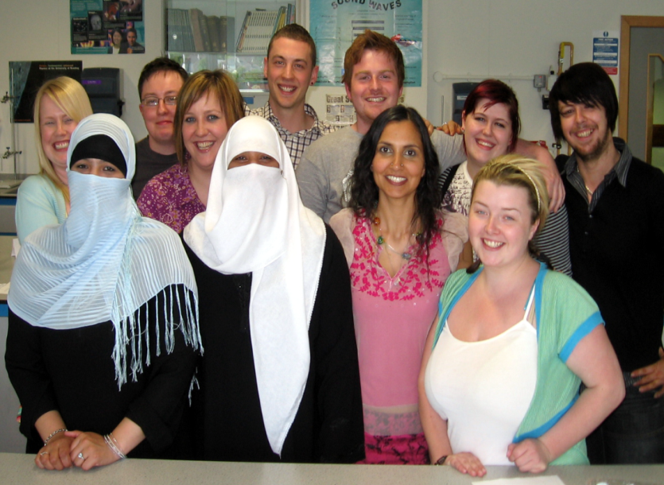
SFC impact for access fund
SFC legislative responsibility for w.p. triennial review
“Guidance is important” – what do you mean
the student life cycle and a quality framework – Colleges and Universities

Slide 3
our challenges
commission on widening access – “step up”.
7.2% figure (NUS report 2012)
Education Scotland reports – supporting learners to succeed and maximising learner success

Slide 4
methodology
1. Define guidance through quality benchmark indicators – 10 top level and 95 subsidiary points. Existing benchmarks, Education Scotland reviews and Outcome agreements
2. Interviewed student services, w.p. teams
3. Challenged initial analysis with a focus group – highlighting specific issues, student learning cycle and additional aspects e.g. influencers
4. Developing key recommendations. Usability for practitioners.

Slide 5
key recommendations – student life cycle
Four stages which can be matched to both Education Scotland and QAA quality frameworks. Additional indicators can be used to assess areas of enhancement. A resource of excellent and innovative practice.
Getting In
e.g. Potential to succeed activities / Forever button
Settling In
E.g. induction activities phased over several weeks / experienced Adviser of Studies
Getting On
e.g. relationship between academic and support staff is key / recognition of volunteering opportunities
Moving On
e.g. pre-exit guidance as a result of events through the 3 previous stages / clarity of progression routes

Slide 6
additional recommendations
additional four key crosscutting aspects.
Complexity and developing professionalism
Identifying and nurturing student potential
Using data effectively
Highlighting getting on – moving from sticking plaster to attainment

Slide 7
and whilst we are here
Consider influencers / Colleges and Universities are great “places” to work with other organisations
Engagement with students and student associations
Moving from project based towards a blueprint for access

Slide 8
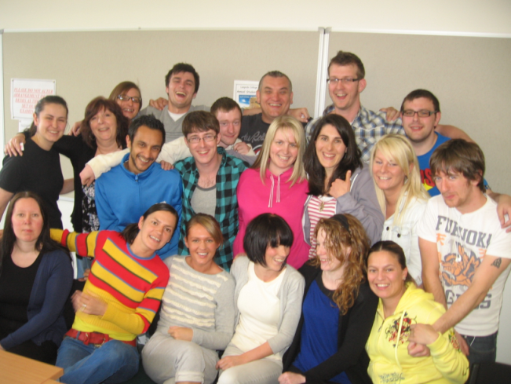
some thoughts for today
Highlighted role of guidance and practitioners: how do you want to influence wp
Looking at 4 main recommendations - know when we are doing well and reporting how we can improve
In what practical ways can we work together to develop the crosscutting aspects

Slide 9
Contact us
Lesley Dunbar and Kenny Anderson
Scottish Wider Access Programme
Web: http://www.scottishwideraccess.org
Edinburgh office 0131 650 6861
Glasgow office 0141 564 7206
swapwest@scottishwideraccess.org

