Slide 1
SWAP East Study Skills Event
Scottish University of the Year 2017
Academic Writing: Tackling Essays With Confidence
13th December 2017

Slide 2
Aims of the Session
To examine the process of writing an essay;
To identify the key components of an essay;
To explore the importance of referencing & avoidance of plagiarism.

Slide 3
Academic Writing Conventions
Presentation
Academic Writing Conventions
Structure
Content
Notes:
THREE conventions of academic writing: PRESENTATION, STRUCTURE, CONTENT
What is meant by presentation?
use of language in an appropriate ‘register’, that is, in ways that are appropriate to the more formal format expected at this level of study.
use of paragraphing
correct spelling, grammar, punctuation and syntax
use of spacing to make the text more legible
page numbering
What is meant by content?
Is it relevant?
Does it contain what it is expected to contain?
Is there evidence and analysis? (more than just description)
What is meant by structure?
Is it ordered logically?
Does it flow?
This powerpoint will cover each of these three areas in turn.

Slide 4
What do we mean by presentation?
Good presentation is:
font style, size, spacing and page numbering
(But it’s MORE THAN just that!)
Good presentation includes paying attention to:
Spelling
Grammar
Punctuation
Syntax
Register
https://www.pexels.com/search/typewriter/
Notes:
Definitions:
Syntax - the arrangement of words and phrases to create well-formed sentences.
Register - often refers to the degree of formality of language, but in a more general sense it means the language used by a group of people who share similar work or interests (e.g. the technical language of a subject or discipline).
The next few slides show how errors in punctuation, spelling and grammar can not only create a bad impression, but also change the meaning of what you are trying to say.
The fundamental message in the next few slides is that presentation is MORE than surface features. In order to show your content in its best light, it is necessary to use correct spelling, grammar, etc. or your argument can easily become lost. That’s why it is crucial to PROOF-READ and EDIT your work before submitting.
Significance of type-writer? They challenge the user to see their errors on paper. (N.B. we are not advocating typewriter use! Just for careful proof-reading step by step in the essay writing process.)

Slide 5
Presentation
Notes:
Would YOU pay money to have this person proof-read your work?
You don’t have to pay someone to do it. You can learn to do it yourself.
The fundamental message in these past few slides is that presentation is MORE than surface features. In order to show your content in its best light, it is necessary to use correct spelling, grammar, etc. or your argument can easily become lost. That’s why it is crucial to PROOF-READ and EDIT your work before submitting.
Ideas for proof-reading:
Read your work aloud. What your eye misses your ear might pick up on!
Use electronic spelling/grammar checkers but be aware of their limitations. They are not infallible.
’Step away from the essay’ – let it ‘rest’ - go do something else then come back to it with fresh eyes.
Let someone else read it.
Any more……..?

Slide 6
Structure
ACTIVITY
IN SMALL GROUPS:
Think about the STRUCTURE of a piece of academic writing. Design or sketch a diagram or image that you think portrays the structure of a piece of academic writing.
https://pxhere.com/en/photo/776296
Notes:
Moving on to structure:
Good structure is a vital component of any piece of academic writing. Without it, no matter how good your content and presentation is, your points will seem jumbled, and you will take your reader on a ramble rather than a well signposted journey.
ACTIVITY (allow at least 15 minutes in total, preferably longer if time) MATERIALS: flip chart paper, pens, blu-tac
IN GROUPS:
Think about the STRUCTURE of a piece of academic writing. Take a piece of flip-chart paper and design a diagram or image that you think portrays the structure of a piece of academic writing. You have complete free rein. Use shapes, words, colours, anything…
Ask groups to feedback on their designs. (THIS MIGHT TAKE SOME TIME DEPENDING ON CLASS SIZE)

Slide 7
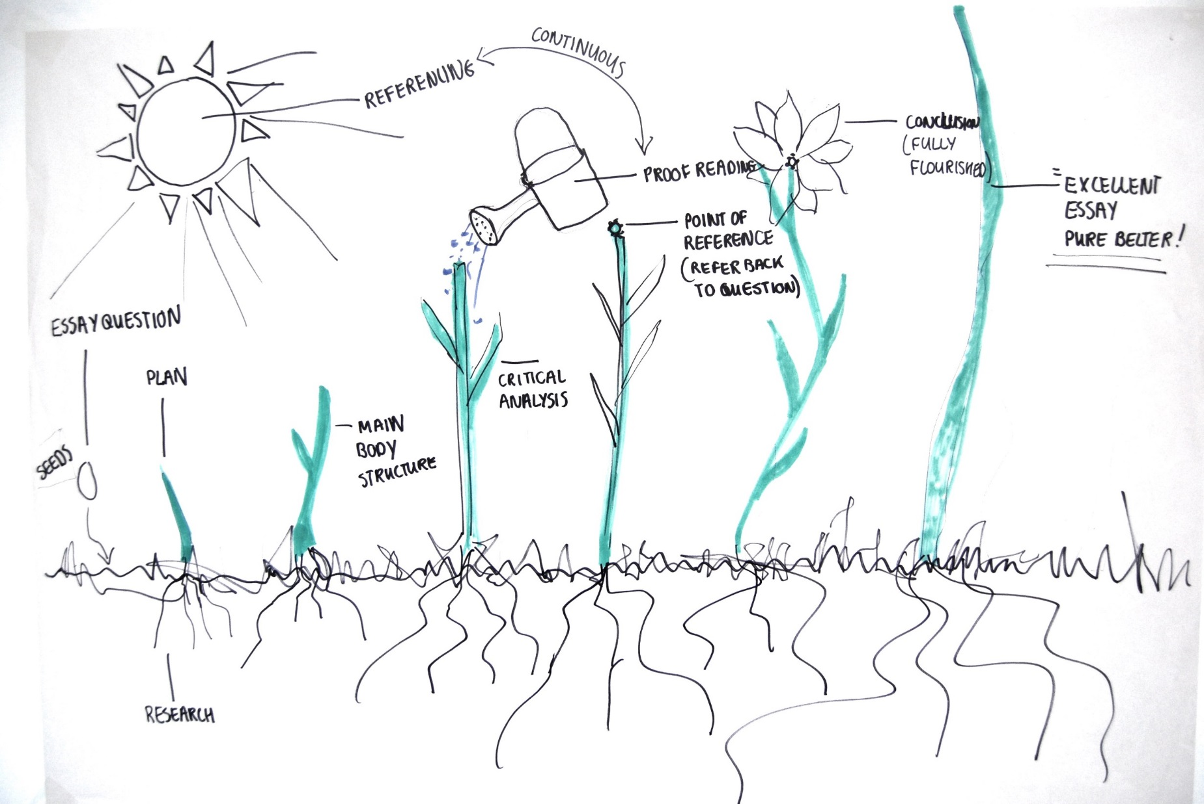
Notes:
PREVIOUS EXAMPLE:
Garden Essay - Design 4th year
Seeds = essay question: potential for growth but needs to be nurtured correctly.
First shoots = essay plan, rudimentary ideas – leading on to a sense of structure of the main body.
Roots = research: drilling down for information / gives the plant a firm ‘rooting’ in relevant literature
Critical analysis gives strength to the plant, which in turn needs water and sunlight (i.e. energy and effort on the part of the student). The leaves represent the different sub-topics or strands of an argument.
Flowerhead = conclusion: ‘fully flourished’.
Sunlight and water represent the essential ingredients of energy, inspiration and giving the essay the effort it deserves.

Slide 8
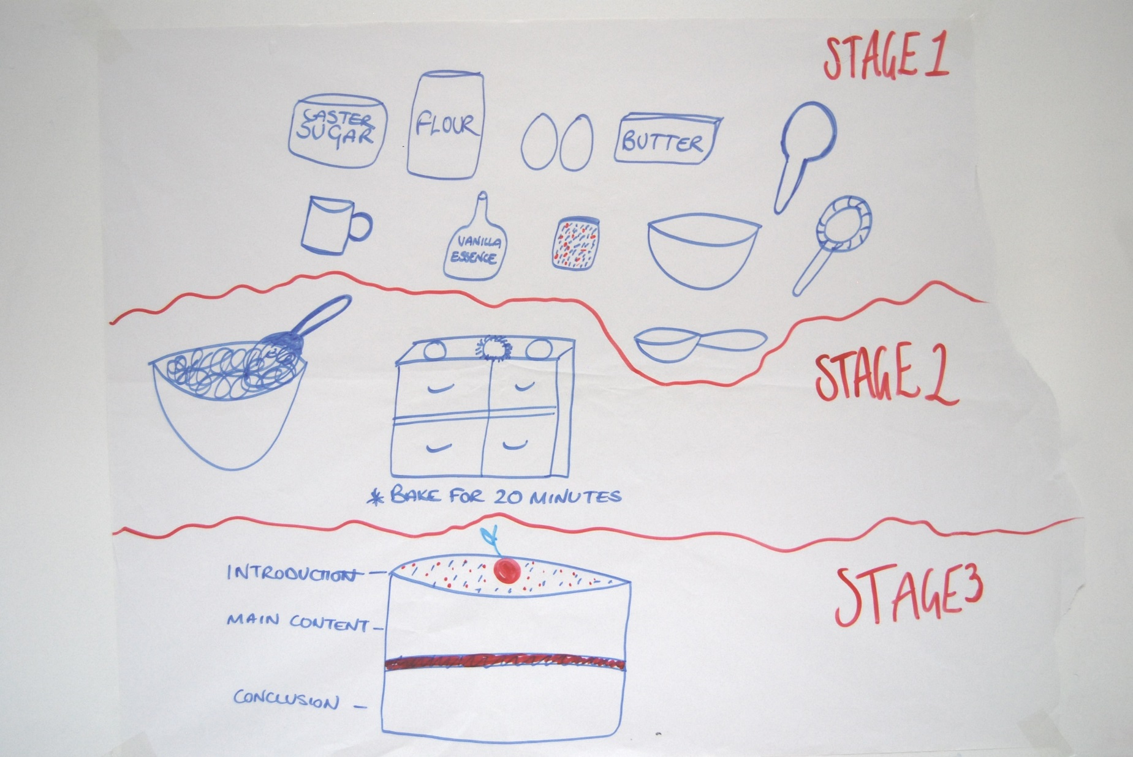
Notes:
The Bake Off Essay – Community Learning & Development 1st year
Stage 1 = research: gather your ingredients, consult a recipe or make up your own, AKA stick to writing conventions, carefully weigh and measure – this represents evaluating your sources/reading materials.
Stage 2 = critical thinking/analysis/synthesis stage. It’s a mixing of ideas, developing points, allowing time for these to develop but also carefully sticking to the recipe and timings.
Stage 3 = piecing it all together, the layers of the cake represent the intro/main body/conclusion
The cherry on the top represents the final proof read.

Slide 9
Essay Structure ‘The Sweetie Wrapper’
Notes:
Here’s our attempt. A very basic image, but captures the simplicity of how to structure a piece of academic writing.
However, there is meaning behind these deceptively simple shapes.

Slide 10
The ‘Sweetie Wrapper’ unwrapped
Context
Key ideas / Statement of intent
‘Signposting’
Return to intention
Mini conclusion concepts
Place in wider context
Introduction
Main
Body
Conclusion
Critical
analysis/
Mini-
conclusion
(from each
sub-point)
Subpoint 1
Subpoint 2
Subpoint 3
Notes:
Previous model in more depth. (This slide needs talked through carefully.)
This model can be applied to short essays and longer essays. It is the amount of sub-points, or depth of your analysis in your sub-points that dictate the length. This basic structure holds true regardless of the length of the essay.
INTRODUCTION
Should ‘set the scene’, i.e. show where the topic sits in a wider context. This can be a BRIEF history, but keep it brief. Potted histories and biographies can be seen as a waste of word-count.
Begin to narrow it down. What are the specific areas that your essay will focus on. State your intentions and tell your reader exactly where you are going. Leave no surprises to the end.
‘Signpost’ the discussion that will follow in your main body.
In light of this, it is often a good idea to craft your introduction after the main body. At least be prepared to revise it to make sure it fits with what you have written.
MAIN BODY
Order your themes logically. The structure of each of these themes (or subpoints) follows the same structure albeit on a micro scale. E.g. Each paragraph should have an introductory sentence, followed by a development of the theme or argument, followed by a mini conclusion. MORE ON THIS LATER in the PowerPoint.
CONCLUSION
Refer back to your intentions
Sum up the mini conclusions from your sub-points.
Draw it back out in to the wider context again.
A conclusion should not contain any new information, ideas or analysis. E.g. Don’t put in quotes by authors that haven’t appeared elsewhere in the essay. If you find yourself doing this, STOP and ask yourself if it’s worthy. If it is, work it into the main body. If it isn’t, leave it out.
A conclusion is not the place to carry out your analysis. Many students write purely descriptive essays then bank up all their analysis to the last paragraph or two. This is not how to do it. Critical analysis and evaluation should be build in to each stage in the main body.
Moving on to CONTENT…

Slide 11
Identify the focus – Breaking down the ‘Question’
Four elements to any question:
Instruction word(s)
Topic
Aspect
Restriction(s)
https://pixabay.com/en/photos/question%20mark/?image_type=vector
Notes:
One of the reasons a student might receive a poorer mark than expected is because they have misidentified the focus of the assignment. It’s actually an easy mistake to make!
Here is a basic 4-stage process that should be applied to ANY essay task.
Identify the following four elements in your essay question(s):
Instruction words:
-Assess, Discuss, Explain, Consider, Evaluate, Why, Describe, Outline, How, What….
SOMETIMES THERE IS MORE THAN ONE
Topic:
What is the focus of assignment?
Aspect:
What specific aspect of the topic is in question?
Limitations/Restriction/Expansion
Is it asking you to only look at a specific time period, a specific law, a specific case study? Or is it asking you to expand out to other areas or aspects?
By identifying and focusing on these, you are a lot less likely to go off topic.
Note: essay questions are often not actual questions, but instructions.

Slide 12
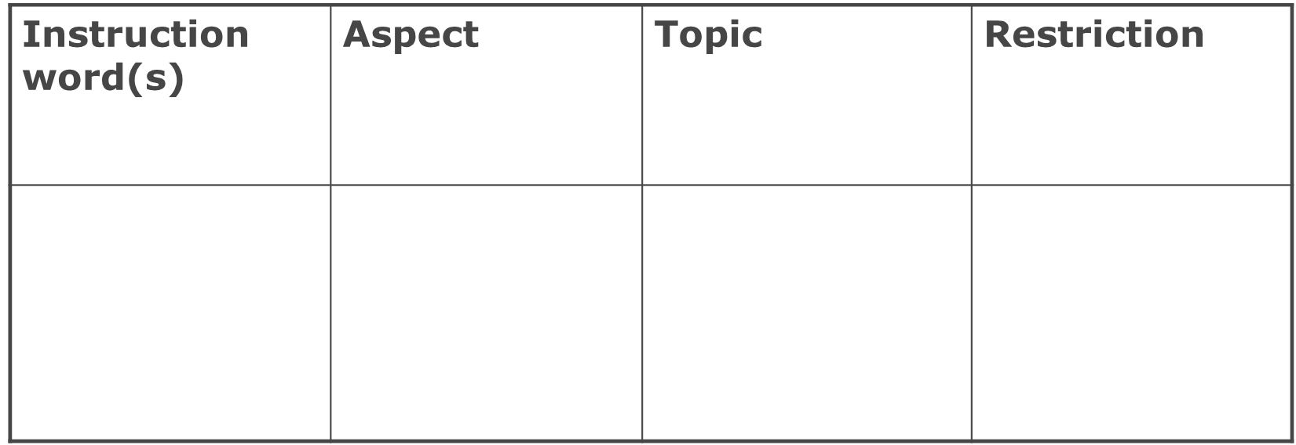
Examples
“Poverty is both a cause and consequence of ill-health” (WHO 2005) Critically evaluate this statement with reference to people affected by cancer and other long term conditions.

Slide 13
“Poverty is both a cause and consequence of ill-health” (WHO 2005) Critically evaluate this statement with reference to people affected by cancer and other long term conditions.
One interpretation…
Instruction word(s) | Aspect | Topic | Restriction
Critically evaluate | Cause and consequence of ill health | Poverty | People affected by cancer / long term conditions

Slide 14
Examples
Outline and evaluate the causes of the First World War. What role did the alliance system play in the outbreak of war?

Slide 15
Outline and evaluate the causes of the First World War. What role did the alliance system play in the outbreak of war?
One interpretation…
Instruction word(s) | Aspect | Topic | Restriction
Outline and evaluate | Cause of war | First World War | The alliance system

Slide 16
Brexit means Brexit
Question:
Explore the view that during the 2016 referendum the British public were deceived into voting to leave the European Union. (2000 words)
Group Task:
Break down the question
Identify core themes / issues to explore Keeping the word count in mind
Develop an Essay Plan

Slide 17
Brexit Essay Review
What are the main topics / issues?
What conclusion are you aiming to reach?
How would you go about writing this essay?

Slide 18
Essay Writing Process
A really useful suite of booklets is available from the Institute of Academic Development at The University of Edinburgh.
This is taken from their proofreading advice worksheet.
Available at: http://www.ed.ac.uk/institute-academic-development/undergraduate/essentials (Accessed 3/10/17)

Slide 19
Proofreading and Editing
Use spellcheck, but use it critically
Experiment with printing work out and editing on the page
Read your work aloud, or ask someone to read it back to you
Read (separately?) for content, structure and style
Look out for your known errors/weaknesses

Slide 20
Referencing and Plagiarism
You can be guilty of plagiarism if you make it appear as though you are using someone else’s work as if it were your own. Examples include:
not citing the source
using the material word-for-word without citing the source
using the idea without citing the source
using a string of quotations without any interpretation

Slide 21
Avoiding Plagarism
Always ensure you note the publication details when you take notes from a text
Reference in the text as well as providing a Bibliography at the end of your work
Use the prescribed referencing system for your degree programme

Slide 22
Recommended resource
Pears, R. & Shields, G. (2013) Cite them right. 9th ed. Basingstoke: Palgrave MacMillan
Available: http://www.citethemrightonline.com/
Notes:
The University library has copies of Cite Them Right available for loan and for reference.
The Cite Them Right website allows students to login with their usual UoD credentials to get full access to the online resource.

Slide 23
REFERENCING EXERCISE Using Cite Them Right, convert the following sources into a Harvard reference list:
BOOK: ‘Cultural Tourism: The Partnership Between Tourism and Cultural Heritage Management.’ By Dr Hilary DuCros and Dr Bob McKercher. Published in 2012 by Taylor and Francis in the city of Hoboken, New Jersey.
NEWSPAPER ARTICLE: 17 April 2012. ‘The making of Delhi’s Lotus Temple’ by journalist Joanna Sugden, in The Wall Street Journal
JOURNAL ARTICLE: Carlos Ortega Arámburo. THE BILBAO EFFECT. March 2016. Volume 239, issue 1429. Architectural Review. Pages 53-56
VIDEO: ‘Frank Gehry interview: On Ethics, Architecture and much more’. Posted by ‘The Ethics Incubator’ on YouTube on 14th Feb 2017 https://www.youtube.com/watch?v=sXHPrNlHJd0

Slide 24
Reference List
Arámburo, C.O. (2016) ‘The Bilbao Effect’, Architectural Review, 239(1429), pp.53-56.
DuCros, H. and McKercher, B. (2012) Cultural Tourism: The Partnership Between Tourism and Cultural Heritage Management. Hoboken: Taylor and Francis.
Sugden, J. (2012) ‘The making of Delhi’s Lotus Temple’, The Wall Street Journal, 17 April
The Ethics Incubator (2017) Frank Gehry interview: On Ethics, Architecture and much more. Available at: https://www.youtube.com/watch?v=sXHPrNlHJd0 (Accessed: 13 October 2017)

Slide 25
…and finally…
Enjoy writing essays – they provide you with the best chance to show off your knowledge and the depth of your research.
Good Luck!

Slide 26
dundee.ac.uk

