Slide 1


SWAP East
Take note! Getting the most out of your lectures
Scottish University of the Year 2017
Amanda Whitehead & Tom Cunningham
Academic Skills Centre, University of Dundee
13/12/17

Slide 2
Goals for this session
To consider the purpose of lectures
To discuss why taking effective notes is important while learning at university
To consider different note-taking taking techniques
To practice note-taking techniques in a live lecture setting;
Notes:
Over the next half hour we are going to explore why it is important to be able to take good notes when we are studying for a degree.
We are going to think about the kind of learning scenarios where you will have to put your note-taking skills to go use.
And we will explore some different types of note-taking techniques.
After this half-hour session is finished, you are going to receive a lecture from Matt Graham, history lecturer. This will give you the opportunity to put some of these skills into practice.

Slide 3
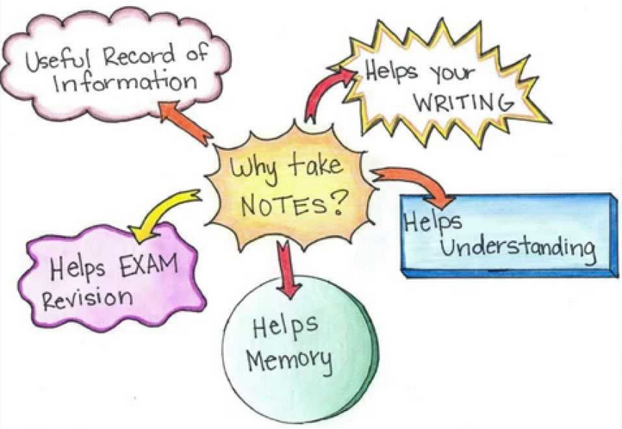
Why take notes?
Notes:
Why should we take notes? Most of us do it because we think it is what we are expected to do. But what do we do it for? What are your thoughts?
Very few, probably none, of us have perfect recall. We need to take notes to help us remember key information, because we will probably need that information for writing essays, sitting exams and etc.
The benchmark of any set of notes is how much sense they make to you 3 or 6 months down the line when you return to them as a starting point for exam revision or for writing an essay.
If you look at your notes and think ‘What was I thinking when I wrote this!?’ then they’re not good notes.
If you look at your notes and see all the key information PLUS your own thoughts that you had at the time, you have an excellent springboard for your taking your revision or research further.

Slide 4
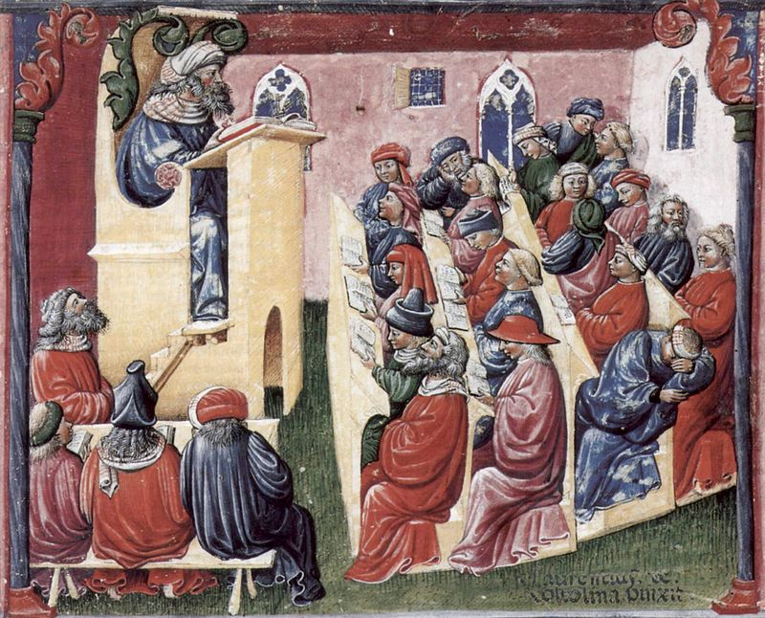
Notes:
The word ‘Lecture’ comes from the French word meaning ‘reading’.
Lectures have been around at least as long as universities have – nearly 1,000 years (University of Bologna, Italy, A.D. 1088).
You can see from this picture above, from the mid 14th century, that things haven’t changed that much. We still have tiered lecture theatres, lecterns…people sleeping…

Slide 5
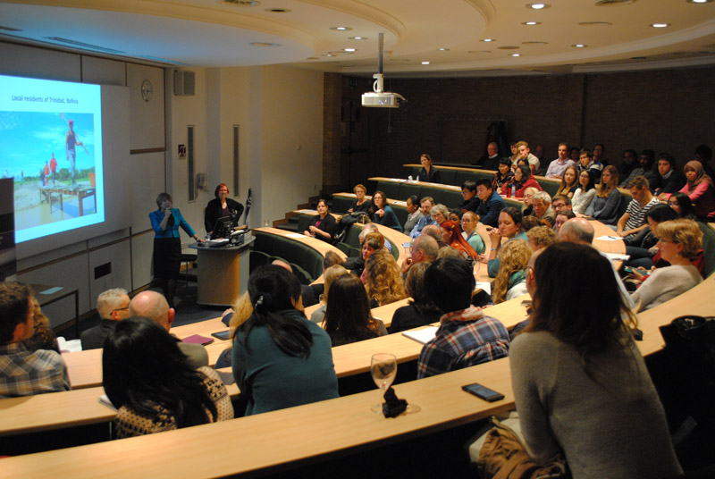
Notes:
Lectures are oral presentations intended to present information or teach people about a particular subject.
Though lectures are much criticised as a teaching method, universities have not yet found practical alternative teaching methods for the large majority of their courses. They are still considered the most effective way of conveying information to large numbers of people at once.

Slide 6
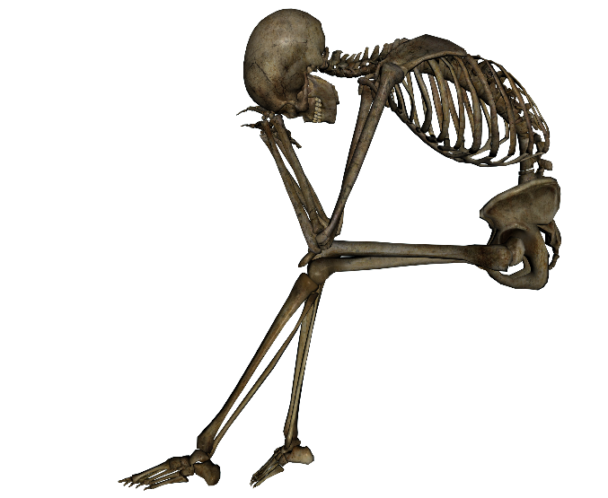

What are lectures?
Offer an overview of a subject or topic
Deliver detailed information on a subject or topic
A valuable resource!
Notes:
For the purposes of today’s session, we are going to focus on note-taking in lectures as this is probably one of the main differences between learning at university compared to college. Lectures with 100+ students can be a daunting experience to begin with. So let’s take a minute or two to think about what lectures are and how to get the most out of them.
1) Some lectures can be viewed as the bare bones of a topic. They introduce you to the topic, set the groundwork… With these type of lectures you will be expected to flesh it out with further reading on and around the topic in your own time.
2) Other types of lecture already expect students to have a grasp of the topic, on which they will build in the lecture itself. In cases like this you will need to do careful preparatory work before a lecture. You should always aim to find out if there is any recommended reading you can do in preparation for the lecture. Preparatory reading will make it easier for you to engage with the lecture content and provide you with a framework for making opinions and comparisons. When the lectures are linked in a series, you should also review your notes from the previous lecture.
All Lectures provide you with a invaluable resource. They can synthesise the views of several researchers and books, or sometimes your lecturers will provide new and unpublished information.
What lectures are NOT:
Although they are integral part of student life, they are not the be all and end all of your learning on that topic. Tip of the iceberg.

Slide 7

Before a lecture…
What can you do to maximise what you get out of it?
preparatory reading
think about what you already know about the topic
think about what you hope to get from the lecture
consider the who?/where?/when?
  (need to adjust note-taking style accordingly?)
https://www.flickr.com/photos/abee5/8314929977
Notes:
PREPARATORY READING – It’s always a good idea to prepare for a lecture before it starts. Browse textbooks or other reading materials. Get familiar with any subject-specific terminology that you might encounter so it doesn’t throw you off track if you’re hearing it for the first time in the lecture itself.
BRAINSTORM WHAT YOU ALREADY KNOW ABOUT THE TOPIC - Often it’s useful to think about what you already know on the topic. The lecture might relate to one you had earlier in a semester, or perhaps it is on a topic you covered at college. Refreshing your knowledge of the topic will only do good.
WHAT DO YOU HOPE TO GET OUT OF THE LECTURE - Thinking about what you hope to gain from the lecture is another useful way of getting the most out of it. Are you hoping it will introduce you to a topic you plan to write an essay on in the future? Will the content of the lecture provide you with some necessary theory that ties in with things you are doing in your placements or clinical skills sessions?
WHO? WHERE? WHEN? - This might seem a strange one, but once you get to know your lecturers you will learn that you need to adapt your style of listening and taking notes accordingly. For example, if you have a soft spoken lecture make sure you sit somewhere where you can hear. If your lecturer uses a lot of visual aids, make sure you can see. You will also want to adapt to note-taking style to fit the lecturer’s style and the particular structure of his or her lecture. Also, the time of day or the environment can affect how responsive you are to learning. After lunch? Late in the day? First thing in the morning? Everyone has their own optimum learning times, and some environments are more conducive to learning than others.

Slide 8
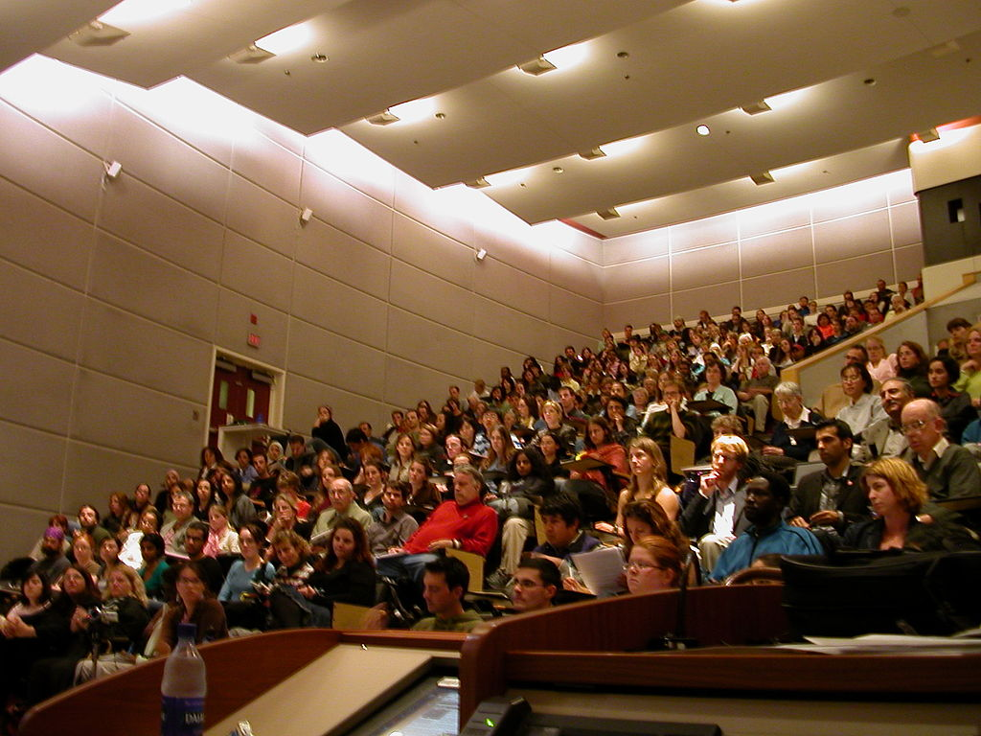
During a lecture…
What should you do during it?
Listen?
Think?
Ask questions?
Take notes?
https://commons.wikimedia.org/wiki/File:Activism_Course.jpg
Notes:
Lectures shouldn’t be a passive experience.
Although you might not get the opportunity to ask questions in the lecture itself, you should always be asking questions in your mind (i.e. thinking critically about the information that is being presented to you!)
LISTEN - It’s quite impossible to take notes for a full lecture. Your hand will need a rest sometimes. That is where your ears take over. If there is a part of a lecture where you think you would benefit from sitting listening and thinking, then do so. Some people are auditory learners, which means they learn best by listening. If this applies to you, it’s important to write up your notes as soon as you can after the lecture so you don’t forget them.
THINK - This is a definite yes. It requires practise to do this, but taking notes shouldn’t be an exercise in dictation. You should be thinking critically about the information being given to you. What does it mean? What are the larger themes emerging? How does this tie in with what you already know on the topic? Do you agree with everything or do you disagree with some of it? ALL of this is critical thinking, which is a key skill that students must develop, therefore you should be doing it even at the note-taking stage.
ASK QUESTIONS - Yes and no. Some lecturers leave time at the end for questions. Some invite questions at specific points during their lecture. It’s rare for all students’ questions to be answered ad lib because the lecturer has a set amount of information he or she needs to get through. If you do have questions and did not get the opportunity to ask them, email your lecturer after class.
TAKE NOTES - It’s usually necessary to take notes. Even if the PowerPoints are given as handouts, remember PPT slides are just the tip of the iceberg!

Slide 9
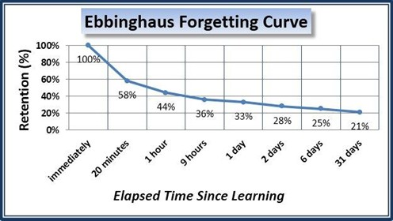
Why take notes?
TIME PERIOD
20 mins
1 hour
9 hours
2 days
6 days
% RETAINED
58%
44%
36%
28%
25%
https://www.inkling.com/blog/2015/08/why-google-changed-the-forgetting-curve/
Notes:
What is the first thing that happens when you leave a lecture? You begin to forget.
In 1885 German researcher Hermann Ebbinghaus, pioneered a series of experiments identifying what is now known as the ‘forgetting curve’. This term describes the rate in which newly acquired knowledge starts to deteriorate or be forgotten. Ebbinghaus discovered that a significant amount of information was forgotten within twenty minutes of having been learned. The table outlines the results from the research on the forgetting curve.
So, what have you got to do to help retain this information? Well, there are many things you can do. Taking good notes in the lecture itself is a good place to start. So how do we do this? Let’s look at some note-taking techniques and consider the pros and cons.

Slide 10
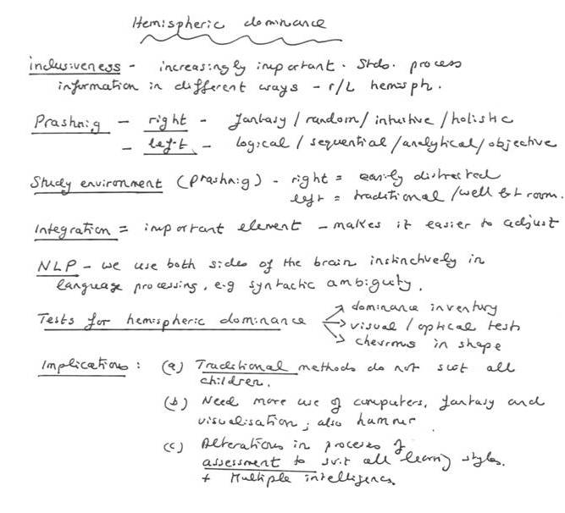
Keyword notes
Notes:
KEYWORD NOTES
Pros:
Good for topics where there are clear divisions to the structure of the lecture. For example, if the lecturer clearly outlines the intended structure at the beginning of the lecture you know it will probably lend itself well to this style of note-taking.
Easy read-back
Space to annotate
Especially useful if you miss a point or wish to add more of your own thoughts when you follow-up after class (use white space effectively)
Good for recall
Makes them good for revision purposes
Cons:
Not so good for lectures where the structure isn’t made explicit.

Slide 11
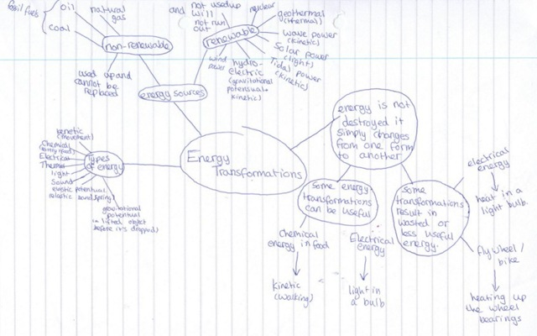
Concept map notes
Notes:
Pros:
Good for diverse subjects where there are different linkages and overlaps.
Encourages ‘bigger picture’ thinking – helps students see the connections between topics. Does not come naturally to everyone, but definitely worth experimenting with.
Good for lectures where the lecturer seems to back track or follow no discernible pattern.
Easy to annotate with further thoughts after class. Lends itself well to being colour-coded.
Cons:
Can take up a lot of space / easy to get out of control / hard to condense to A4.
Doesn’t come naturally to everyone (but it’s a skill worth honing!)

Slide 12
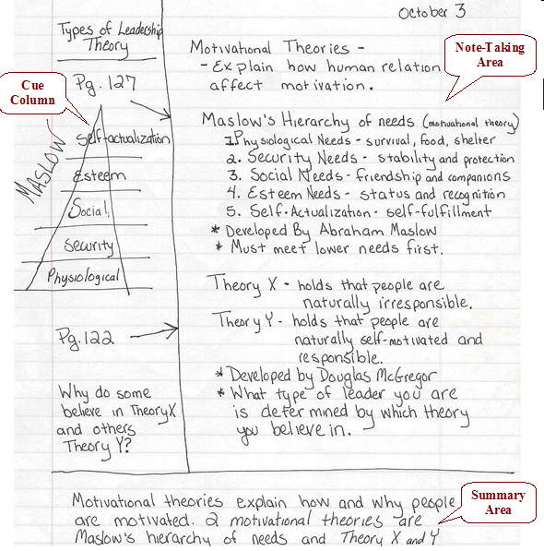
Cornell notes
Notes:
Cornell notes.
This style suits ALL learning situations. It just takes a bit of leg-work before hand splitting up your page into three sections.
This style encourages students to take notes in their natural style (see ‘note taking area), while at the same time really THINK about what they are hearing and note down any questions or connections that occur to them (see ‘Cue Column’. This encourages critical thinking and synthesis in your learning.
The action of summarising after class (in the bottom section of the page), rather than re-writing, aids deeper learning and recall and is much more quick and effective than re-writing notes.

Slide 13
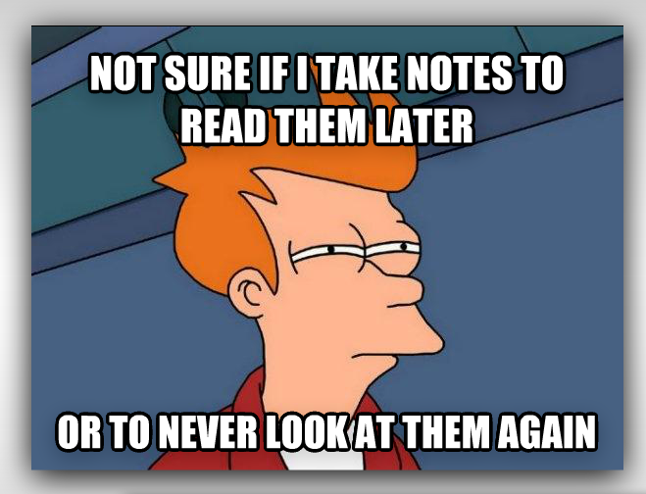
After a lecture…
What will you do after it?
Fill in the blanks?
Re-write your notes?
Memorise your notes and the PowerPoints?
File them away and forget about them until exam time?
Adapt/rework them
https://elc.polyu.edu.hk/ecNews/1310/FromOurStudents.htm
Notes:
*highlighting points which seem particularly important or central;
*adding any details which you can remember from the lecture;
*showing links between points;
*correcting any mistakes;
*adding questions to highlight areas you don't understand or need further information on.
Rewriting your notes without doing anything different with them (i.e. reworking them) is not a good use of your time.
Memorising lectures is also a fairly shallow way to learn. You need to analyse, synthesise and think critically about the material you are trying to learn.

Slide 14
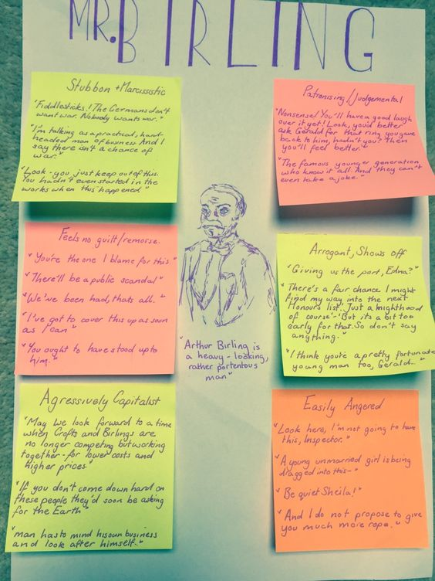
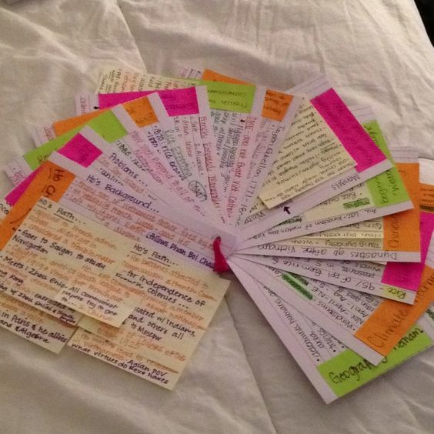
Reworking your notes
https://www.pinterest.co.uk/pin/220324606748114944/
https://www.pinterest.co.uk/pin/460422761887187503/
https://www.pinterest.co.uk/pin/285274957621453084/
Notes:
Here are some real life examples of how students have reworked their notes.
This English Lit student has created a poster capturing the key quotes of the character Mr Birling from the play ‘An Inspector Calls’. Great for revision purposes.
This student has distilled the information they learned in each of their Geography lectures and has created a set of flashcards. Summarising the key information in this way helps embed it. Again, a poster like this would make for an excellent revision tool.

Slide 15
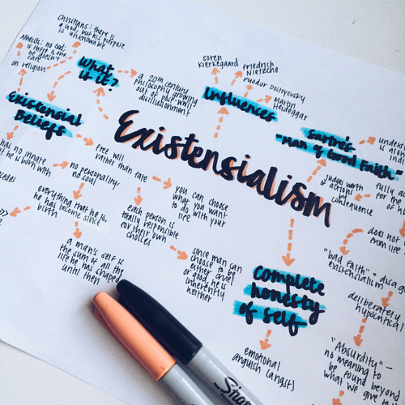
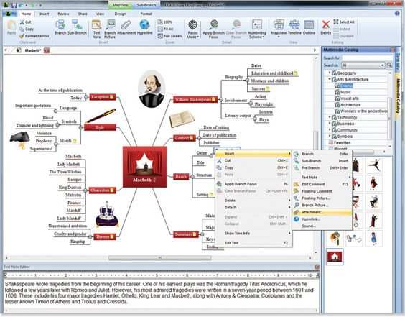
Reworking your notes
https://www.pinterest.co.uk/pin/220324606748114940/
https://www.pinterest.co.uk/pin/567172146808873853/
https://www.pinterest.co.uk/pin/460704236854205515/
Notes:
This Philosophy student has turned their linear/keyword notes into a mind-map in order to create a useful guide to existentialism
2) This English Lit student has used MindView (mindmapping software) to create a mindmap of MacBeth. Note how they have summarised in the bottom section. Software such as Mindview allows you to attach files (e.g. the lecture powerpoint, images, etc.), hyperlinks to webpages

Slide 16
Your task…
We are about to hear a lecture on ‘What is the Purpose of History?’
This lecture will last approximately 45 minutes.
Your job is to choose a note-taking style and take effective notes.
You should aim to record as much factual information as you can.

Slide 17
Part 2
How effective were your notes…. REALLY!
Notes:
We have 15 approx mins for this section (8 slides)

Slide 18
How effective are your notes…really!
  What was the basic definition of history shown on slide 3?
  Who was the author of the more complex definition, shown on slide 4?
  Who said “History will be kind to me, because I intend to write it.”
  Who said ““Who controls the past controls the future: who controls the present controls the past.”
Notes:
QUESTIONS BASED ON MATT’S PPT (sent in advance) – 3 minutes max
Be prepared to ad lib on the day depending on Matt’s actual content
What was the basic definition of history shown on Slide 3?
“History is the study of the collective human past, with a view to explaining how the world has evolved into its present condition”
Who was the author of the more complex definition, shown on slide 4?
Arthur Marwick
Who said “History will be kind to me, because I intend to write it.”
Churchill
Who said ““Who controls the past controls the future: who controls the present controls the past”
Orwell
Other possible questions (as suggested by Matt, depending on his content):
○ Liechtenstein war with Italy in 1868… how many went, and how many returned? Answer: sent 80 soldiers, none were injured and returned with 81 as they had made a new friend..
○ The Anglo-Zanzibar war of 1896 is the shortest war on record. How long did it last? Answer: It lasted an exhausting 38 minutes.
○ Officially, the longest war in history lasted from 1651 to 1986. It was between the Netherlands and where? How many casualties? Answer: The Isles of Scilly. There were no casualties.
The sort of questions we have asked you here are testing your knowledge of the factual elements of the lecture. To really get the most from any lecture, you should be recording these factual elements while also engaging in thinking critically about the content of the lecture.
Sometimes it is difficult to do this in the lecture itself, but this is the sort of thing that you should definitely be doing in your follow-up work to any lecture. To engage critically with a lecture, we need to ask ourselves questions such as:
What were the main themes of the lecture?
What key concepts emerged from the lecture?
Do you agree or disagree with these themes and concepts?
What questions or further lines of enquiry are you going to pursue in light of this lecture?

Slide 19

In pairs:
Compare your notes with your partner.
    Did they note things that you missed, or vice versa?
Work together to write a brief summary of the lecture.
    Aim to summarise the KEY POINTS. Max.100 words.
Turn to a pair behind you (or in front) and share your summaries.
    How similar or different were your summaries?
Notes:
Timed-task - 8 minutes maximum for whole task! Tutors to mingle and hear the summaries being presented.
If students don’t need the full 8 minutes to complete this, ask for some volunteers to read out their group’s summary.
Remind students that this is the sort of thing they should be doing with their notes after a lecture (i.e. not re-writing them!, but engaging critically with the content.)

Slide 20
dundee.ac.uk
Notes:
Any questions

