Slide 1
Strategies for independent study
Marta Ulanicka
Effective Learning Adviser
Queen Margaret University

Slide 2
What do we mean by independent study?
Notes:
Students discuss with neighbour, participate in polleverywhere

Slide 3
‘Independent learning’ definitely does not mean…
…you will have to do everything for yourself.
…nobody will help you when you need help.
…you’ll be working on your own all the time.
X
X
X

Slide 4
Remember…
Learning is actually dependent and inter-dependent.
Knowledge is produced and developed collaboratively.
You can depend on lecturers, authors, fellow students and others to support your learning.
Notes:
Image: CC image from Southern Arkansas University on Flickr

Slide 5
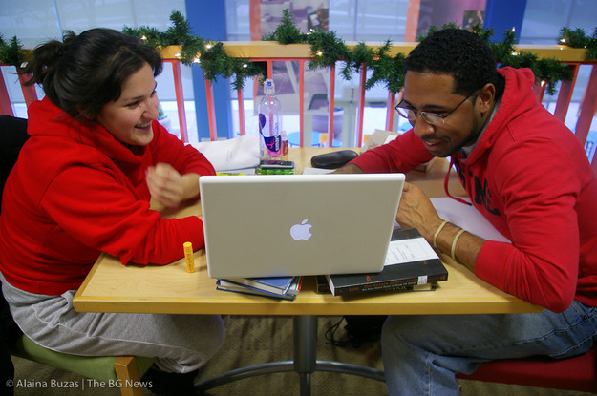
At university you will…
…develop your own questions
…manage more of your time
…look more deeply into your subject
…challenge established ideas and develop new ones.
Notes:
Therefore, what do we mean by independent learning/study?
CC image by Alaina Buzas from Flickr

Slide 6
Three ‘practical’ components of independent study:
Managing time
Reading and note making
Critical thinking
Notes:
How do we implement a more independent model of learning?
Introductions and pointers to further development opportunities

Slide 7
Managing time (in a nutshell)
Divide up tasks
Less helpful:
More helpful:
Write essay
Analyse essay question
Jot down thoughts
Search for sources
Initial reading (source A, B, C…)
Add to plan
Detailed reading/note making (source B,D,E)
More detailed plan
Draft (paragraph/topic X, Y, Z)
Edit
Check and proofread

Slide 8
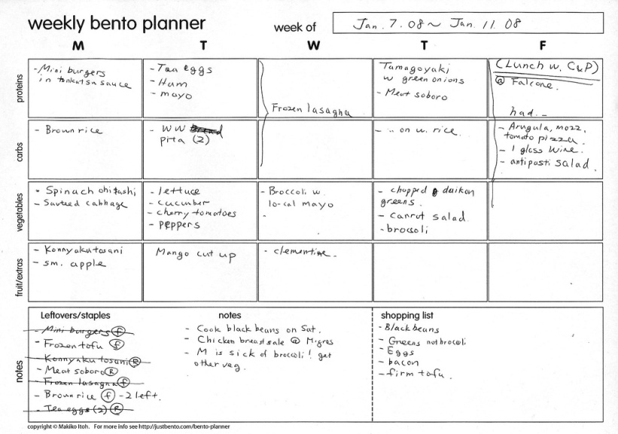
Managing time (in a nutshell)
Use (a) planning tool(s)
from http://www.flickr.com/photos/makiwi/2208425697/
https://www2.le.ac.uk/offices/ld/resources/study/timetables

Slide 9
Managing time (in a nutshell)
Avoid distractions and take regular breaks (the Pomodoro technique: https://cirillocompany.de/pages/pomodoro-technique)
Build in time to prepare for and follow up lectures and seminars (discussion, reading, note making: e.g. overview of lecture with outstanding questions)
Include time for rest, exercise and rewards
Notes:
CC image from Flickr by University of Liverpool Faculty of Health and Life Sciences
CC image from Flickr by Cookieater2009

Slide 10
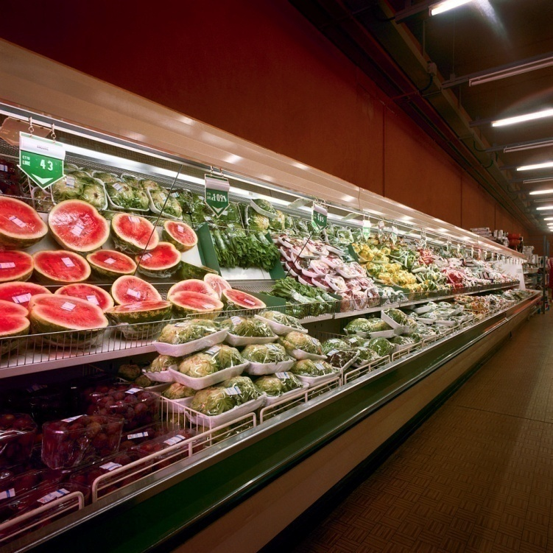
Reading
Notes:
The metaphor of shopping for a dinner party with friends.
Sources are not written with you or with your particular assignment or task in mind, so you have to be an intelligent shopper and pick what you need. Advantage: you are increasingly in control over what you read and what you learn.
Shopping trolley: CC image from KAM Workshops on Flickr

Slide 11
Ideas for making reading more focused
Reading goals:
a series of questions about a specific topic
facts/information on a specific topic
evidence to endorse or contradict an argument
summary for future reference
Active reading technique such as SQ3R:
includes surveying/pre-reading to help you establish how much to ‘delve into’ a text
example guide: http://archive.qmu.ac.uk/els/docs/active%20reading.pdf
SQ3R

Slide 12
Note making (in a nutshell)
Record original source
Make your notes brief and organised (headings, lists, diagrams?)
Ensure your notes reflect your needs and your understanding of the material – don’t allow yourself to be led by the text’s original purpose(s).
Useful note making template: https://www2.le.ac.uk/offices/ld/resources/study/template-analysing-academic-sources
Notes:
CC image by Pongo 2007 on Flickr

Slide 13
Questions, questions and more questions
Critical Analysis/Critical Thinking: new terms for what we do already in other spheres of our lives:
ask questions
evaluate perspectives
weigh up arguments
Useful resources:
https://www2.le.ac.uk/offices/ld/resources/study/critical-student
https://www.plymouth.ac.uk/uploads/production/document/path/1/1710/Critical_Thinking.pdf (see the question model on page 4)
Notes:
The video tutorial uses the example of renting an apartment

Slide 14
In which area might you change/develop your practice?
Managing time
Reading and note making
Critical thinking
A combination of the above
None of the above

Slide 15
Study skills resources
Queen Margaret University Effective Learning Service (click on ‘Guides and Resources’): www.qmu.ac.uk/els
The Open University: Skills for OU study
https://www2.open.ac.uk/students/skillsforstudy/index.php
The study skills handbook, by Stella Cottrell. Palgrave MacMillan
Essential study skills: the complete guide to success at university, by Tom Burns and Sandra Sinfield. Sage Study Skills series

