Slide 1
Getting the most out of your lectures
Mel Kinchant
Academic Skills Adviser
Coming from College Adviser
(Widening Participation)
wideningaccess@napier.ac.uk

Slide 2

Notes:
In this short presentation I’m going to talk about how you can get the most from your lectures by taking notes effectively.

Slide 3

Note making
What should you do in a lecture?
What kind of notes do you need?
Notes:
3
Before next slide – what are some of the differences between learning & teaching at university compared to college?
What do you think might be different about studying at university compared to college?

Slide 4
What is different at University?
  Lectures
  Tutorials/Seminars
  Independent learning
It’s all on you!!
Notes:
Without active learning how much information (as a %) do we forget in only 3 weeks?

Slide 5

The head is a great place for creativity but a terrible place for storage!
Notes:
Ask group for ideas re: some of the differences between school and university.
Why do we need to take notes?

Slide 6

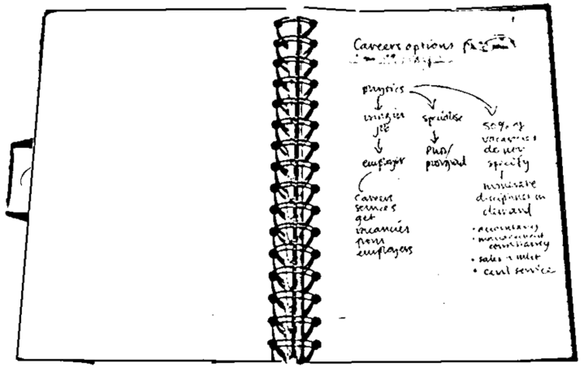
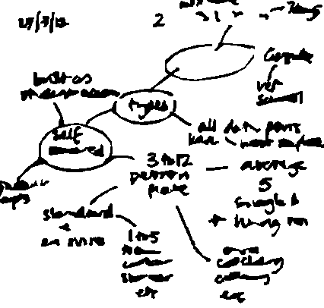
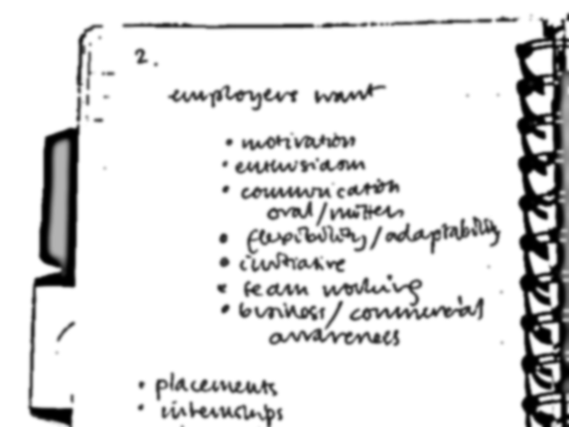
Why make notes?
Notes act as memory aid
Notes:
6
All sorts of formats can be used to make notes. You will develop your own styles for different purposes (and different lecturers).
Leaving some space allows you to add to them later.

Slide 7
Why make notes?
Notes act as memory aid
  Buzan (1999): Without active learning, we forget 98% of information in just three weeks
It actively involves you in the learning process
It helps to develop your understanding
It allows you to reduce information to a
manageable size
Notes are helpful when preparing assignments or for exams
Notes:
7
Your notes will be a valuable outline of the course and the material your lecturers view as being important.
Lecturers usually bring together material from published works, compare and contrast points of view and can introduce ideas which may not have been published in text books yet. Your notes can summarise all of this.

Slide 8
Note Making Process
Before lecture
After lecture
During lecture
Useful lecture notes

Slide 9
❶ Before: Prepare and tune in
Prepare:
  Advance reading
  Print off and read the lecture outline (slides or notes)
  If relevant, read your notes from the previous lecture
  Look up scientific / technical terms and subject-specific jargon.
  Tune yourself into the topic by thinking of questions.
Notes:
9
Going in to a lecture without doing any preparation makes it much harder to follow the lecture. Even if you haven’t much time to prepare beforehand, you can still tune in by looking up the basics. Ask yourself who, what, why, where, when and how.
Going into a lecture cold can leave you confused by terms you are unsure of and authors or concepts you have not heard of before. Familiarising yourself with these beforehand means you will get more out of what they lecturer is covering.
If the lecture is one of a sequence on a topic or field of study, it is important you have a good idea of what went before and where this lecture fits in.
Thinking of questions beforehand helps you to know what you understand already and what you need to clarify. You may need to follow up these questions afterwards.

Slide 10

❷ During: Make notes
  Listen and watch – cues, clues and signposts
    e.g. 'there are four key points here’
Don't write everything down
  Key words, phrases, short sentences, abbreviations
Annotate handouts
Note questions you have
Note making improves with practice
Notes:
Framework: Lecturers often say at the beginning of a lecture how they have structured their lecture and what they are going to cover. Listen carefully for this. It can provide a framework for your note making.
Practise makes perfect! At the beginning, students often find it hard to make notes in lectures. Here are some of the things they say:
"I don't know what's important."
"My notes are useless because I can't make sense of them later."
"I try to write down too much and then I lose the place."
It is difficult at the beginning, because you're making notes in 'real time' – you can't stop and rewind! It's also more difficult when the subject is unfamiliar. In addition, lecturers vary in presentation, and some are easier to follow than others! With practice, most students find their note making skills improve.
Don’t write everything down! Your goal isn’t to transcribe the lecture word for word, rather it’s to extract and record the main points of it. The trick to successful note-taking is learning how to separate the wheat from the chaff. Your lecturer will likely go off on tangents during the lecture!
Pay attention to cues your lecturer gives off either consciously or subconsciously. Whenever you see them, it probably means he’s/she’s saying something important, so write it down.

Slide 11
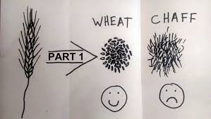
Lecturer signposting…
Framework: Lecturers often say at the beginning of a lecture how they have structured their lecture and what they are going to cover.
Don’t try to write everything down! Your goal isn’t to transcribe your lecturer word for word.
kizombaharmony.com
Notes:
Framework: Lecturers often say at the beginning of a lecture how they have structured their lecture and what they are going to cover. Listen carefully for this. It can provide a framework for your note making.
Don’t write everything down! Your goal isn’t to transcribe your lecturer word for word.
You want to extract and record the main points of it (separate the wheat from the chaff).

Slide 12
Lecturer signposting…
Pay attention to cues – conscious or subconscious.
“You need to know this,” or “This will come up in your…”
Repetition is often used to reinforce key points.
Anything said very slowly, so that it can be taken down word for word.
If your lecturer starts talking more quickly, loudly or with more emphasis.

Slide 13
Lecturer signposting…
Look out for for language that shows relationships between ideas…
  first, second, third
  especially, most significant, most important, however, on the other hand
  because, so, therefore, consequently
  a possible explanation of this…
  it might be that…
  to clarify…
  Look out for language that signposts direction…
  later on I’m going to talk about…
  and now I’m going to…
Notes:
Here are a few cues your lecturer may give during the lecture.

Slide 14
Most students adopt their own abbreviations for note taking
& | and
? | question mark - a good way to remind yourself to ask about something or look this point up later on
∴ | therefore
≤ | smaller or equal to…
Adapted from The Open University (2013)

Slide 15

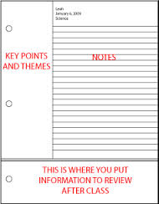
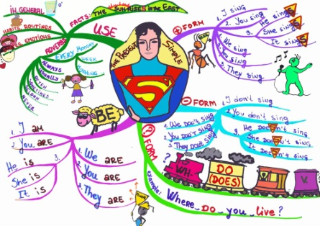
Get organised
How do you work best?
  What note-taking style works for you?
  Laptop? Planned?
  Mind maps?
Notes:
With the advent of new technologies such as iPads and Smart phones note taking can be even easier than before. Investigate apps, such as Evernote, and note taking software such as Microsoft’s OneNote.

Slide 16

Note Making Styles: Linear notes
line by line
short and structured
headings and subheadings
abbreviations and key words
bullet points
  highlight
  key
  points
Notes:
This is the most common type of note making and is the method most students use in lectures. You jot the notes down as the information comes along, starting a new line for each new point. You write key words, short phrases or brief sentences. You can also use a numbering system or bullet points if you have some idea of the structure of the information.
Use colour and highlighting for memorable sections
Note down names and look them up afterwards

Slide 17


Mind Mapping
Related theme 1
Related theme 2
Central idea
Visual
Not often
used in lectures
Make memorable
Highlighting
Good for organising after
Reading / revision
Colour
Notes:
This is a very visual way of capturing information, and allows you to show hierarchies of information and how different bits of information are connected. It really helps you organise information. Very few students use mind mapping in lectures, but quite a lot of people find mind maps useful for making notes from their reading, and when they're making notes for exams.

Slide 18
Other ways to capture
 | Process 1 | Process 2
Advantages | Less expensive | More effective
Disadvantages | Less effective | More expensive
Characteristics | Manual | Automatic
Evidence | Widely used | Laboratory testing
Notes:
If comparing perhaps one theory against another or different processes, you may be Able to quickly draw a table to capture the information.

Slide 19

Identify your Learning Style
Do you absorb information best by:
Listening and then writing the information down
Describing what you have just heard to someone
Creating diagrams to illustrate key concepts
Notes:
19
Recording lectures in real time? Perhaps record your own voice speaking from the notes you have taken so that you can play this back. Always check the audio recording policy at your institution.
Different methods of note taking for different purposes.

Slide 20
Top tips
Make notes in your own words
Use different methods for different purposes
  e.g. flowcharts for processes
  tables for comparison
Organise your notes
  title, date, page numbers – and file them
Don't cram too much in – leave room to add in
Don’t leave reviewing notes until revision
Notes:
Make notes in your own words.
Make sure you can read your notes later.
Don't cram too much on the page.
Use different note making methods for different purposes, for example flowcharts for process planning, tables for comparison.
Organise your notes so that you can easily find what you are looking for.
Title your notes and date them. If you have several pages on one topic, include page numbers.

Slide 21
❸ After: Add value
Review your lecture notes
You might want to:
  Edit and clarify your notes
  Add further information
  Question some of what you have
  Add your own thoughts
It's not enough just to re-read notes...
you have to use them!
Notes:
21
Rewriting notes neatly is usually a wasted effort – much better to actively clarify and add to them.
Use the time to add to your notes instead. You should seek to use your lecture notes as actively as you can. You want to be able to understand the ideas for yourself and that means engaging your brain as much as possible.
Ideally revisit your notes as soon as possible (within 24 hours)
Look over them again a few days later (within a week)
Use them again as the basis for your exam revision (within the semester)
Go through your notes adding material:
Clarification, definitions and links to other notes you may have.
Aim to relate the material to what you already know.
Look for patterns, check the evidence and examine the arguments.
Slide lecture notes: If there are slide lecture notes provided on the VLE, it is worth checking them for anything you missed and add this to your own notes. You probably won’t want to print out all or some of the slide lecture notes for every lecture, but it is worth saving them on your computer or a memory stick to have offline for revision purposes.

Slide 22

Architect your knowledge
Important to see how your knowledge fits together- not in isolation.
Note making = active participation
Make information your own
Connect to what you have read previously
Notes:
Evidence from neuro-science & gaming studies shows that it is important to see how knowledge fits together and you will need to try and make links between the different aspects of your learning.

Slide 23
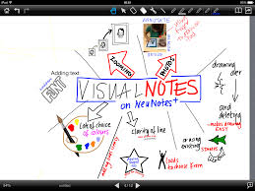
Get Ready
http://www2.napier.ac.uk/getready/managing_studies/index.html

Slide 24
The Open University (2013). Effective note taking. Available from: http://www.open.ac.uk/choose/unison/develop/my-skills/effective-note-taking [accessed 05.12.17]

