Slide 1
Sociology
Social class and education

Slide 2
George Orwell (1937)
Context to the discussion we’re having today – this is what UK was like for poor – before welfare state
https://www.youtube.com/watch?v=AmDvLY9f82A
(from 1m50sec)

Slide 3
Social class inequality

Slide 4
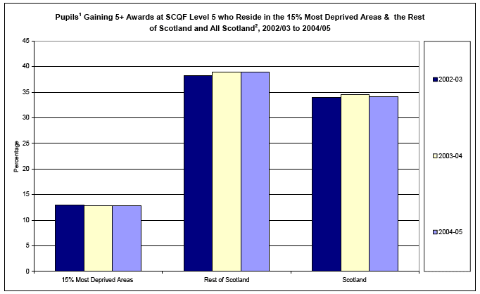

Slide 5
Stop and think…
Discuss with people beside you
What is social class?
What does it measure beyond wealth?
What are different classes called?
Why do we care about social class?

Slide 6
Defining and categorising social class
Problematic: lack of agreement
Many classification systems exist

Slide 7
Pierre Bourdieu

Slide 8
Bourdieu’s 3 key types of capital
Economic capital: material goods and wealth
Cultural capital: a. educational qualifications b. knowledge and understanding of creative and artistic culture (music, art, theatre, film)
Social capital: social networks, who you know and who can help you

Slide 9
Bourdieu – field and habitus
Habitus - Experience and social position – Embodied – Uncritical
Field – Space
Doxa – the rules of the game

Slide 10
Bourdieu: education and social class: ‘cultural reproduction theory’
Cultural reproduction theory - education system biased against working class, favours dominant (middle) class culture
Fundamental role of education - ‘cultural reproduction’

Slide 11
Strangers in Paradise – Reay et. al., 2009
Working class students in elite universities
Bourdieu argues in unfamiliar field the habitus is transformed, ‘a habitus divided against itself’
Paper argues it’s more nuanced – students develop ‘creative adaptations and multi-faceted responses’ (p. 1103)

Slide 12
Stop and think…
Shout out – how might class
impact on your experiences of higher education?

