Slide 1
Notes:
Presenter to Introduce themselves.

Slide 3
Student Help Point
The Student Help Point is the gateway to Student Life:
Accommodation Queries
Fees & finances
Registration
Student Issues
Documents & ID
Study Skills & Counselling Appointments
Ishbel Gordon Building
Level 3
www.rgu.ac.uk/studenthelppoint
@RGUHelppoint
studenthelppoint@rgu.ac.uk
01224 262182
01224 263660
Notes:
The Student Help Point located in the Ishbel Gordon Building is your one-stop shop for all your non-academic queries.
It is the gateway to Student Life and the support services that are available across the University.
The Help Point can cater to any question, there is no such thing as a stupid question, they are extremely approachable and are there for YOU.
If they can’t answer your question themselves, then they will be able to put you in touch with someone who can.
The Student Help Point also acts as the admin hub of the University,
Here you can request – student status letters, check your records, pay fees, or order new student cards.

Slide 4
Inclusion Centre
The Inclusion Centre team are here to support you if you have:
Long-term health conditions / Sensory impairments
Physical disabilities
Mental Health difficulties
Specific learning difficulties, e.g. dyslexia
Social & communication disorders, e.g. autism spectrum disorder (ASD)
Short term injuries
Ishbel Gordon Building
Level 3
www.rgu.ac.uk/disability
inclusion@rgu.ac.uk
01224 262 103
Notes:
The Inclusion Centre team are here to support you if you have a health condition or disability that has an impact on your studies. We support students with, Long-term health conditions / Sensory impairments, Physical disabilities, Mental Health difficulties, specific learning difficulties, autism spectrum disorder, short term injuries.
Inclusion Centre are here to support you if you have any health or disability issue which has an impact on your studies.

Slide 5
Inclusion Centre
We can offer you:
Teaching & Learning adjustments
Exam arrangements such as extra time
Dyslexia screening and evaluation
In-house assessment of needs
Guidance on applying for Disabled Students’ Allowance
Support through external agencies
pic
Notes:
The support we offer is tailored to the individual student but can include teaching and learning adjustments such as accessible course materials and alternative exam arrangements such as extra time. If your had exam arrangements at school or college and would like to have them here, you should contact the Centre by 1 October at the latest to make sure they are in place for the December exams. If you have a temporary injury, the Inclusion team would be the ones to put alternative arrangements in place.
We also offer a dyslexia screening service for students. If you think you may have dyslexia and want to find out, make a screening appointment with an Inclusion Coordinator. They can discuss the options with you and refer you to an Educational Psychologist. Don’t be concerned if a tutor suggests that you come for a screening, around 200 students are screened each year and the service is confidential. We can discuss your options and the range of support which is available.
THe Centre is able to support students to apply for Disabled Students Allowance which can meet study related costs such as specialist software or amplification equipment. If this might be relevant for you, come to speak to one of the coordinators,
THe Centre will not pass on any information about a student without the individual’s permission and you can chose what information if any we pass on. For example if you have a health condition it might be useful for tutors to know that you may be absent from time to time for genuine medical reasons. You do not need to let tutors know what condition you have. Come to see the coordinators either for an appointment or at one of the drop-in sessions to see what support might be useful for you,

Slide 6
Counselling & Wellbeing
Studying at University is an exciting and rewarding experience. For some it also brings changes which might at times be difficult and stressful. We have counsellors and a Student Wellbeing Advisor who can talk over and support you with issues which may be concerning you.
This is a safe, confidential, one-to-one short-term working alliance with a trained person who can listen with empathy, in a non-judgemental way.
Ishbel Gordon Building
Level 3
www.rgu.ac.uk/counselling-and-wellbeing
counselling@rgu.ac.uk
01224 262 120
Notes:
We want you to have a great time here at Robert Gordon University, but we know that for some people the changes can be stressful and it would be good to speak to someone. We offer a safe, confidential space where you can talk to a trained counsellor or wellbeing adviser without judgement. The Counselling contact is usually a short series of appointments where you can explore what is going on for you and what might help.

Slide 7
Counselling & Wellbeing
We can help with:
Adjusting to University life
Living with others
Fitting in
Anxiety and depression
Relationship difficulties
Coping with change and homesickness
Exam panic
Stress
Self-confidence and low self-esteem
Substance misuse
Procrastination
Bereavement
Self-harm
Notes:
The kind of issues we can help you with are detailed in the list, from problems settling in to University life, anxiety and relationship issues. Ev,ery student will have an initial appointment with our Wellbeing adviser who can refer you to a Counsellor and offer other support depending on what works for you. You can telephone the service for an appointment or go to our drop in service at Woolmanhill on Wednesdays between 4 and 6:30. We also host a lunchtime get together on Wednesdays in the Georgina Scott Sutherland Learning Centre. Its not formal, just a place to bring some lunch and have some company.

Slide 8
Resilience
In 2017 RGU Student Life brought together a small group of staff and students with expertise in mindfulness, cognitive behavioural therapy techniques, sports and physical activities, social media and events management. We have developed a resilience Moodle area and run regular resilience events.
Ishbel Gordon Building
Level 3
www.rgu.ac.uk/buildingresilience
Notes:
MINDFULNESS
COMMON THINKING ERRORS
PHYSICAL ACTIVITY
CONNECTIVITY

Slide 9
Mental Health
RGU strives to create a culture within our community that promotes and supports positive wellbeing in order to create the best possible student experience.
The Student Mental Health Agreement outlines the University and Union's commitment to improving the mental wellbeing of all students through activities and initiatives
www.rguunion.co.uk/about/campaigns/
mentalhealth/
Notes:
RGU has mapped this effort through the following the five main objectives you can see here.
If you want to get involved or want to see what resources are available to help you with any mental health issues you may come across during your time at RGU then you can visit the Mental Health Agreement website, or contact the RGU Union.

Slide 10
ResLife
The RGU: ResLife team is here to support your time in student accommodation and beyond, we provide out-of-hours welfare and pastoral support and are on hand to advise all residents on upcoming social events arranged by RGU: ResLife. We also provide an extensive signposting service to students in order to make your living experience as pleasurable as possible.
Ishbel Gordon Building
Level 3
www.facebook.com/rgureslife
reslife@rgu.ac.uk
01224 26 2141
Notes:
Res Life is a peer support group of students living in Student Halls to provide a smooth transition to Uni life.
There are plenty of social interaction opportunities to create peer support groups and to make friends.
The ResLife team is trained to provide welfare and pastoral support with the knowledge of professional services and can support you as required.

Slide 11
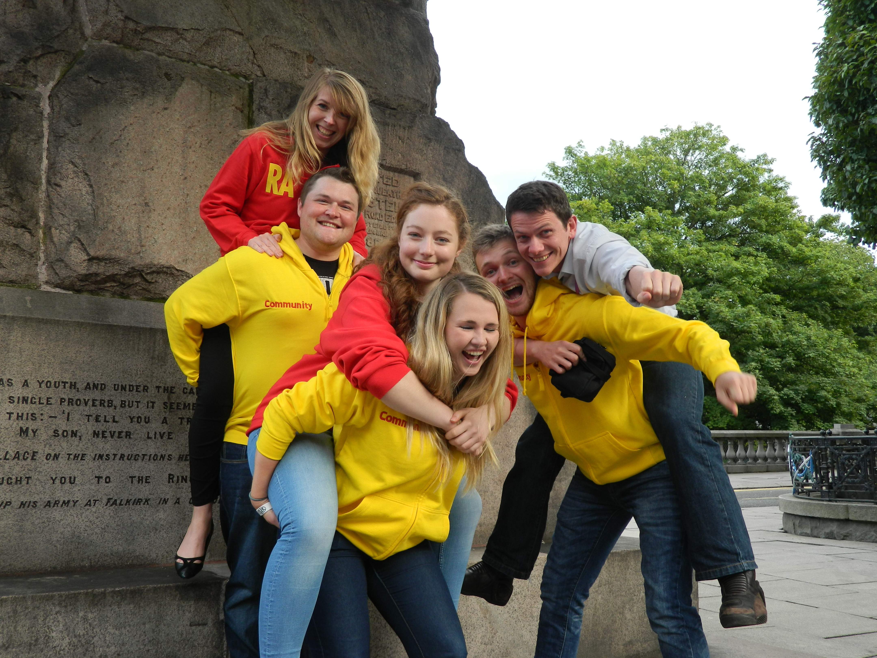
ResLife
We provide:
A comprehensive social calendar as well as access to support services.
Out-of-hours cover is provided at most sites for emergencies.
A dedicated team of full-time student welfare & advice professionals.
Support for students even after they have moved out of RGU's accommodation.
Advice on all aspects of living experience, including the private rented sector.
pic
Notes:
ResLife caters to the entire student living experience.
We can provide help, support & advice on any sector of accommodation, in halls or a private flat.

Slide 12
Chaplaincy
From providing a listening ear for students and staff to assisting people with life event, conducting Baptism, Wedding or Funeral -
The chaplaincy service is available for people of all faiths and none.
We have a dedicated prayer facility for members of the RGU Community at Kaim Cottage.
Kaim Cottage
chaplaincy@rgu.ac.uk
01224 640119

Slide 13
StudentLife@rgu.ac.uk
Notes:
Any questions?

