Slide 1
What is the purpose of history?
Dr Matt Graham 7/12/2018
m.v.graham@dundee.ac.uk @SAHistoryMatt

Slide 2
Objectives
What is history?
History as a part of who we are
Some of the main purposes of history as an academic subject
Interpretations and problems
  The example of history and culture
Case-study: South Africa

Slide 3
What is history?
A basic definition:
History is the study of the collective human past, with a view to explaining how the world has evolved into its present condition

Slide 4
What is history?
A more complex definition:
“History is our knowledge about the past produced by historians, which is established through the production (research, interviews, etc.), the communication of (through books, articles, TV, etc.), and teaching on that topic”
Arthur Marwick

Slide 5
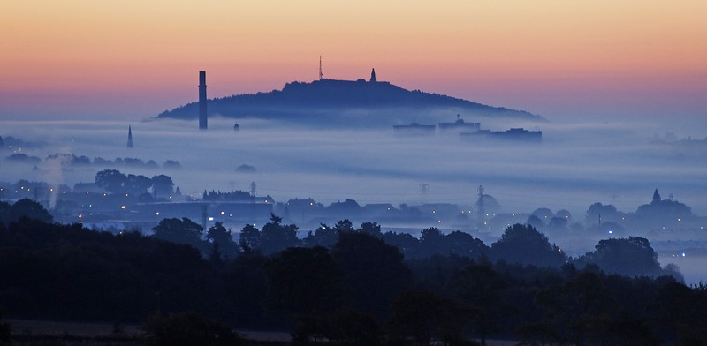

We cannot escape history!
History is all around us!
Our own individual past
  Our history defines us
  How can you shape your own future without knowledge of / learning from mistakes in life?
Collective histories
  A family / a community / a sports team, etc.
Nationality
  Our national identity is partially based upon the past

Slide 6
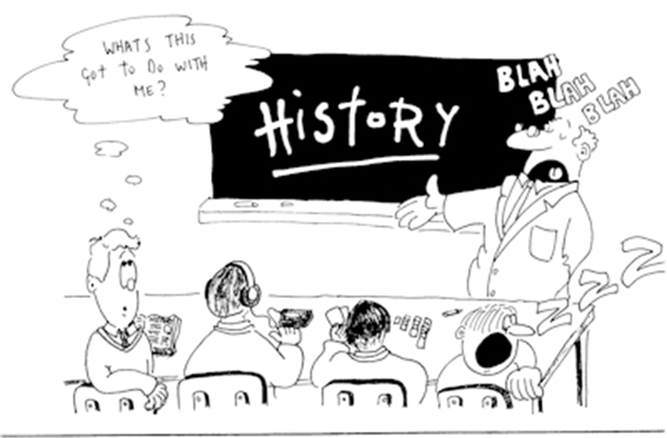
Class Task
What do you think the purpose of history is?
(i.e. why is it important & why do we study it / take an interest in the past)
Write down a few bullet points

Slide 7
Common answers: What is the purpose of history?
History is something we can learn from
History shines a light onto peoples & communities that came before us
History is a morality tale…?
History helps to explain the present-day world
History is worth studying for its own sake
History is entertaining / strange

Slide 8
Interpretations and problems
“History will be kind to me, because I intend to write it” (Churchill)
“History tells us more about the person who wrote it than about the people being written about” (Carr)
“Who controls the past controls the future: who controls the present controls the past” (Orwell)
“We learn from history that man can never learn anything from history” (Hegel)

Slide 9
History is simply a version of the past…
There are always multiple sides to the story
Can we ever really know what happened?
Importance of time and place
Myths dominate our understanding of the past

Slide 10
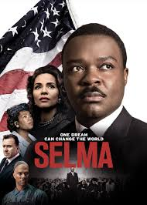
Culture: History on the screen
Most common way of history being ‘told’ today
Can’t films be as good, if not better than writing?
Does film bring history to life?
But, how do you condense ‘big’ issues into a couple of hours?

Slide 11
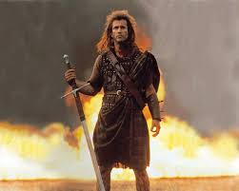
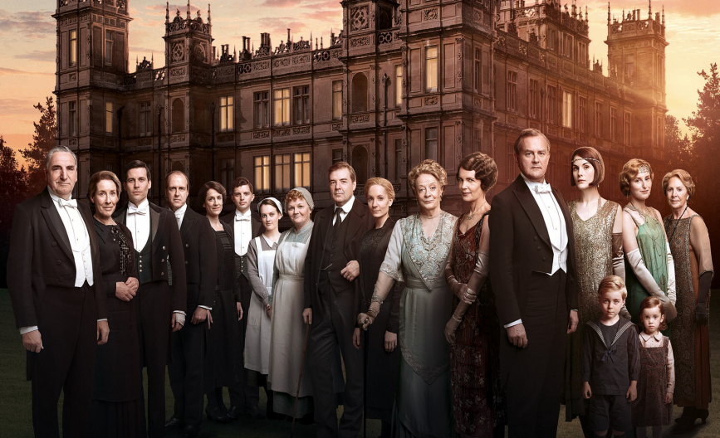
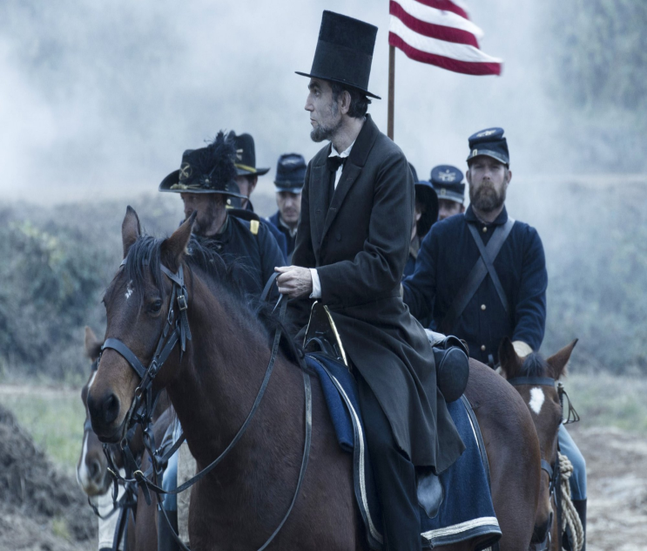
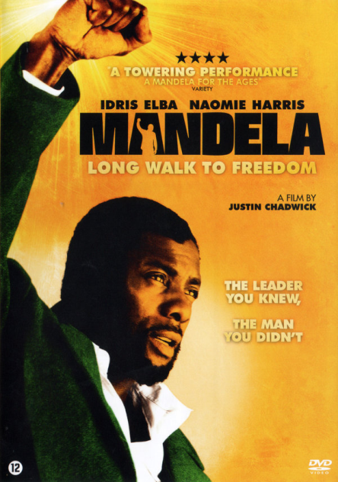
Culture: History on the screen
Task: How can history on the screen affect our perspectives on the past?

Slide 12
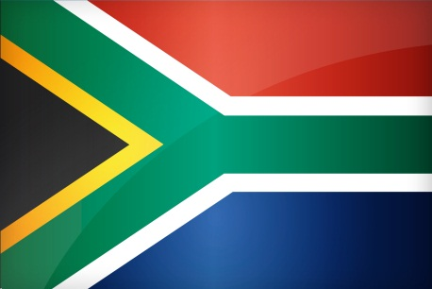
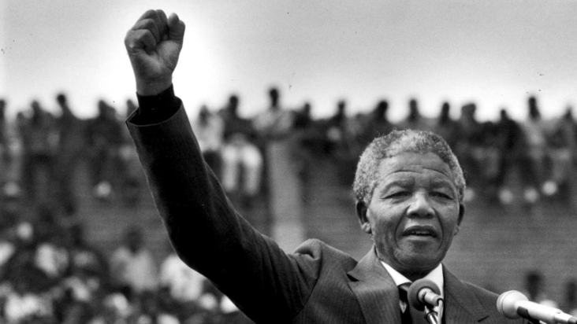
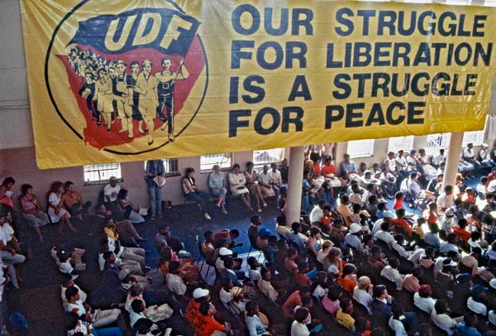
Case-study: South Africa
History is highly contentious in modern South Africa
Manipulation of the past by current politicians
Creation of historical myths by the African National Congress (ANC)
Why?: Self-serving / legitimacy to rule / to exclude others from power

Slide 13
Questions
Do you have any questions?

