Slide 1
SWAP East – Access to Nursing 2018/19 Study Skills: Preparing for University Quick Guide to Essay Writing
Amanda Whitehead
Academic Skills Centre, University of Dundee
07/11/18

Slide 2
Academic Writing Conventions
Presentation
Structure
Content
Academic Writing Conventions
Notes:
THREE conventions of academic writing: PRESENTATION, STRUCTURE, CONTENT
What is meant by presentation?
use of language in an appropriate ‘register’, that is, in ways that are appropriate to the more formal format expected at this level of study.
use of paragraphing
correct spelling, grammar, punctuation and syntax
use of spacing to make the text more legible
page numbering
What is meant by content?
Is it relevant?
Does it contain what it is expected to contain?
Is there evidence and analysis? (more than just description)
What is meant by structure?
Is it ordered logically?
Does it flow?
This powerpoint will cover each of these three areas in turn.

Slide 3
What do we mean by presentation?
Good presentation is:
font style, size, spacing and page numbering
(But it’s MORE THAN just that!)
Good presentation includes paying attention to:
Spelling
Grammar
Punctuation
Syntax
Register
https://www.pexels.com/search/typewriter/
Notes:
The next few slides show how errors in punctuation, spelling and grammar can not only create a bad impression, but also change the meaning of what you are trying to say.
The fundamental message in the next few slides is that presentation is MORE than surface features. In order to show your content in its best light, it is necessary to use correct spelling, grammar, etc. or your argument/discussion can easily become lost. That’s why it is crucial to PROOF-READ and EDIT your work before submitting.
Significance of type-writer? They challenge the user to see their errors on paper. (N.B. we are not advocating typewriter use! Just for careful proof-reading step by step in the essay writing process.)
Definitions:
Syntax - the arrangement of words and phrases to create well-formed sentences.
Register - often refers to the degree of formality of language, but in a more general sense it means the language used by a group of people who share similar work or interests (e.g. the technical language of a subject or discipline).

Slide 4
Presentation
Notes:
Would YOU pay money to have this person proof-read your work?
You don’t have to pay someone to do it. You can learn to do it yourself.
Ideas for proof-reading:
Read your work aloud. What your eye misses your ear might pick up on!, especially with regard to punctuation and sentence structure.
Use electronic spelling/grammar checkers but be aware of their limitations. They are not infallible.
’Step away from the essay’ – let it ‘rest’ - go do something else then come back to it with fresh eyes.
Let someone else read it.
Any more……..?

Slide 5
Essay Structure ‘The Sweetie Wrapper’
Notes:
Moving on to structure:
A very basic image, but captures the simplicity of how a piece of academic writing is structured.
However, there is meaning behind these deceptively simple shapes.

Slide 6
The ‘Sweetie Wrapper’ unwrapped
Context
Introduction
Main Body
Conclusion
Key ideas / Statement of intent
‘Signposting’
Section 1…
Main body must have:
Proper paragraphs
Sense of ‘flow’/logical structure
‘Critical analysis’
Section 2…
Section 3, etc…
Return to intention
Summarise critical analysis
Place in wider context
Notes:
Previous model in more depth.
This model can be applied to short essays and longer essays. It is the amount of sub-points, or depth of your analysis in your sub-points, that dictate the length of the essay. This basic structure holds true regardless of the length of the essay.
INTRODUCTION
Should ‘set the scene’, i.e. show where the topic sits in a wider context.
Begin to narrow it down. You can not write everything there is to know about the topic of the essay. That is why you need to be discerning: What are the specific areas that your essay will focus on? State your intentions and tell your reader exactly where you are going. Leave no surprises to the end.
‘Signpost’ the discussion that will follow in your main body.
In light of this, it is often a good idea to craft your introduction after the main body. At least be prepared to revise it to make sure it fits with what you have written.
MAIN BODY
Order your themes logically. The structure of each of these themes (or sub points) follows the same structure albeit on a micro scale. E.g. Each paragraph should have an introductory sentence, followed by a development of the theme or argument, followed by a mini conclusion. MORE ON THIS LATER in the PowerPoint.
CONCLUSION
Refer back to your intentions
Sum up the mini conclusions from your sub-points.
Draw it back out in to the wider context again.
A conclusion should not contain any new information, ideas or analysis. E.g. Don’t put in quotes by authors that haven’t appeared elsewhere in the essay. If you find yourself doing this, STOP and ask yourself if it’s worthy. If it is, work it into the main body. If it isn’t, leave it out.
A conclusion is not the place to carry out your analysis. Many students write purely descriptive essays then bank up all their analysis to the last paragraph or two. This is not how to do it. Critical analysis and evaluation should be build in to each stage in the main body.
Moving on to CONTENT…

Slide 7
“Not enough critical analysis…”
“Lacking in depth”
“Too descriptive”
But what do they mean?
Notes:
So, let’s focus in now on the main body. This is where the bulk of the content of the essay will lie.
These are typical comments that students often receive in their feedback. But what do these comments actually mean, and what can you do to prevent your essays receiving such comments?

Slide 8
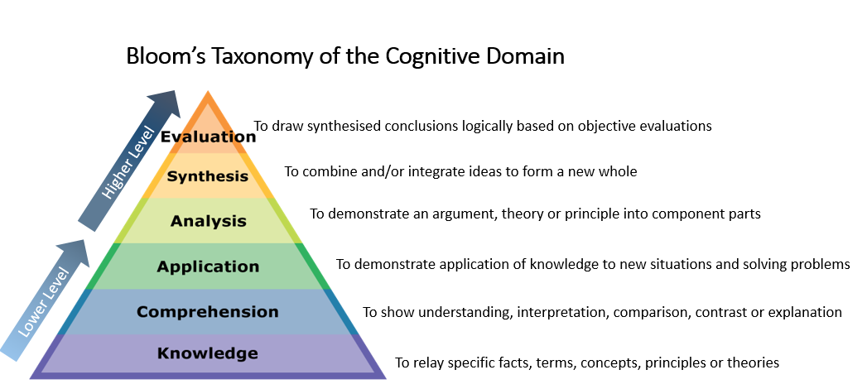
Content: How to bring criticality into your writing
Bloom’s Taxonomy of the Cognitive Domain
To draw synthesised conclusions logically based on objective evaluations
Higher Level
To combine and/or integrate ideas to form a new whole
To demonstrate an argument, theory or principle into component parts
To demonstrate application of knowledge to new situations and solving problems
Lower Level
To show understanding, interpretation, comparison, contrast or explanation
To relay specific facts, terms, concepts, principles or theories
See: Granello, D.H. (2001) Promoting Cognitive Complexity in Graduate Written Work: Using Bloom’s Taxonomy as a Pedagogical Tool to Improve Literature Reviews. Counselor Education and Supervision. 40 (4) Available at:http://onlinelibrary.wiley.com/doi/10.1002/j.1556-6978.2001.tb01261.x/epdf
Notes:
CONTENT
What exactly is critical analysis?
Here is some theory behind it…
Benjamin Bloom was an American educational psychologist in 1950s/60s. One of his biggest contributions to the field was his classification of educational objectives, which has come to be known as ‘Bloom’s Taxonomy’
At school, and maybe to a lesser extent, college – we can get by comfortably by hovering in these lower level skills (knowledge, comprehension). Having a sound knowledge of a subject, or remembering what your teacher told you about it or what you read about it (and ‘regurgitating’ it in essays or exams) isn’t enough in higher education.
University differs in the sense that your markers often take it for granted that you should already have a good working knowledge and comprehension of your topic or subject – therefore you don’t need to show this off in your essays. Very rarely will your markers be expecting to see you display only knowledge in your writing. What they expect to see is how you analyse the concepts, theories or principles; how you evaluate them, and how you synthesise them to make informed judgements or action plans. This is what markers mean by ‘critical analysis’, ‘depth’, etc.
The next few slides will look at techniques for helping you build in that all-important analysis.

Slide 9
Content: How to bring criticality into your writing Paragraph structure
TOPIC
EVIDENCE
ANALYSIS
Introduce the topic of the paragraph
Draw upon relevant literature
Explain its significance
Notes:
It is important to build ANALYSIS (aka ‘depth’, aka higher level Bloom’s Taxonomy), into each main point in your essay. Ideally each paragraph should contain all of these elements.
So how do we do this?:
One simple but effective model: ‘Cup of TEA’
Topic – introduce the topic of the paragraph. What is this paragraph about? Generally, this will be descriptive.
Evidence – show the evidence. Quote / draw upon evidence from literature on the topic. What theory relates to the topic of this paragraph?
Analysis – What’s the relevance of what you are saying? Why is it important? What’s the relevance to YOUR essay task or the argument you are trying to build?
This last part (i.e. higher level Bloom Taxonomy!) is the part that a lot of students miss out, and is one of the main reasons for poor grades.
NB. ‘Analysis’ in this sense can mean ‘critical analysis’, ‘critical evaluation’, ‘informed opinion’, ‘depth’, etc. (i.e. all the things that marks scribble over essays that are too descriptive!)

Slide 10
‘Discuss the shortage of nursing staff within mental health and its impact on patient care’ (What’s missing from this sample paragraph from the main body?)
The value of mentorship in providing strong support in clinical settings is characteristic of all nursing situations, including mental health. Cleary and Happell (2005) suggest that specific characteristics of mental health settings render the need for high-quality clinical support to be even greater. Cowman et al (2009) supports this notion and describe the working environment within mental health settings as very different from general nursing areas. They believe there is less structure with a reduced amount of focus on physical tasks, a greater degree of professional autonomy and more emphasis is placed on a multidisciplinary team approach to care which makes a mentorship program all the more valuable. Humpel and Caputi (2010) present that the characteristics of new nurses working in mental health make them more likely to quit because nurses with less than two years nursing experience process a lack of emotional competency and reduced ability to cope with work related stress.
Notes:
This is a sample paragraph taken from part of the main body of an essay on the shortage of nursing staff within mental health and it’s impact on patient care. What is missing from this paragraph?
Answer: It’s missing the ‘critical’ part. The A for Analysis if we are using the TEA model.
The student tells us what the literature says about the issue, but where is the critical analysis/mini conclusion? A paragraph likes this leaves your marker begging ‘So what? Why are you telling me this? What’s the significance to your argument?’

Slide 11
Discuss the shortage of nursing staff within mental health and its impact on patient care’
The value of mentorship in providing strong support in clinical settings is characteristic of all nursing situations, including mental health. Cleary and Happell (2005) suggest that specific characteristics of mental health settings render the need for high-quality clinical support to be even greater. Cowman et al (2009) supports this notion and describe the working environment within mental health settings as very different from general nursing areas. They believe there is less structure with a reduced amount of focus on physical tasks, a greater degree of professional autonomy and more emphasis is placed on a multidisciplinary team approach to care which makes a mentorship program all the more valuable. Humpel and Caputi (2010) present that the characteristics of new nurses working in mental health make them more likely to quit because nurses with less than two years nursing experience process a lack of emotional competency and reduced ability to cope with work related stress. Therefore, it can be argued that more resource needs to go into supporting mentorship schemes if a shortage of nursing staff within mental health is to be avoided. Consequently, if health services continue to treat the same numbers of people with insufficient numbers of nurses, patient care will be compromised.
T
E
A
Notes:
Again, back to the ‘sweetie wrapper’ structure, but this time showing how it relates to paragraph structure and TEA
The blue text denotes the all-important critical analysis. You can see it answers the ‘so what?’ that was left in the marker’s mind in the previous example.
Red = Topic
Green = Evidence
Blue = Analysis
If you are unsure if your essay has enough balance between description, evidence and analysis, try separating it in this way - use 3 different colours of highlighter and you’ll see easily if it is lacking in the all important evidence and analysis.
A good paragraph must introduce the topic of which that paragraph is about. It must then develop the topic and include evidence. Finally it must draw to a logical mini conclusion or critical judgement based on that evidence.

Slide 12
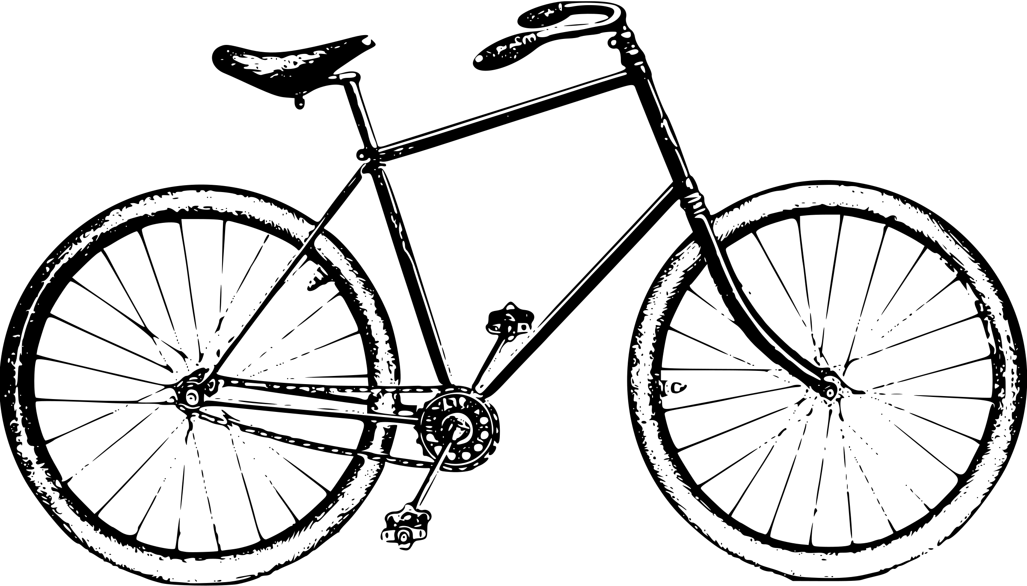
The academic writing cycle
1. Choosing the topic
2. Reading & researching,
5. Resting
3. Planning
4. Crafting & drafting
6. Proofreading & Editing
12. Feed forward to next assignment
8. Submitting
9.Waiting!
10. Receive feedback
11. Reflect on feedback
7. Printing (if required)
For a useful writing planning tool, see http://www.staffs.ac.uk/ask/
Notes:
The stages of producing an academic essay
Choose the topic, or, if you have been set a question, break it down to make sure you know exactly what it is asking you to do.
Start on your reading, taking good notes, and jotting down the bibliographical details so that you can return to that text again if you need to.
Plan what will make it into your essay. What subtopics are you going to focus on in the main body in order to best answer the question? For typical undergraduate essays of 1500/2000 words you have to be pretty discerning about what you leave out as much as what you will include because you can’t write everything there is to know on that topic in that amount of words.
Craft your essay. Create it piecemeal if it makes it easier. (i.e. focus on one subtopic area at a time, then ‘join’ it together into an essay with a suitably fitting intro and conclusion.
Allow yourself time to ‘step away’ from the essay for a day or so. Come back to it with fresh eyes and you’ll see things you can change, edit and improve.
Proofread carefully. Use spell/grammar checkers, and ask someone to read your work back to aloud. This will help you pick out run-on sentences and if it generally ‘makes sense’.
…most essays are submitted electronically these days but for bigger pieces of work such as dissertations, you will probably be required to submit a hard copy too.
Get it in on time! Marks lost for lateness are such a waste.
Can seem like forever but usually you’ll have other assignments in the pipeline to focus on.
Read the feedback carefully – don’t just fixate on the grade
Reflect on what you did well and what you need to work on.
Make an action plan of how you will address these things before your next essay.

Slide 13
Thank you, and…
…with your future studies!

Slide 14
dundee.ac.uk
Notes:
Any questions – please email awhitehead@dundee.ac.uk

