Slide 1
Critical Thinking
Clare Brown
Effective Learning Adviser
Queen Margaret University, Edinburgh

Slide 2
What is critical thinking?
Criticising? Being negative? Nit-picking?

Slide 3
What is critical thinking?
?
Identifying a point of view or argument
Evaluating whether that point of view is valid
What evidence supports it?
Asking questions
Not taking things at face value

Slide 4
Everyday Critical Thinking

Slide 5
Everyday Critical Thinking
This is the phone for you!

Slide 6
Everyday Critical Thinking
Memory
Size
Usability
New/used
Battery Life
Weight
Price
Colour
Longevity
Operating system

Slide 7
Who would you trust to recommend a phone?
Your GP
Guy at the corner shop
Your mum
Independent phone expert
Employee of phone company

Slide 8
Which source would you trust?
‘Garlic can prevent and cure a cold.’
A leading Scottish garlic producer
The Scottish Government
A nutritionist
Your granny

Slide 9
Agendas and reliability
Garlic Producer
Wants to sell garlic?
Scottish Government
Wants to support Scottish garlic sellers?
Nutritionist
Wants to provide balanced advice based on research?
Granny
Wants you to get better!

Slide 10
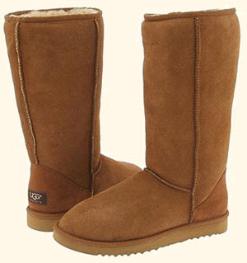
Does the reasoning make sense?
Between November and February the rates of people wearing boots and consuming hot drinks increase.

Slide 11
Does the reasoning make sense?
Between November and February the rates of people wearing boots and consuming hot drinks increase.
X The wearing of boots causes people to consume more hot drinks.
X Consuming hot drinks causes people to wear boots.
There is a third factor, the cold weather between November and February, which causes these events to occur independently.

Slide 12
What would you ask?
“In the reading test, the five children who were taught to read using phonics performed better overall than the five children taught using the whole word method. This shows that the phonics method is a better choice for schools.”

Slide 13
What would you ask?
Sample size?
What does ‘performed better overall’ signify?
If repeated, would same results occur?
Unintentional bias in test?
Parental involvement?
Equivalence of intelligence, age, gender…?
Transferability to all school environments?
Implications for practice?

Slide 14
Critical Note-Making
Main points and arguments | Evidence | My comments

Slide 15
Critical Thinking: Summary
Ask Questions!
What is being said?
How is it being justified?
Is it logical?
Are there underlying assumptions?
Are there alternatives?
Does this work for everyone/every situation?
What information is missing?
What if…?
What next…?

Slide 16
Critical Thinking Resources
Queen Margaret University Effective Learning Service (click on ‘Guides and Resources’): www.qmu.ac.uk/els
The Open University: Thinking Critically booklet
https://www2.open.ac.uk/students/skillsforstudy/booklets.php
Critical Thinking Skills, by Stella Cottrell (Houndmills: Palgrave MacMillan, 2005)

