Slide 1


Take note
Mel Kinchant
Academic Skills Adviser
Widening Participation
academicskills@napier.ac.uk
Notes:
Introduction and session overview.

Slide 2

Why?
Notes:
Why do you think note taking is important when studying at university?

Slide 3

The head is a great place for creativity but a terrible place for storage!
Notes:
Ask group for ideas re: some of the differences between school and university.
Why do we need to take notes?

Slide 4

Note making
What should you do in a lecture?
Why take notes when reading?
What kind of notes do you need?
Notes:
4

Slide 5
What is different at University?
  Lectures
  Tutorials/Seminars/Practicals
  Independent learning
Why do we need to take notes?
  To help us remember what was covered
  Not everything is in textbooks
  To help us revise later
Notes:
Most students at university will have a combination of lectures (in a setting like this) and smaller classroom based activities such as tutorials or seminars and/or practicals.
At university, whilst you are certainly given direction and a certain amount of information, you will be expected to be ‘independent’ in your learning – what does that mean?
You will be in charge of your own learning.
You will need to find and access additional learning resources and undertake further reading and research.

Slide 6

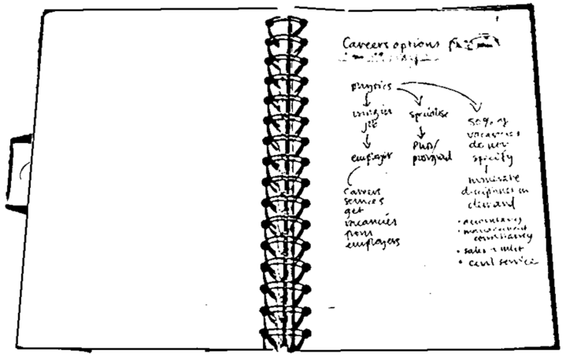
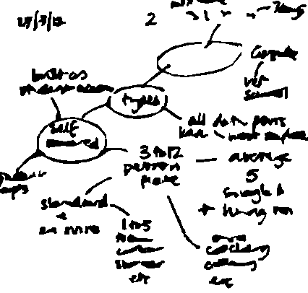
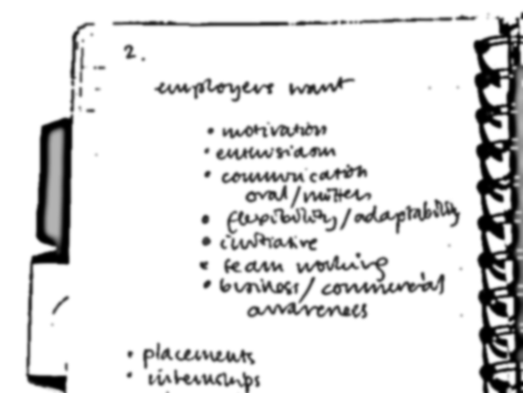
Why make notes?
Notes act as memory aid
Notes:
6
All sorts of formats can be used to make notes. You will develop your own styles for different purposes (and different lecturers).
Leaving some space allows you to add to them later.
ACTIVITY – ask group how much information is lost if we don’t take notes?
Taking notes helps us to be active in the learning process, it helps you to really engage with the information to help you to develop your knowledge and understanding within the subject area.

Slide 7
Why make notes?
Notes act as memory aid
  Buzan (1999): Without active learning, we forget 98% of information in just three weeks
It actively involves you in the learning process
It helps to develop your understanding
It allows you to reduce information to a
manageable size
Notes are helpful when preparing assignments or for exams
Notes:
7
Taking notes helps us to be active in the learning process, it helps you to really engage with the information to help you to develop your knowledge and understanding within the subject area.
Your notes will be a valuable outline of the course and the material your lecturers view as being important.
Lecturers usually bring together material from published works, compare and contrast points of view and can introduce ideas which may not have been published in text books yet. Your notes can summarise all of this.

Slide 8
Note Making Process
Before lecture
After lecture
During lecture
Useful lecture notes
Notes:
Note taking is a process, which is why it might be better to call it ‘note making’, with a before, during and after stage if you want your notes to be really effective in terms of your learning.

Slide 9
❶ Before: Prepare and tune in
Prepare:
  Advance reading
  Print off and read the lecture outline (slides or notes)
  If relevant, read your notes from the previous lecture
  Look up scientific / technical terms and subject-
  specific jargon.
  Tune yourself into the topic by thinking of questions.
Notes:
9
Going in to a lecture without doing any preparation makes it much harder to follow the lecture. Even if you haven’t much time to prepare beforehand, you can still tune in by looking up the basics.
Going into a lecture cold can leave you confused by terms you are unsure of and authors or concepts you have not heard of before. Familiarising yourself with these beforehand means you will get more out of the lecture content.
If the lecture is one of a sequence on a topic or field of study, it is important you have a good idea of what went before and where this lecture fits in.
Thinking of questions beforehand helps you to know what you understand already and what you need to clarify. You may need to follow up these questions afterwards.

Slide 10
❷ During: Make notes
  Listen and watch – cues, clues and signposts
    e.g. 'there are four key points here’
Don't write everything down
  Key words, phrases, short sentences, abbreviations
Annotate handouts
Note questions you have
Note making improves with practice
Notes:
Practise makes perfect! At the beginning, students often find it hard to make notes in lectures. Here are some of the things they say:
"I don't know what's important."
"My notes are useless because I can't make sense of them later."
"I try to write down too much and then I lose the place."
It is difficult at the beginning, because you're making notes in 'real time' – you can't stop and rewind! It's also more difficult when the subject is unfamiliar. In addition, lecturers vary in presentation, and some are easier to follow than others! With practice, most students find their note making skills improve.
Don’t write everything down! Your goal isn’t to transcribe the lecture word for word, rather it’s to extract and record the main points of it. The trick to successful note-taking is learning how to separate the wheat from the chaff. Your lecturer may well go off on tangents during the lecture.
Pay attention to cues your lecturer gives off either consciously or subconsciously. Whenever you see them, it probably means he’s/she’s saying something important, so write it down.

Slide 11
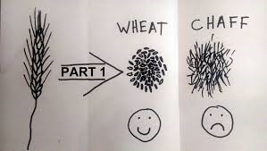
Lecturer signposting…
Framework: Lecturers often say at the beginning of a lecture how they have structured their lecture and what they are going to cover.
Don’t try to write everything down! Your goal isn’t to transcribe your lecturer word for word.
kizombaharmony.com
Notes:
Framework: Lecturers often say at the beginning of a lecture how they have structured their lecture and what they are going to cover. Listen carefully for this. It can provide a framework for your note making.
Don’t write everything down! Your goal isn’t to transcribe your lecturer word for word.
You want to extract and record the main points of it (separate the wheat from the chaff).

Slide 12
Lecturer signposting…
Pay attention to cues – conscious or subconscious.
“You need to know this,” or “This will come up in your…”
Repetition is often used to reinforce key points.
Anything said very slowly, so that it can be taken down word for word.
If your lecturer starts talking more quickly, loudly or with more emphasis.

Slide 13
Lecturer signposting…
Look out for language that shows relationships between ideas…
  first, second, third
  especially, most significant, most important, however, on the other hand
  because, so, therefore, consequently
  a possible explanation of this…
  it might be that…
  to clarify…
  Look out for language that signposts direction…
  later on I’m going to talk about…
  and now I’m going to…
Notes:
Here are a few cues your lecturer may give during the lecture.

Slide 14
Most students adopt their own
abbreviations for note taking
& | and
? | question mark - a good way to remind yourself to ask about something or look this point up later on
∴ | therefore
≤ | smaller or equal to…

Slide 15

~ | approximately
↑ ↑↑ ↓ ↓↓ | increase rapid or large increase decrease rapid or large decrease
# | number
cf | contrast with/cross reference
Adapted from The Open University (2013)
Notes:
When you make quick notes, it helps if you can use a shorthand way of writing things down and most students adopt their own set of familiar abbreviations. It is quite useful to shorten any frequently used words. Some common examples are given here.
Helpful to use established/ recognised abbreviations from your discipline/practice area (make a sheet with a list of commonly used ones).

Slide 16
ct | court
apl | appeal
D | defendant
C.I.L. | contemporary issues in law
Adapted from The Open University (2013)
Notes:
Here are some form Law for example

Slide 17


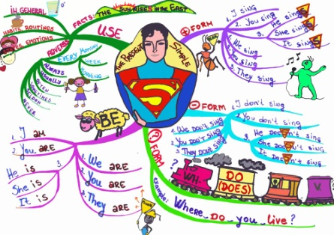
Get organised
How do you work best?
What note-taking style works for you?
  Laptop? Planned?
  Mind maps?
Notes:
iPads and Smart phones. Apps such as Evernote and note taking software such as Microsoft’s OneNote.

Slide 18

Note Making Styles: a) Linear notes
line by line
short and structured
headings and subheadings
abbreviations and key words
bullet points
  highlight
  key
  points
Notes:
This is the most common type of note making and is the method most students use in lectures. You jot the notes down as the information comes along, starting a new line for each new point. You write key words, short phrases or brief sentences. You can also use a numbering system or bullet points if you have some idea of the structure of the information.
Use colour and highlighting for memorable sections (often better to add this in later)
Note down names/specific terminology and look them up afterwards

Slide 19


b) Mind Mapping
Related theme 1
Related theme 2
Central idea
Visual
Not often
used in lectures
Make memorable
Highlighting
Good for organising after
Reading / revision
Colour
Notes:
This is a very visual way of capturing information, and allows you to show hierarchies of information and how different bits of information are connected. It really helps you organise information. Very few students use mind mapping in lectures, but quite a lot of people find mind maps useful for making notes from their reading, and when they're making notes for exams.

Slide 20
Top tips
Make notes in your own words
Use different methods for different purposes
  e.g. flowcharts for processes or
  tables for comparison
Organise your notes
  title, date, page numbers – and file them
Don't cram too much in – leave room to add in
Don’t leave reviewing notes until revision
Notes:
Make notes in your own words if possible. This will help you to clarify as to whether you have understood the information (or not) and will also help to prevent any potential issues with unintentional plagiarism.
However, sometimes it is not possible to do this because certain things are very precise and it is important to capture the information exactly as it is.
Make sure you can read your notes later.
Don't cram too much on the page.
Use different note making methods for different purposes, for example flowcharts for process planning, tables for comparison.
Organise your notes so that you can easily find what you are looking for.
Title your notes and date them. If you have several pages on one topic, include page numbers.
Taking down everything verbatim can sometimes distract you from keeping up with and understanding the discussion in class. Try wherever possible to reduce the actual amount you take down.

Slide 21

❸ After: Add value
Review your lecture notes
You might want to:
  Edit and clarify your notes
  Add further information
  Question some of what you have
  Add your own thoughts
It's not enough just to re-read notes...
you have to use them!
Notes:
21
Rewriting notes neatly is usually a wasted effort – much better to actively clarify and add to them.
Use the time to add to your notes instead. You should seek to use your lecture notes as actively as you can. You want to be able to understand the ideas for yourself and that means engaging your brain as much as possible.
Ideally revisit your notes as soon as possible (within 24 hours)
Go through your notes adding material:
Clarification, definitions and links to other notes you may have.
Aim to relate the material to what you already know.
Slide lecture notes: If there are slide lecture notes provided on the VLE, it is worth checking them for anything you missed and add this to your own notes. You probably won’t want to print out all or some of the slide lecture notes for every lecture, but it is worth saving them on your computer or a memory stick to have offline for revision purposes.

Slide 22
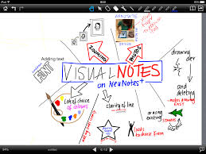
Get Ready
http://www2.napier.ac.uk/getready/managing_studies/index.html

Slide 23

The Open University (2013). Effective note taking. Retrieved from: http://www.open.ac.uk/choose/unison/develop/my-skills/effective-note-taking

