Slide 1
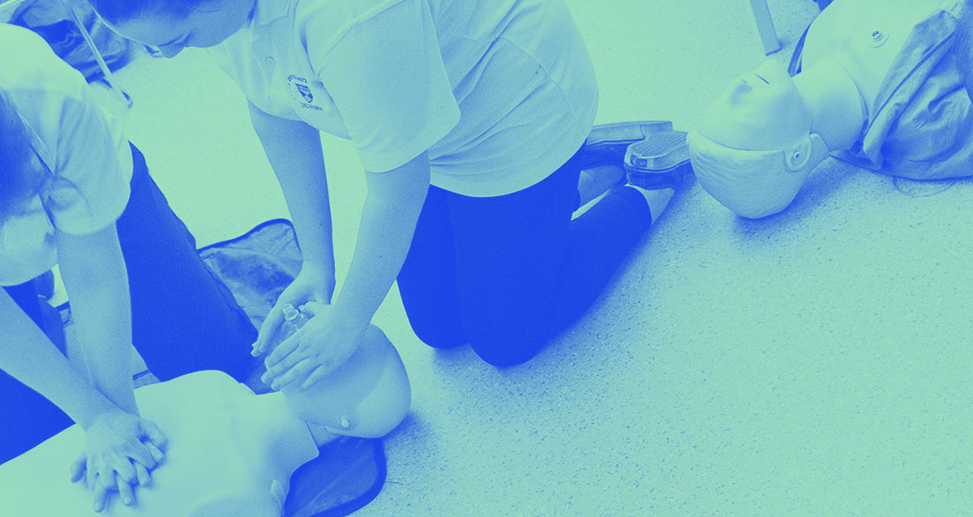

Study Skills: Preparing for University
Access to Nursing
A World Top 200 university, Times Higher Education 2018
Dr Tom Cunningham, Academic Skills Centre
14th November 2018

Slide 2
Intro & Structure
Dr Tom Cunningham, Academic Skills Tutor, Student Services
Short introduction to the Academic Skills Centre, and why I am here;
Some discussion on lectures and the importance of taking good notes;
A lecture delivered by Iain Burns, Senior Lecturer;
A ‘fun’ quiz and rounding up.

Slide 3
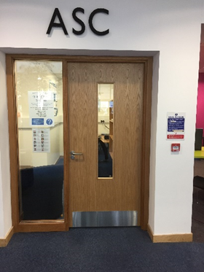
Academic Skills Centre
We offer several forms of support for students:
  One-to-one meetings for advice and support
  Academic skills modules, courses and workshops
  Bespoke classes and workshops
  Distance and online support
  We have drop-ins for any quick questions. In the ASC Zone, opposite the Coffee Shop in the LLC. Monday to Thursday, between Midday and 1pm
  We also hold drop-ins in the Library of the Fife (Kirkcaldy) Campus (usually once or twice a month). Look out for details of these.
  For more information see: www.dundee.ac.uk/asc

Slide 4
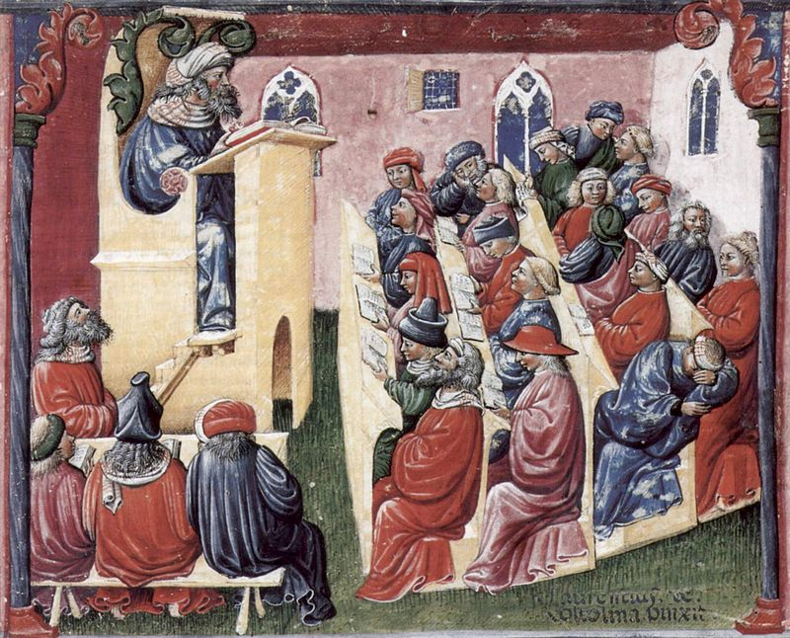
Artist: Laurentius de Voltolina Source: https://commons.wikimedia.org/wiki/File:Laurentius_de_Voltolina_001.jpg
14th Century!
Notes:
The word ‘Lecture’ comes from the French word meaning ‘reading’.
Lectures have been around at least as long as universities have – nearly 1,000 years (University of Bologna, Italy, A.D. 1088).
You can see from this picture above, from the mid 14th century, that things haven’t changed that much. We still have tiered lecture theatres, lecterns…people sleeping…!

Slide 5
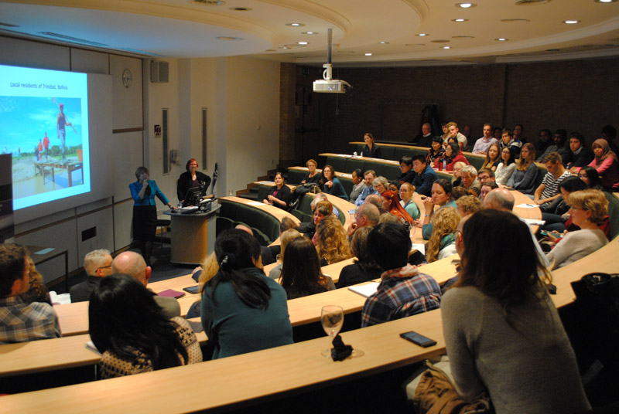
Source: http://www.papplewickpumpingstation.org.uk/annual_papplewick_lecture.html
Notes:
Lectures are oral presentations intended to present information or teach people about a particular subject.
Though lectures are much criticised as a teaching method, universities have not yet found practical alternative teaching methods for the large majority of their courses. They are still considered the most effective way of conveying information to large numbers of people at once.
Thoughts?

Slide 6
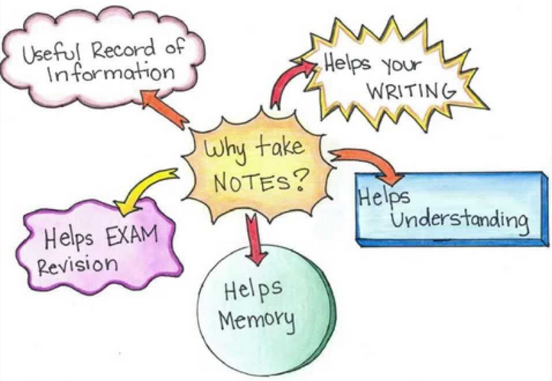
Why take notes?
Notes:
Which brings us nicely on to note-taking. Why should we take notes? Most of us do it because we think it is what we are expected to do. But what do we do it for? What are your thoughts?
Very few, probably none, of us have perfect recall. We need to take notes to help us remember key information, because we will probably need that information for writing essays, sitting exams and etc.
The benchmark of any set of lecture notes is how much sense they make to you 3 or 6 months down the line when you return to them as a starting point for exam revision or for writing an essay.
If you look at your notes and think ‘What was I thinking when I wrote this!?’ then they’re not good notes.
If you look at your notes and see all the key information PLUS your own thoughts that you had at the time, you have an excellent springboard for your taking your revision or research further.
Most of us have a style of note-taking that we tend to stick to. But did you know that not all note-taking styles are suited to every type of lecture? Sometimes it’s useful to be able to adapt your style to fit the situation. Let’s take a look at some the main note-taking styles…

Slide 7
Top Tip
There is NO expectation that you try to write down everything a Lecturer says!
This is neither possible nor desirable. Listen carefully during a lecture and note those points that seem most relevant. Don’t write down everything!

Slide 8
Top Tip Number 2
Printing out the PowerPoint slides is not taking notes….

Slide 9
Note-taking Strategies: Keywords
Good for lectures where there is clear structure to the lecture.
Identify/highlight keywords in the notes for easier read-back.
You will probably have had to do some pre-reading before attending the lecture to make it really effective.
Topic | Lecturer | Date | Venue
Keyword
Aims
Point 1 2 3 4

Slide 10
Note-taking Strategies: Mind Maps
Good for a ‘meandering’ lecture where there is back-tracking and re-emphasis or repetition.
Particularly useful for ‘big picture’ people who like to have an overview of a topic.
Easily annotated but can become cramped – not suitable if you are taking detailed notes.

Slide 11
Note-taking Strategies: Linear Notes
Topic | Lecturer | Date | Venue
Heading | Point 1 2 3 4
Heading | Point 1 2 3 4
Heading | Point 1 2 3 4
Conclusions
refs
Suitable for subjects/lectures that follow a process or procedure.
Use bullet numbering and white space to ‘shape’ your notes

Slide 12
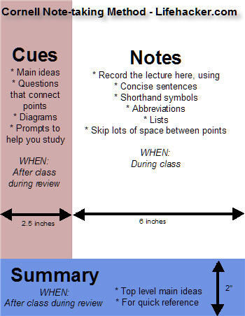
Note-taking Strategies: Cornell Method
Good for a more critical engagement with the lecture or text.
Separate sections for main notes, key themes/keywords, and points you wish to query or follow up.
Can use colour or shading to allow more depth.

Slide 13
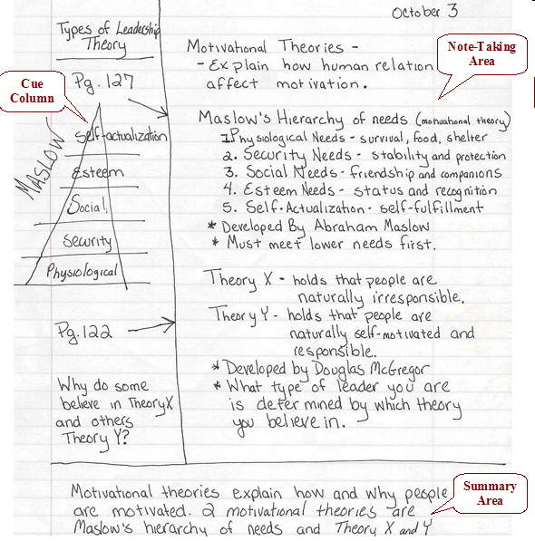
Note-taking Strategies: Cornell Adapted?
Use the Cue Column during the Lecture instead of after the class.
Provides space to ask questions, or thoughts, that come up as the lecture is going, but doesn’t ‘bog down’ the lecture notes themselves.
Harder to be actively critical as lecture is happening, but potential for greater critical depth

Slide 14
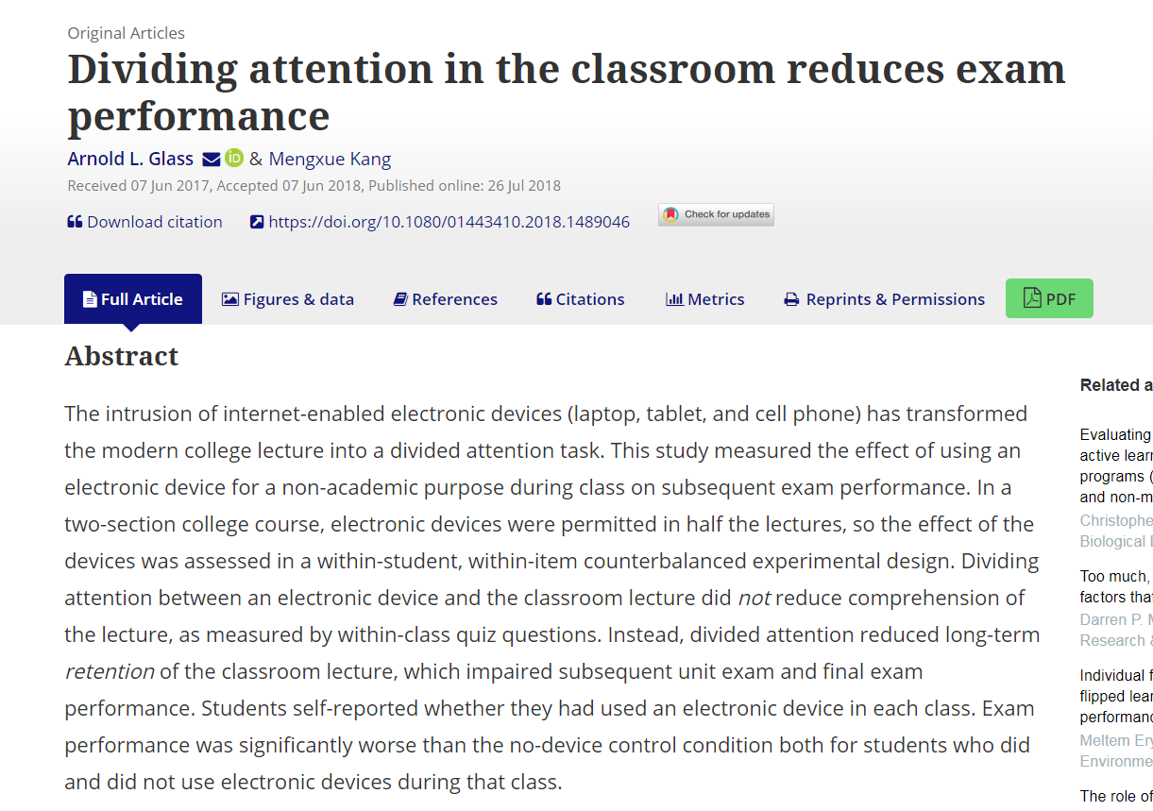
Using Technology
If you like to use phone, tablet or laptop for notes… explore and experiment with various Apps
Evernote, Notability, Zoho Notebook, Bear and Simplenote have all been suggested… but find out for yourself.
Wider point: the use of technology in lectures.

Slide 15
Your task…
The lecture will last approximately 45 minutes
Your job is to choose a note-taking style and take effective notes
You should aim to record as much factual information as you can
You should try to note down your own thoughts about what you are hearing too
We will see how effective your notes were afterwards

Slide 16
So how effective were your notes?

Slide 17
Quiz Time
According to healthliteracy.org.uk, what percentage of information in current circulation is written at too complex a level for working age adults (16-65 years)?
43%
How old was Jill, the single woman in the true story?
21
What source was used to demonstrate the scale of limited health literacy?
Public Health England (2015)
True or False: people will low health literacy find it less difficult to access appropriate health services.
False
Name two of the benefits mentioned of improving health literacy.
  Increases health knowledge
  Builds resilience
  Encourages positive lifestyle change
  Empowers people to manage long-term health conditions
  Reduces the burden on health and social care services

Slide 18
Quiz Time
What is ‘Teach-Back?’
Asking patients to demonstrate understanding using their own words…?
A way to confirm that you have explained to the patient what they need to know in a manner that the patient understands…?
What are the advantages of Teach-Back?
Discuss….

Slide 19
Contact
Dr Tom Cunningham
Academic Skills Tutor
Student Services
t.cunningham@dundee.ac.uk
For more information on the Academic Skills Centre see:
www.dundee.ac.uk/asc

Slide 20
dundee.ac.uk

