Slide 1
Getting the most out of your lectures
Carole Mooney
Senior Widening Participation Officer
wideningaccess@napier.ac.uk

Slide 2

Active learning at college/university
Retaining information
An individualised approach
Notes:
In this short presentation I’m going to talk about how you can get the most from your lectures by taking notes effectively.

Slide 3

Note making
What should you do in a lecture?
What kind of notes do you need?
Notes:
3
Active learning required good notetaking, this presentation will explain the kind of notes you need and what you should do to prepare for a lecture.
Before next slide – what are some of the differences between learning & teaching at university compared to college?

Slide 4

Studying at University
What is different at University?
  Lectures
  Tutorials/Seminars
  Independent learning
Why do we need to take notes?
  To help us remember what was covered
  Not everything is in textbooks
  To help us revise later
Notes:
Without active learning how much information (as a %) do we forget in only 3 weeks?

Slide 5
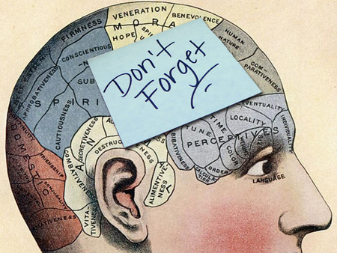
Why make notes?
Notes act as memory aid
  Tony Buzan (1999): Without active learning, we forget 98% of information in just three weeks
It actively involves you in the learning process
It helps to develop your understanding
It allows you to reduce information to a
manageable size
Notes are helpful when preparing assignments or for exams

Slide 6

Identify your Learning Style
Do you absorb information best by:
Listening and then writing the information down
Describing what you have just heard to someone
Creating diagrams to illustrate key concepts
Notes:
6
Recording lectures in real time? Perhaps record your own voice speaking from the notes you have taken so that you can play this back. Always check the audio recording policy at your institution.
Different methods of note taking for different purposes.

Slide 7
The note making process
Before lecture
After lecture
During lecture
The note taking process works best when……
…it is integrated into your learning strategy.
This can take many forms, but must suit you.

Slide 8

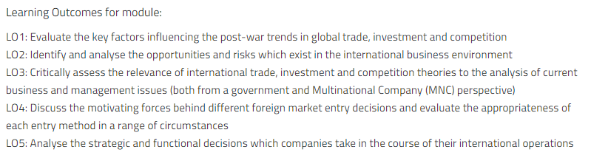
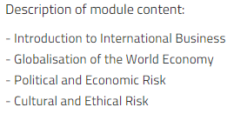

❶ Before: Prepare and tune in
Prepare:
  Develop a good understanding of the module / lecture learning objectives or outcomes
  Advance reading
  Print off and read the lecture outline (slides or notes)
  If relevant, read your notes from the previous lecture
  Look up subject-specific terms in advance
  Tune yourself into the topic by thinking of questions
  Top tip. Download each module descriptor as they set the parameters of learning and assessment
International Business, Edinburgh Napier University
Notes:
Going in to a lecture without doing any preparation makes it much harder to follow the lecture.
Even if you haven’t much time to prepare beforehand, you can still tune in by looking up the basics. Ask yourself who, what, why, where, when and how.
If the lecture is one of a sequence on a topic or field of study, it is important you have a good idea of what went before and where this lecture fits in.
Going into a lecture cold can leave you confused by terms you are unsure of and authors or concepts you have not heard of before. Familiarising yourself with these beforehand means you will get more out of what they lecturer is covering.
Thinking of questions beforehand helps you to know what you understand already and what you need to clarify. You may need to follow up these questions afterwards.

Slide 9
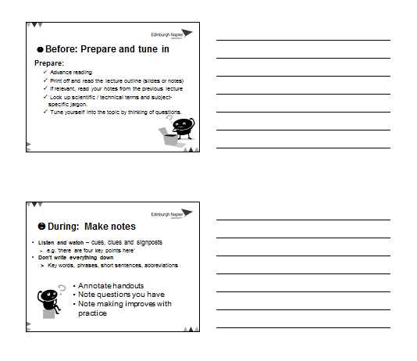
❷ During: Make notes
Annotate handouts
Note questions you have
Note making improves with practice
Notes:
MAKE POINT – SLIDES AMAY BE UP BEFORE LECTURE – STUDENTS MAY CONSIDER NOT ATTENDING
REASONS WHY YOU SHOULD ATTEND
Lecturers might bring something in to the lecture to demo something, or draw things as they go along.
May drop hints regarding assessments and exams. (lecturers often can’t help themselves)

Slide 10
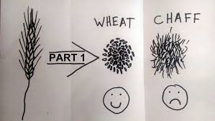
Lecturer signposting…
Framework: Lecturers often say at the beginning of a lecture how they have structured their lecture and what they are going to cover.
Don’t try to write everything down! Your goal isn’t to transcribe your lecturer word for word.
kizombaharmony.com
Notes:
Framework: Lecturers often say at the beginning of a lecture how they have structured their lecture and what they are going to cover. Listen carefully for this. It can provide a framework for your note making.
Don’t write everything down! Your goal isn’t to transcribe your lecturer word for word.
rather it’s to extract and record the main points of it.
Your lecturer will likely go off on tangents during the lecture!
The trick to successful note-taking is learning how to separate the wheat from the chaff.

Slide 11
Lecturer signposting…
Pay attention to cues – conscious or subconscious.
“You need to know this,” or “This will come up in your…”
Repetition is often used to reinforce key points.
Anything said very slowly, so that it can be taken down word for word.
If your lecturer starts talking more quickly, loudly or with more emphasis.

Slide 12
Lecturer signposting…
Look out for for language that shows relationships between ideas…
  first, second, third
  especially, most significant, most important, however, on the other hand
  because, so, therefore, consequently
  a possible explanation of this…
  it might be that…
  to clarify…
  Look out for language that signposts direction…
  later on I’m going to talk about…
  and now I’m going to…
Notes:
Here are a few cues your lecturer may give during the lecture.

Slide 13
Note taking style
You might want to:
  use colour coding, images or diagrams
  use a numeric model
  additional methods
  a combination of the above or whatever works for you
  Consider what style of note taking works best for you

Slide 14
Most students adopt their own abbreviations for note taking
& | and
? | question mark - a good way to remind yourself to ask about something or look this point up later on
∴ | therefore
≤ | smaller or equal to…
Adapted from The Open University (2013)

Slide 15
~ | approximately
↑ ↑↑ ↓ ↓↓ | increase rapid increase decrease rapid decrease
# | number
cf | contrast with/cross reference
Adapted from The Open University (2013)
Notes:
When you make quick notes, it helps if you can use a shorthand way of writing things down, and most students adopt their own set of familiar abbreviations. It is quite useful to shorten any frequently used words, and some common examples are given here.
Text Speak
Use of Emoji’s?

Slide 16
Other ways to capture
 | Process 1 | Process 2
Advantages | Less expensive | More effective
Disadvantages | Less effective | More expensive
Characteristics | Manual | Automatic
Evidence | Widely used | Laboratory testing
Notes:
If comparing perhaps one theory against another or different processes, you may be Able to quickly draw a table to capture the information.

Slide 17

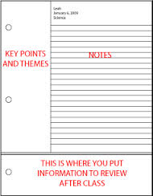
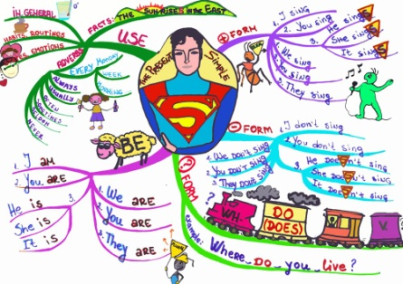
Get organised
How do you work best?
  What note-taking style works for you?
  Laptop? Planned?
  Mind maps?
Notes:
Not everyone is the same
Explore different styles
Be comfortable in your own style
Styles may vary subject-to-subject
With the advent of new technologies such as iPads and Smart phones note taking can be even easier than before. Investigate apps, such as Evernote, and note taking software such as Microsoft’s OneNote.

Slide 18
After a class: add value
Review your lecture notes
You might want to:
  Edit and clarify your notes
  Add further information
  Question some of what you have
  Add your own thoughts
It's not enough just to re-read notes...
you have to use them!
Notes:
Go through your notes adding material:
Clarification, definitions and links to other notes you may have.
Aim to relate the material to what you already know.
Look for patterns, check the evidence and examine the arguments.
Slide lecture notes: If there are slide lecture notes provided on the VLE, it is worth checking them for anything you missed and add this to your own notes. You probably won’t want to print out all or some of the slide lecture notes for every lecture, but it is worth saving them on your computer or a memory stick to have offline for revision purposes.
Rewriting notes neatly is usually a wasted effort – much better to actively clarify and add to them.
Use the time to add to your notes instead. You should seek to use your lecture notes as actively as you can. You want to be able to understand the ideas for yourself and that means engaging your brain as much as possible.
Ideally revisit your notes as soon as possible (within 24 hours)
Look over them again a few days later (within a week)
Use them again as the basis for your exam revision (within the semester)

Slide 19
In summary
Always refer to the module descriptor and use for guidance
Make notes in your own words
Use different methods for different purposes
  e.g. flowcharts for processes
  tables for comparison
Organise your notes
  title, date, page numbers – and file them
  combine all your notes from lectures, tutorials, independent study, group work etc. and compile for exam and assessment revision
Don't cram too much in – leave room to add in
Don’t leave reviewing notes until revision

Slide 20

Get Ready
http://getready.napier.ac.uk/

Slide 21
The Open University (2013). Effective note taking. Available from: http://www.open.ac.uk/choose/unison/develop/my-skills/effective-note-taking [accessed 22.11.16]

