Slide 1
Life as a first year student at university
Holly Robertson-Dick
Recruitment and Employability Manager
School of Biological Sciences

Slide 2
Introduction
Using Biological Sciences as an example:
The academic year
University of Edinburgh calendar 2018/19
Pathway to your degree
First year programme
A typical first year timetable
How you will be taught
Assessment
Support

Slide 3
The academic year
Semester 1 :
Teaching Blocks: 1,2 11 weeks
Revision Week 1 week
Exams 2 weeks
Vacation 3 weeks
Semester 2 :
Teaching Blocks: 3,4 11 weeks
Flexible Learning Week 1 week
Vacation 2 weeks
Revision Week 1 week
Exams28 4 weeks
RESIT EXAMS: AUGUST 2018
Notes:
11 week teaching blocks in each of the two semesters – so short exposure to learning outcomes.
In semester one, one week after teaching ends, exams begin.
Following Christmas holidays, Semester 2 begins. Exams start three weeks after teaching ends (slightly longer due to Easter break).
Resit exams in August. Encourage students to keep up with the course work and lecture content during the teaching weeks, study for and pass the exams. Get them out of the way and enjoy your summer vacation! Don’t want to be studying for exams over summer!

Slide 4
Pathway to your degree
Our Degrees:
BSc in Biological Sciences
Or
BSc in Biological Sciences with Management
Specialised in
One of our 12 Honours programmes:
Biochemistry; Biotechnology; Cell Biology; Development, Regeneration and Stem Cells; Ecology; Evolutionary Biology; Genetics; Immunology; Molecular Biology; Molecular Genetics; Plant Science; and Zoology

Slide 5
Pathway to your degree
Each year:
Students take 120 credits
Compulsory courses and elective courses
Years 1 - 3: Normally 6 x 20-credit courses
Year 1 - Provides most flexibility in your learning (6 x 20-credit courses)
Year 2 - Progressively more specialised (6 x 20-credit courses)
Year 3 - Junior Honours (6 x 20-credit courses)
Year 4:
Senior Honours (50% courses + 50% project = 120 credits)

Slide 6
First year programme
2020 entry to Biological Sciences degrees at the University of Edinburgh, likely to be 80 credits of compulsory courses for Biological Sciences degree pathway.
120 credits of compulsory courses for Biological Sciences with Management.
All courses are at SCQF Level 8!
Notes:
Challenging first year. Challenging because the content within each of the two 11-week terms will be new (new concepts and new learning and understanding) at Level 8. SWAP is a one-year course at Level 6.
Messages:
There will be challenges and this is worth making you aware because if you did choose to apply to us, were made an offer and wanted to accept that offer, we would not want you to lose your confidence!
It’s not impossible to succeed but you may need to be prepared to do some extra background reading to keep us with the course content.
Students come to us from across the globe with very different qualifications and so new students will have experiences slightly different prior learning and teaching.
Do your research in where you want to study at Higher Education Level. If the University of Edinburgh is where you want to study, then this is fantastic news! Not all universities will start at level 8, however, some year 1 is at SCQF Level 7, which you may decide is a more gradual step for you.

Slide 7
A typical first year timetable
Monday | L | P | P | P | L |  | T
Tuesday | L |  | L |  |  | L |  | T
Wednesday |  | L
Thursday | L |  | L |  |  | P | P | P
Friday | P | P | P |  |  | L | T
Most courses contain lectures, practicals (or workshops) and tutorials.
Generally: 9 lectures and 3 practicals per week, 3 tutorials (alternate weeks)
plus 15-20 hours of assigned work or independent study.
Notes:
9 hours of lectures per week, 8-9 hours of practical or workshops per week and 2-3 hours of tutorials per week. Adding up to 20-21 hours of contact teaching time. In addition to this you will need around 15-20 hours to do assigned course work of independent study. It’s like a full time job doing a degree at the University of Edinburgh.

Slide 8
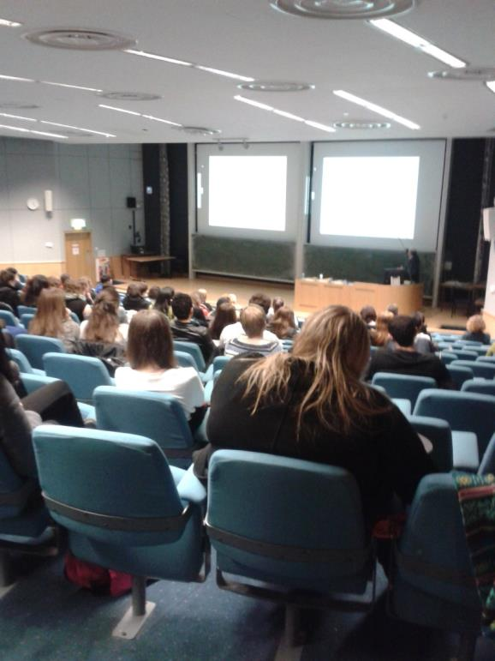
Teaching through lectures

Slide 9
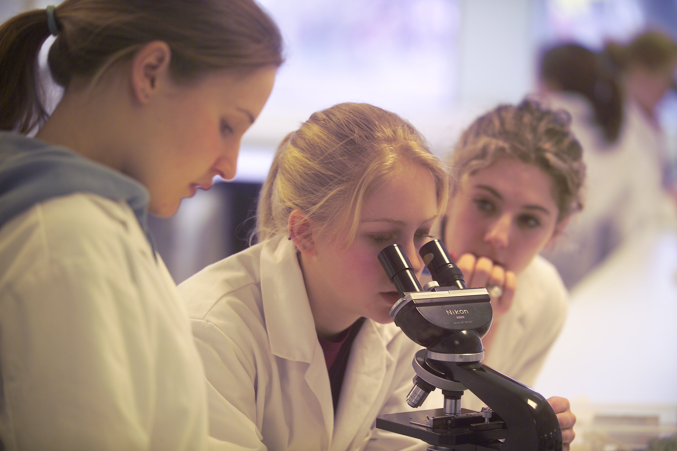
Teaching through practicals

Slide 10
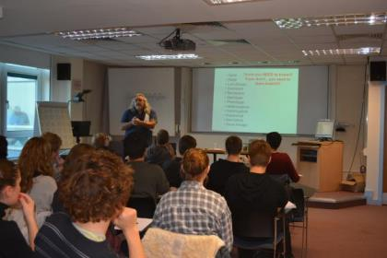
Teaching through tutorials

Slide 11
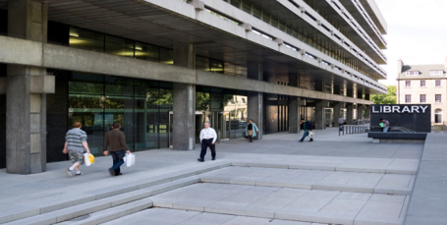
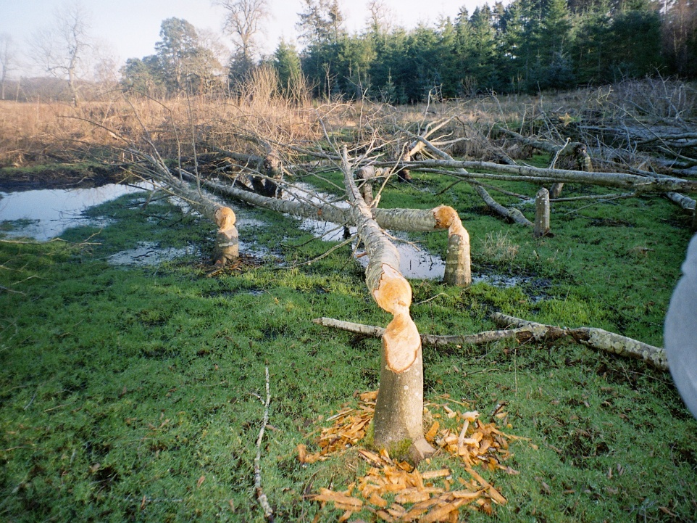
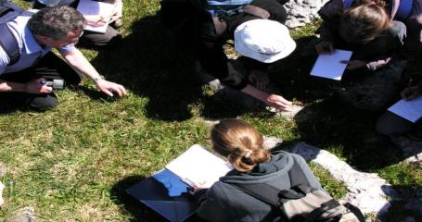
Field work and projects

Slide 12
Assessment
In course assessment and degree exam
In course assessment:
Often essay writing, practical reports, tutorial presentations and problem solving
Exam:
Often multiple choice questions, essays, short answer questions and problem solving questions

Slide 13
Main sources of support
Your subjects Teaching Organisation (Biology, for example)
Personal Tutor
Student Support
Fellow students (e.g. BioPALS)
Course teaching staff and fellow students (Academic)

Slide 14
Other sources of support
EUSA Advice Place
University Health Centre
Disability Service
Counselling Services
University Chaplaincy
Careers Service

Slide 15
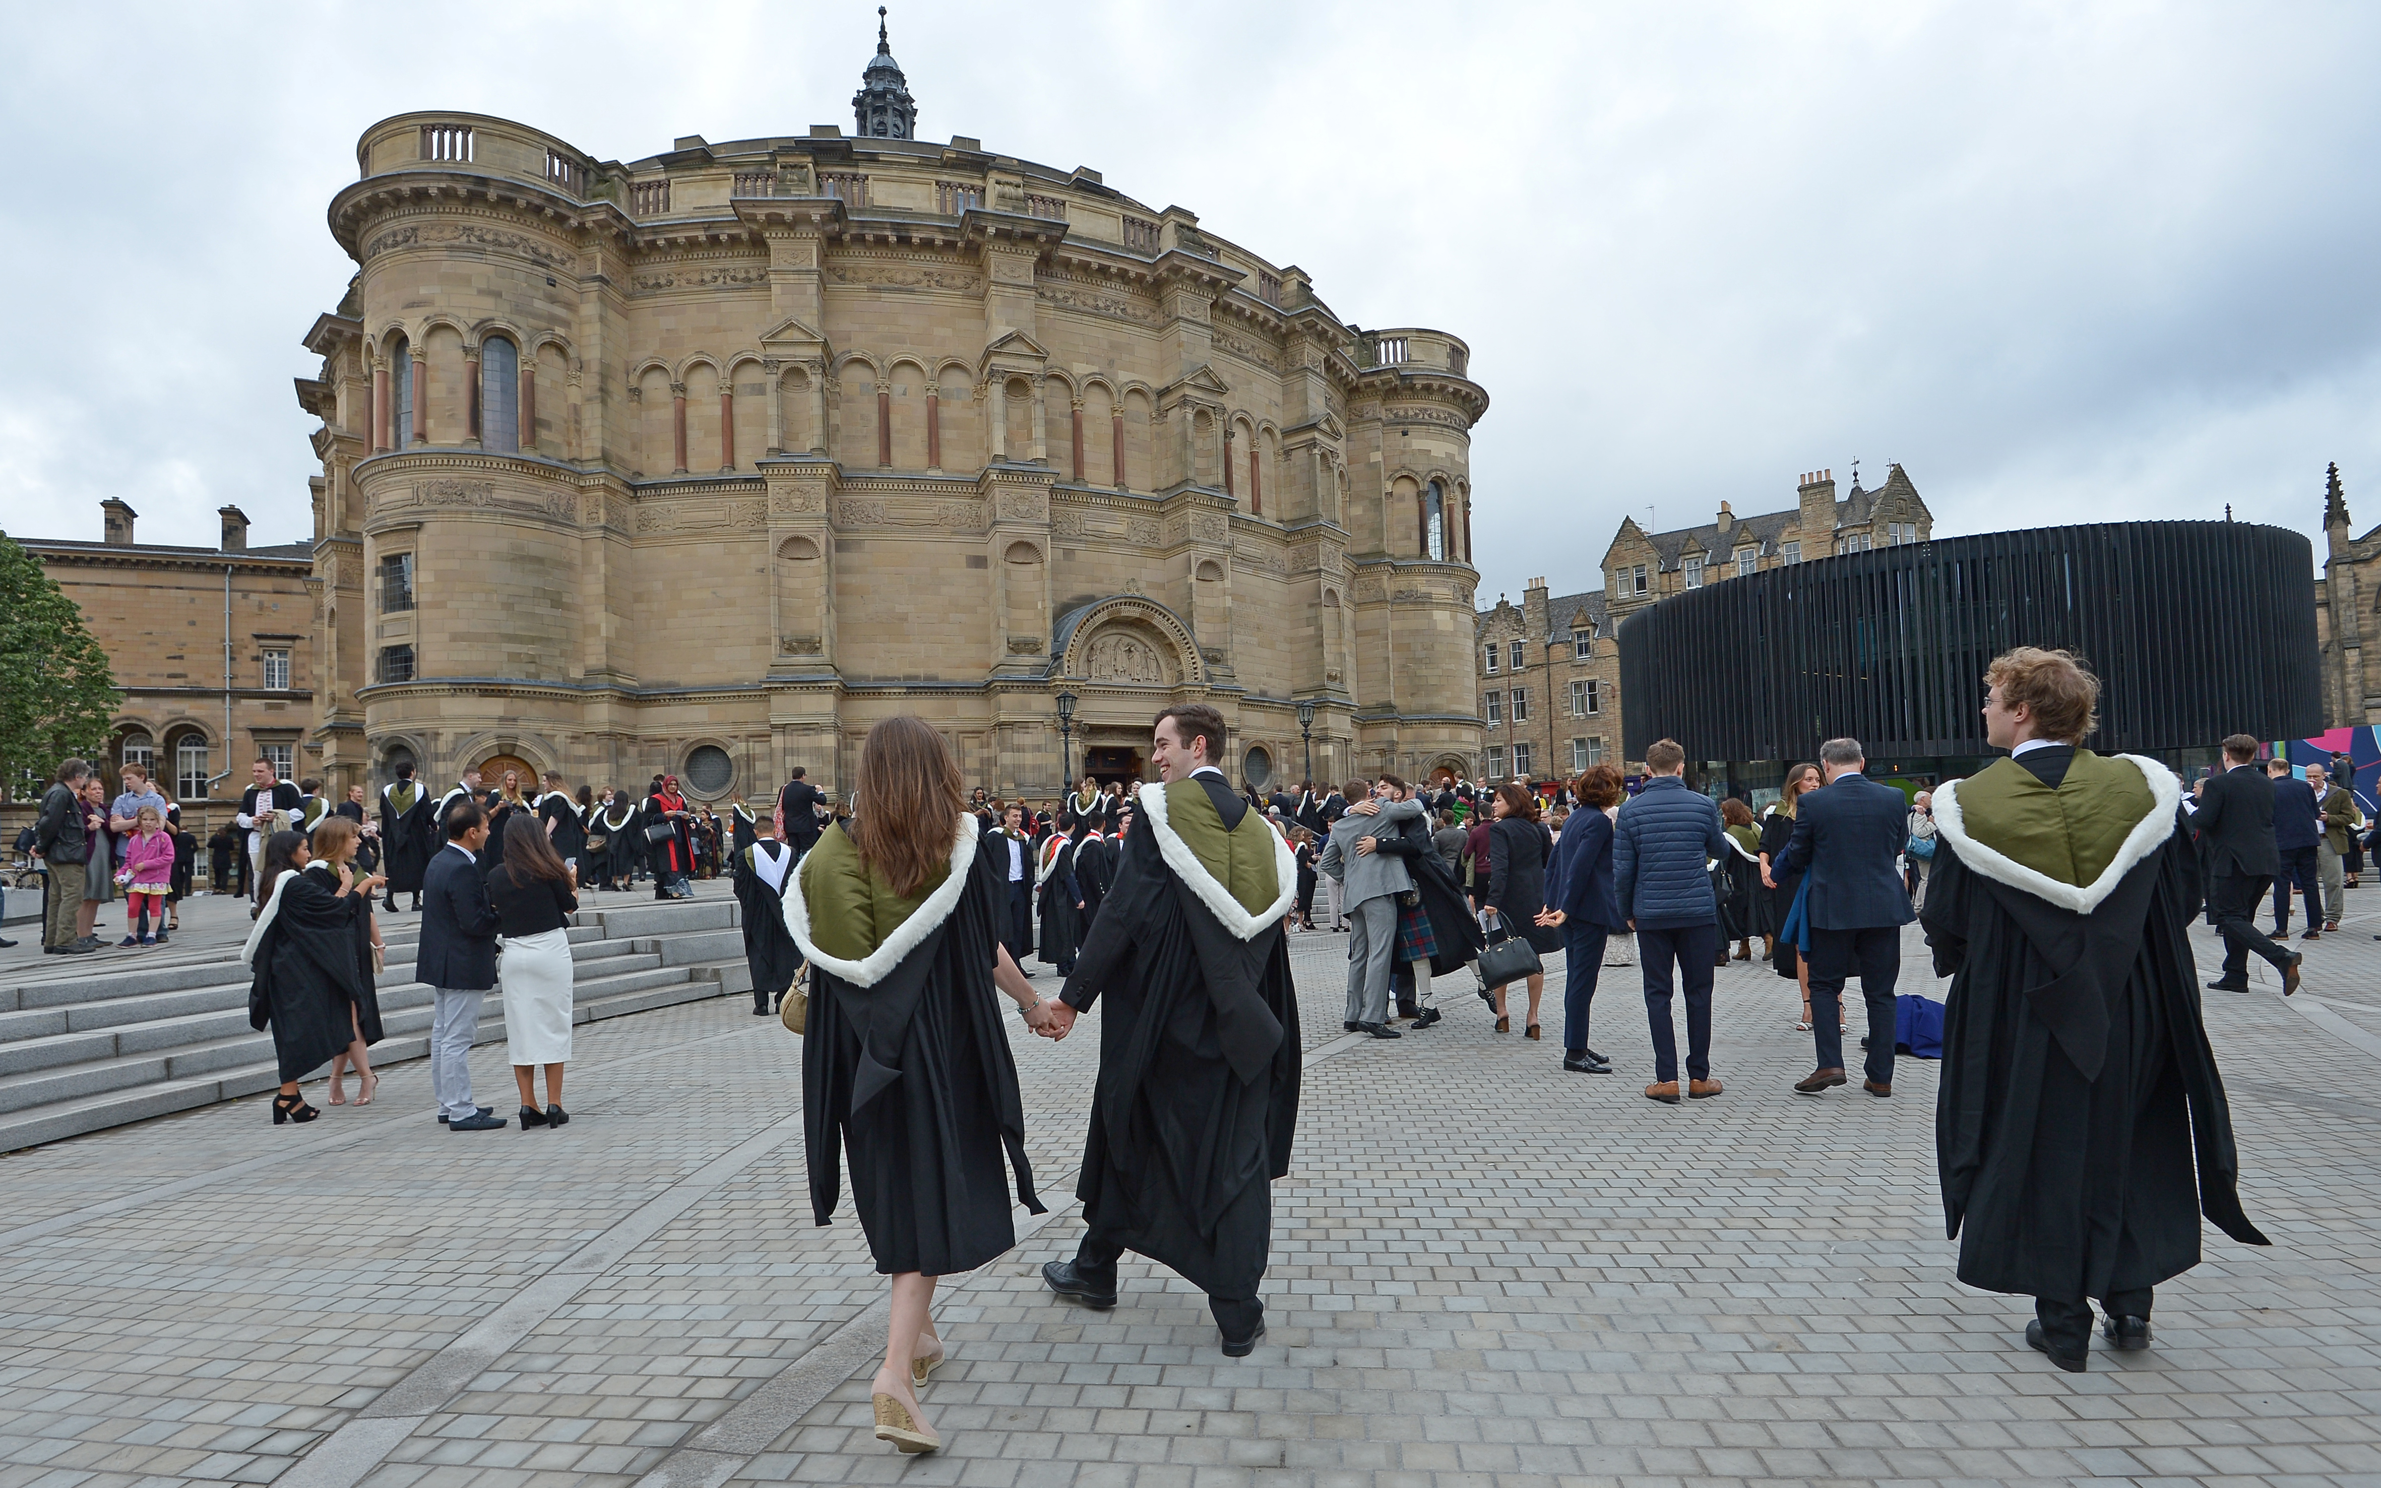
Graduation

