Slide 1

Critical Thinking
Dr Rosa Campbell, Effective Learning Service, Queen Margaret University
(also, Tutor in English Literature, University of St Andrews)

Slide 2
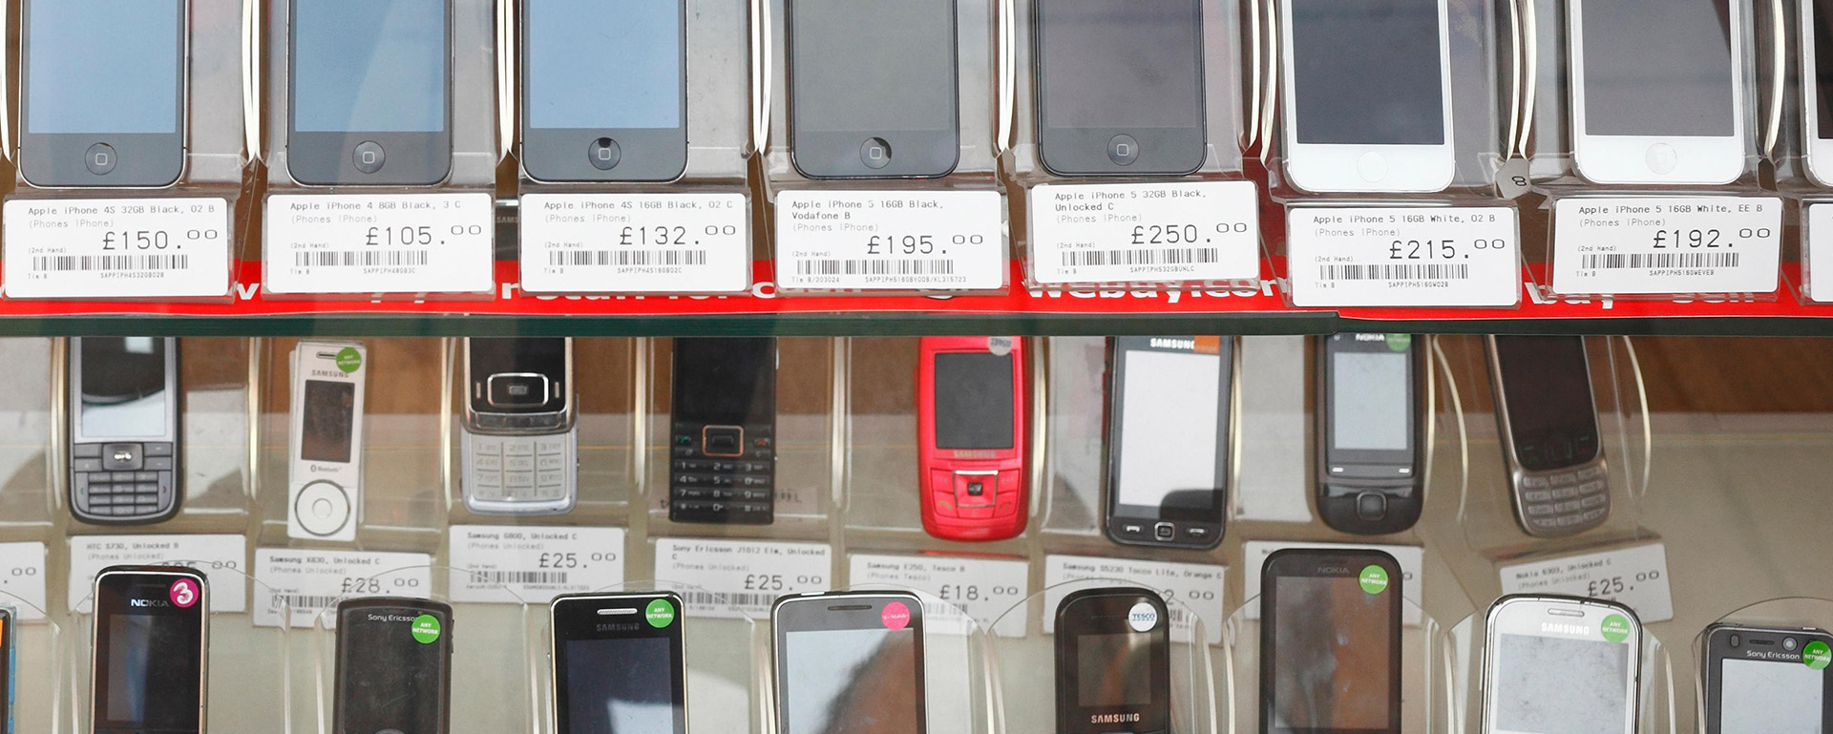
What would you ask?

Slide 3

What is critical thinking?
‘[The] active, persistent and careful consideration of any belief or supposed form of knowledge in the light of the grounds that support it, and the further conclusions to which it tends.’
—— John Dewey (1910)

Slide 4

What is critical thinking?
‘Critical thinking is the art of making clear, reasoned judgements based on interpreting, understanding, applying and synthesising evidence gathered from observation, reading and experimentation.’
—— Tom Burns & Sandra Sinfield (Essential Study Skills, SAGE, 2016)

Slide 5

What is critical thinking?
‘Good critical thinking includes recognising good arguments even when we disagree with them, and poor arguments even when these support our own point of view.’
—— Stella Cottrell (Critical Thinking Skills, Palgrave, 2005)

Slide 6
Critical thinking is about:
active engagement with texts / ideas
careful consideration & understanding
interpretation & evaluation
examination of evidence
asking questions & examining alternatives
intellectual independence

Slide 7

OR: Are you convinced?
If yes, why?
If not, why not?

Slide 8

Why think critically?

Slide 9


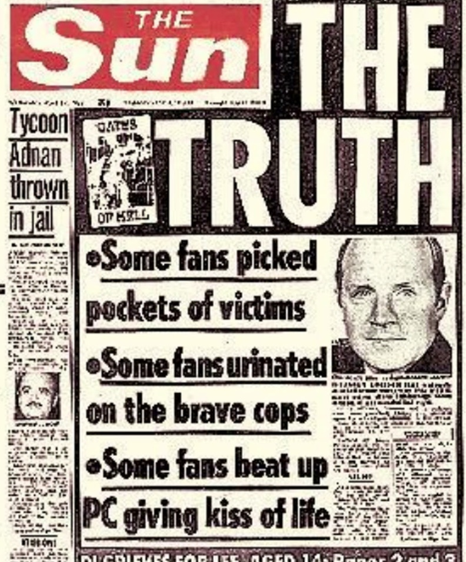
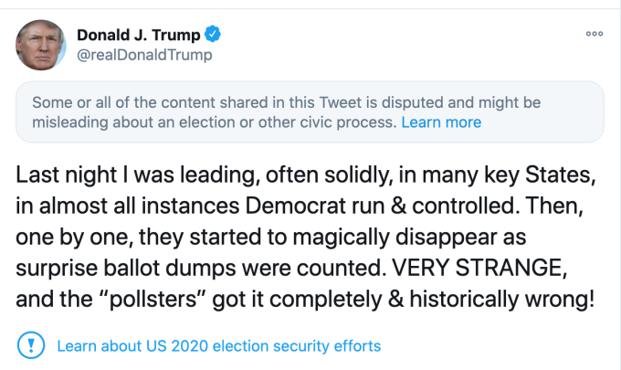

Slide 10
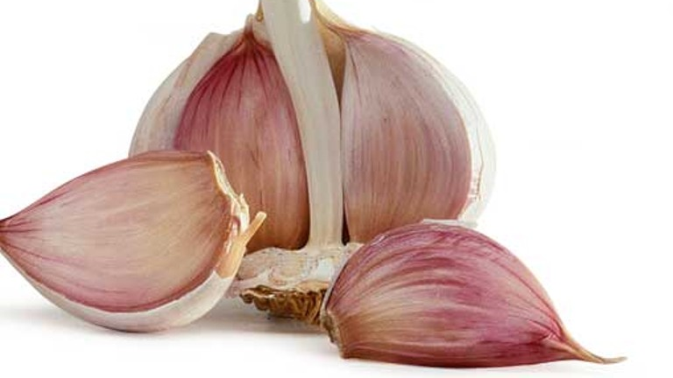
‘garlic can help prevent and cure a cold’
Source?
  GP
  Granny
  Garlic advert
  Government

Slide 11
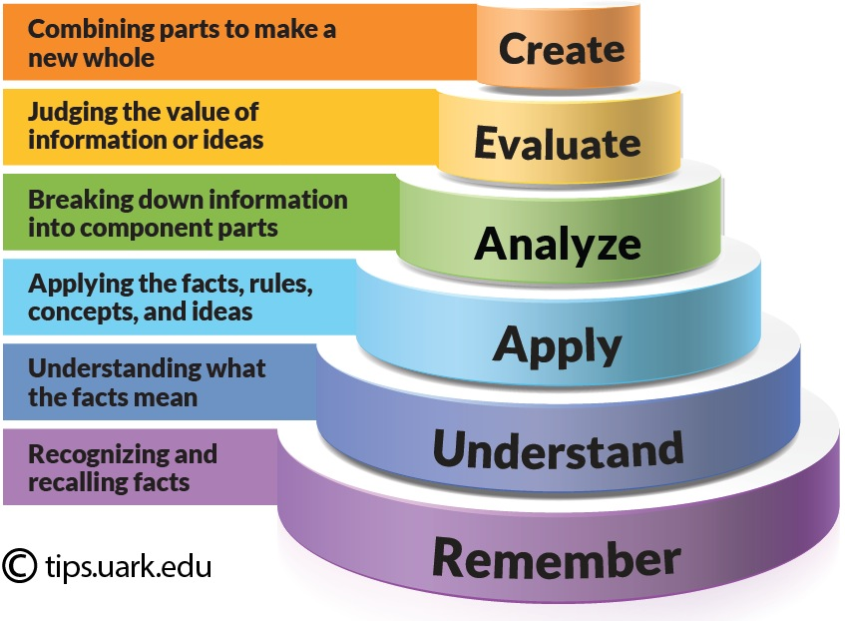
Why think critically?
Bloom’s Taxonomy

Slide 12
Academic success—
To get 40-50: “A passable answer which understands the question, displays some academic learning and refers to relevant literature. The answer should be intelligible and in general factually accurate, but may well have deficiencies such as restricted use of sources or academic argument, over-reliance on lecture notes, poor expression, and irrelevancies to the question asked. The general impression may be of a rather poor effort, with weaknesses in conception or execution. It might also be the right mark for a short answer that at least referred to the main points of the issue”.
Source: http://www.sps.ed.ac.uk/undergrad/current_students/teaching_and_learning/assessment_and_regulations/marking_descriptors

Slide 13
Academic success—
To get 50-60: A satisfactory answer with elements of the routine and predictable. It should be generally accurate and firmly based in the reading. It may draw upon a restricted range of sources but should not just re-state one particular source. Other authors should be presented accurately, if rather descriptively. The materials included should be relevant, and there should be evidence of basic understanding of the topic in question. Factual errors and misunderstandings of concepts and authors may occasionally be present but should not be a dominant impression. The quality of writing, referencing and presentation should be acceptable.

Slide 14
Academic success—
To get 60-70: A very good answer that shows qualities beyond the merely routine or acceptable. The question and the sources should be addressed directly and fully. The work of other authors should be presented critically. Effective use should be made of the whole range of the literature. There should be no significant errors of fact or interpretation. The answer should proceed coherently to a convincing conclusion. The quality of the writing and presentation (especially referencing) should be without major blemish.

Slide 15
Academic success—
To get 70+: “A sharply-focused answer of high intellectual quality, which adopts a comprehensive approach to the question and maintains a sophisticated level of analysis throughout. It should show a willingness to engage critically with the literature and move beyond it, using the sources creatively to arrive at its own independent conclusions”.

Slide 16

CRITICAL READING

Slide 17

READING IS FUNDAMENTAL!
(to all university study!)

Slide 18
Basic framework for critical reading
WHY
am I reading this?
WHAT
is the author trying to achieve?
HOW RELEVANT
is this to my work?
HOW CONVINCING
is the argument or evidence?
WHAT USE
can I make of this?

Slide 19
SUMMARY
Reading is fundamental! Take an active approach.
Critical thinking: think in terms of detail, analysis, investigation, critique.
Critical thinking → critical reading → critical writing → critical thinking
Question everything!
You’ve got this!

