Slide 1
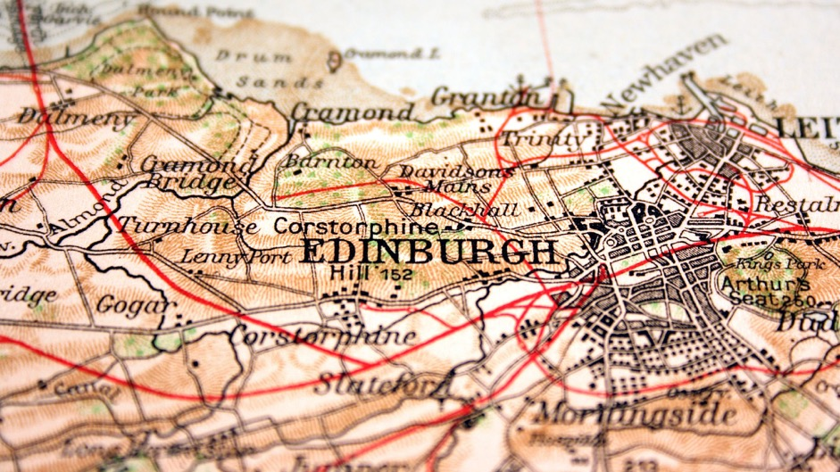
SWAP EAST Study Skills Event Arts, Humanities and Social Sciences
‘Edinburgh: A City of Literature and Duality’
Dr Anya Clayworth
Anya.Clayworth@ed.ac.uk

Slide 2
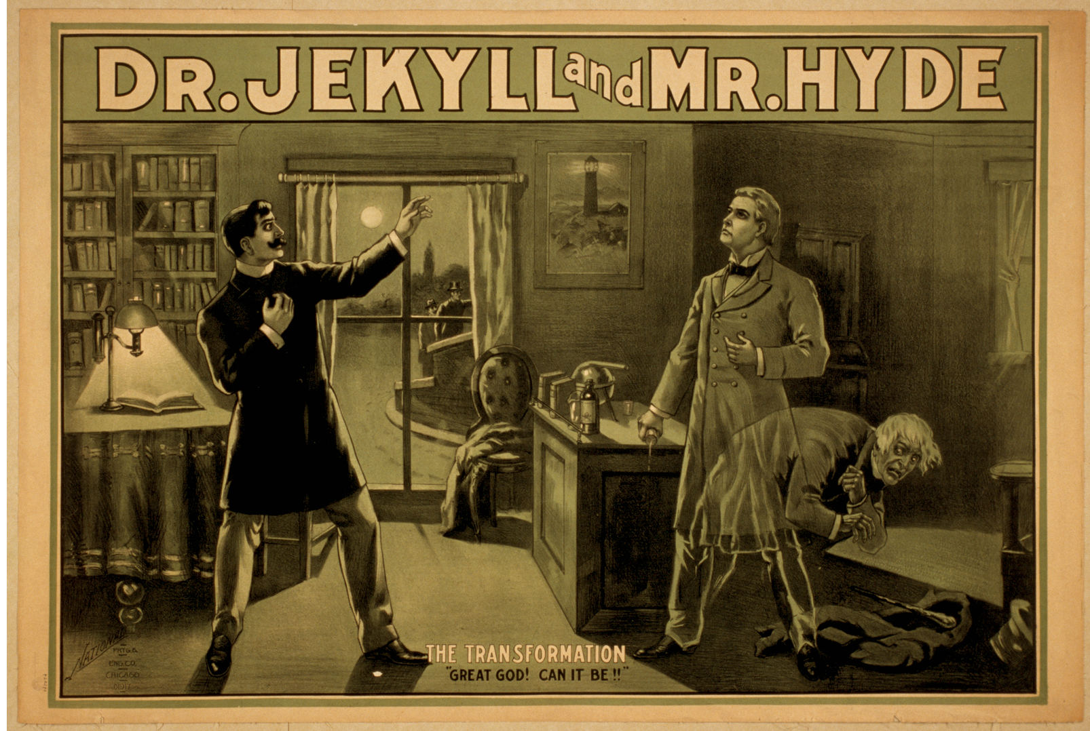
Definition of DUALITY (Cambridge English Dictionary): ‘the state of combining two different things.’

Slide 3
Robert Louis Stevenson: Strange Case of Dr Jekyll and Mr Hyde (1886)
‘With every day, and from both sides of my intelligence, the moral and the intellectual, I thus drew steadily nearer to that truth, by whose partial discovery I have been doomed to such dreadful shipwreck: that man is not truly one, but truly two.’

Slide 4
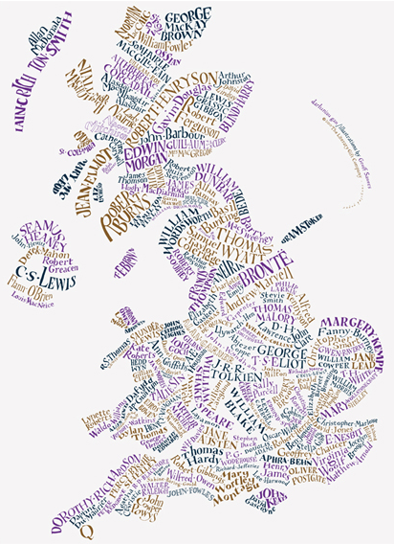
A Literary Map of the UK

Slide 6
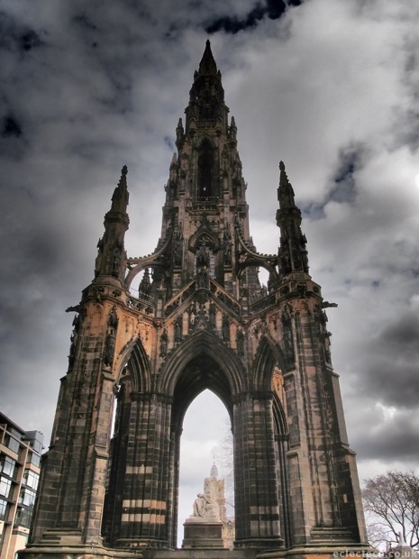
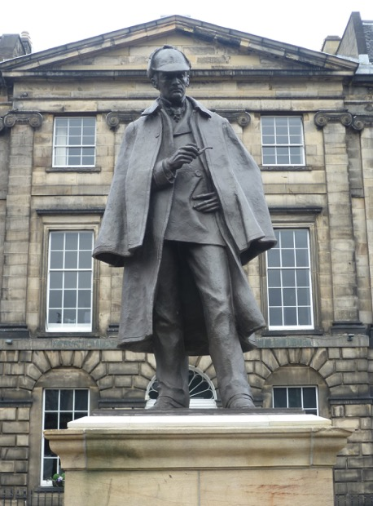
Literary statues in Edinburgh

Slide 7
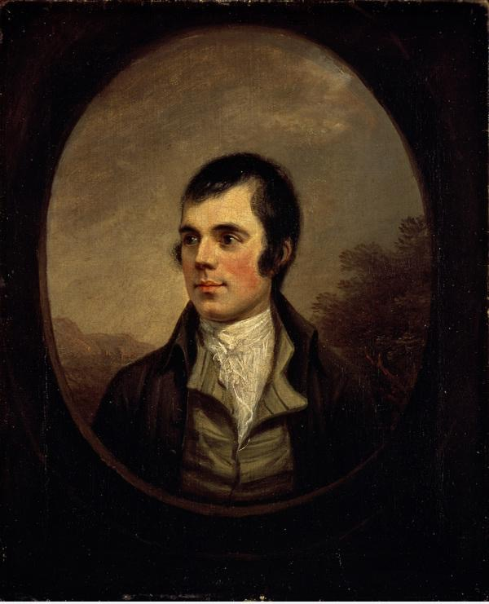
Robert Burns 1759-96

Slide 8
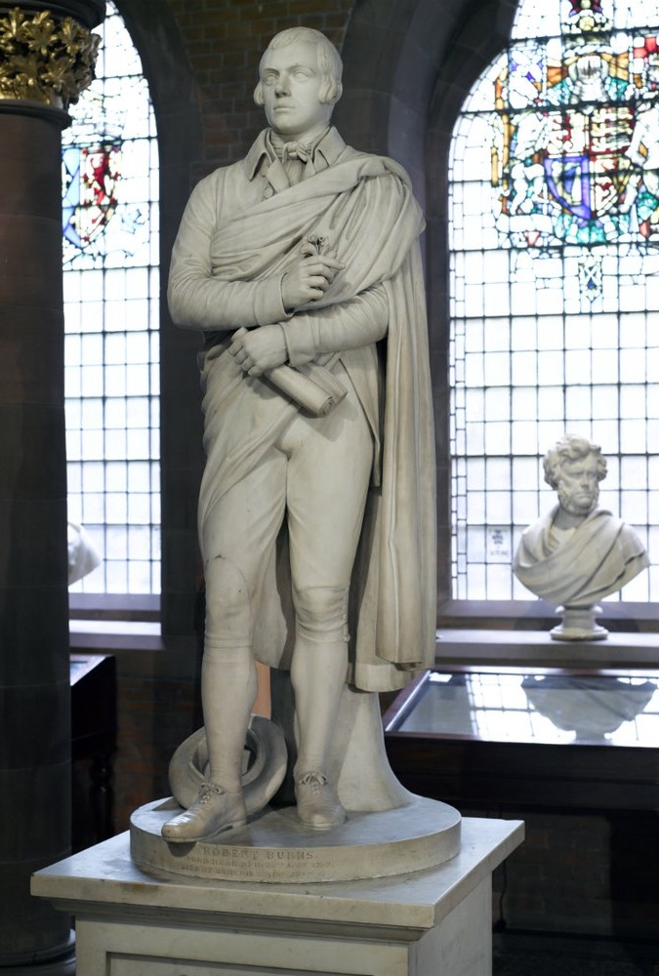
The Burns statue in the Scottish National Portrait Gallery

Slide 9
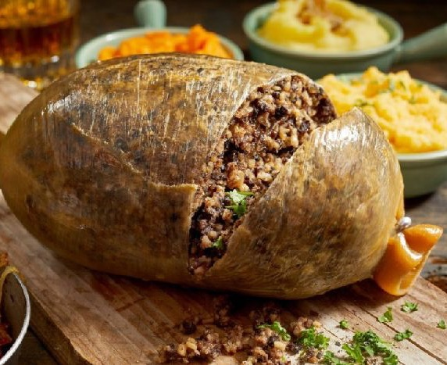
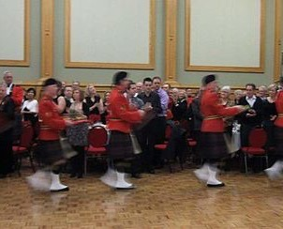
Burns Night 25 January

Slide 10
Evidence of Burns’ presence on the Edinburgh streets…

Slide 11
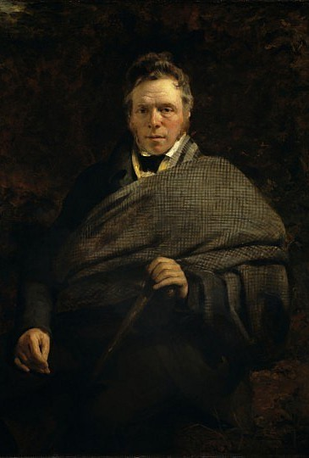
James Hogg 1770-1835

Slide 12
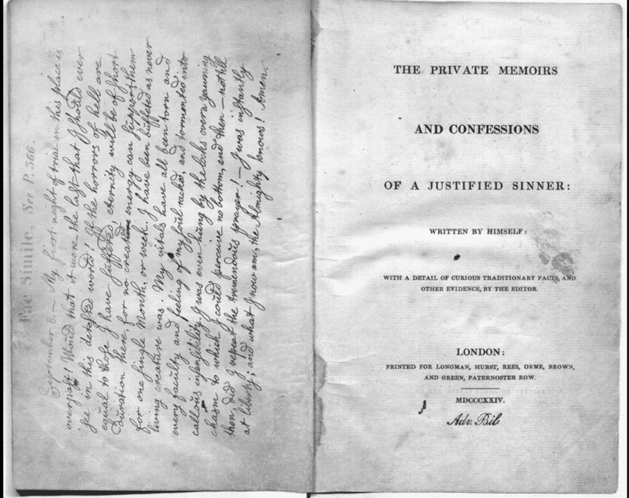
The Private Memoirs and Confessions of a Justified Sinner (1824)

Slide 13
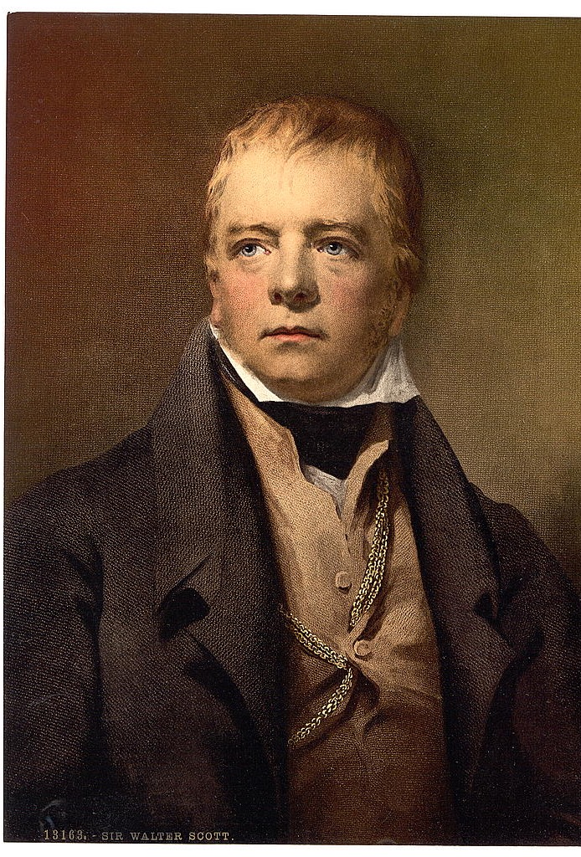
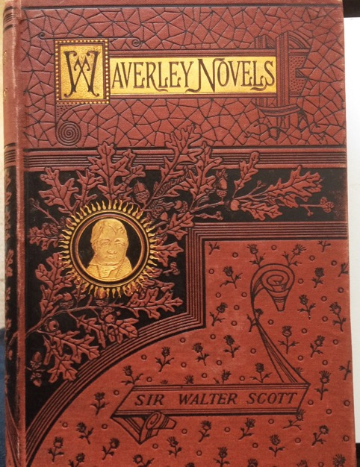
Sir Walter Scott 1771-1832

Slide 14
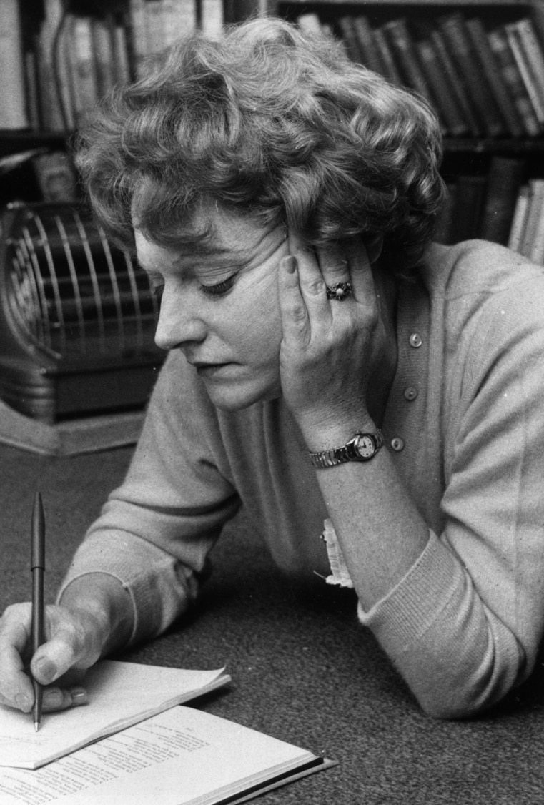
Muriel Spark 1918-2006

Slide 15
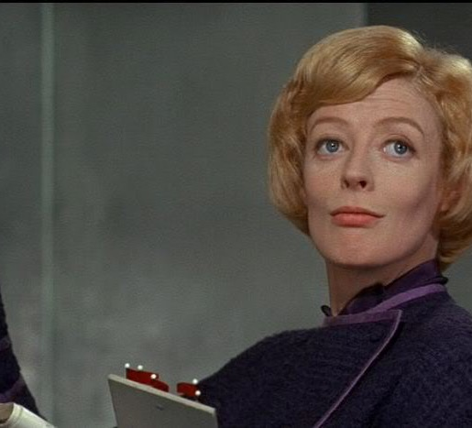
Maggie Smith as Jean Brodie in the 1969 film version of The Prime of Miss Jean Brodie

Slide 16
Writers’ Block Marchmont

Slide 17
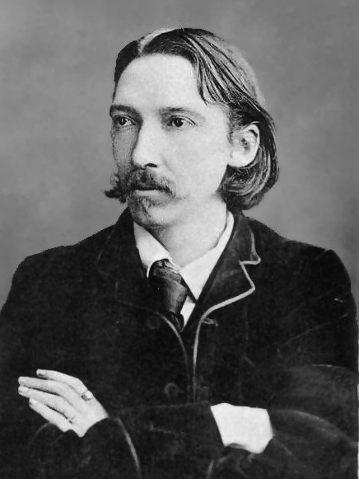
Robert Louis Stevenson 1850-1894

Slide 18
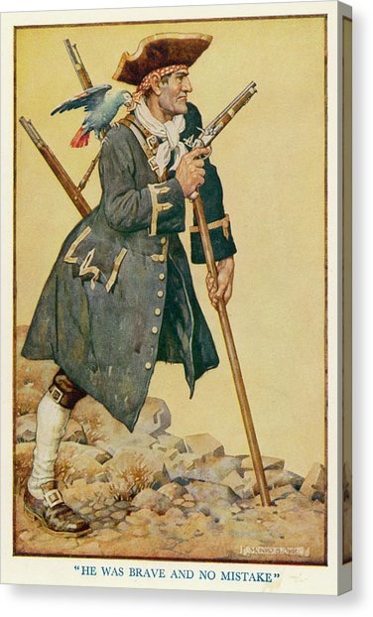
Stevenson’s iconic pirate Long John Silver from Treasure Island and the pirate he inspired…

Slide 19
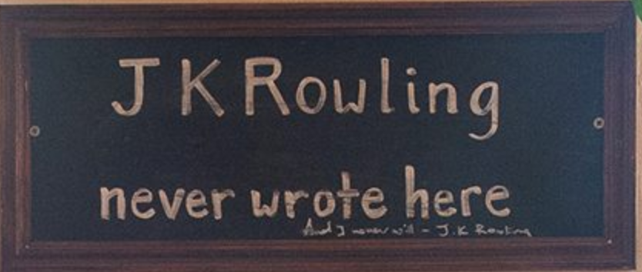
J. K. Rowling 1965-

Slide 20
The Elephant House café where J. K. Rowling wrote Harry Potter and the Philosopher’s Stone

Slide 21
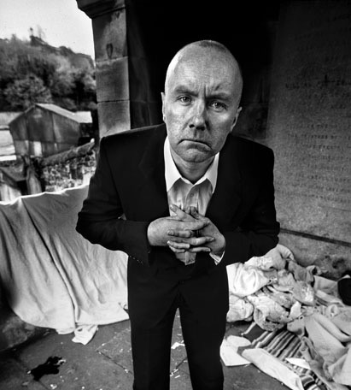
Irvine Welsh 1957-

Slide 22
Irvine Welsh’s Trainspotting (1993)

Slide 23
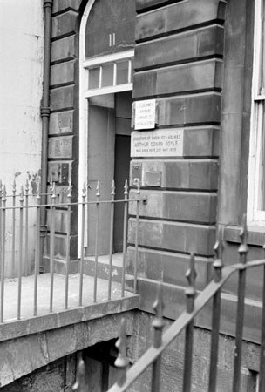
11 Picardy Place, Edinburgh

Slide 24
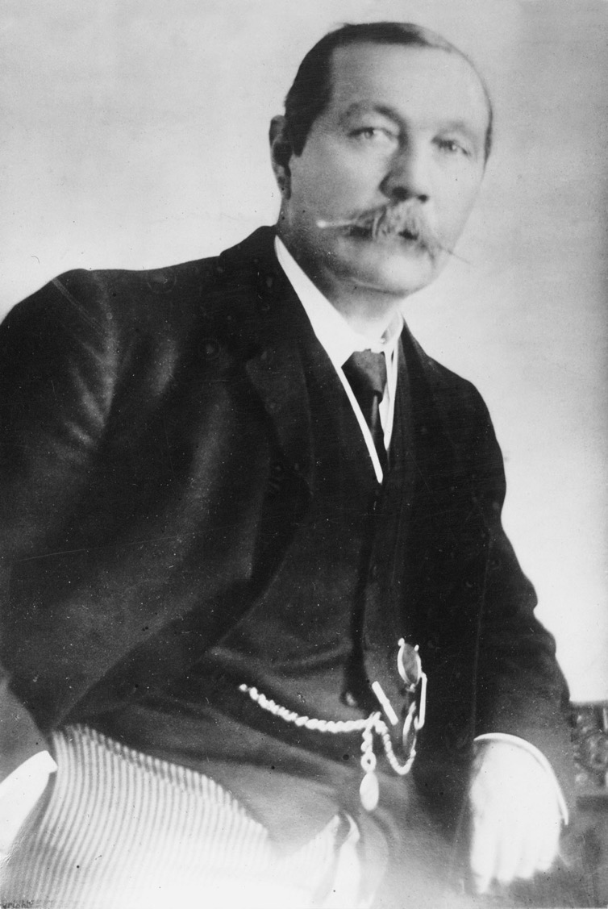
Sir Arthur Conan Doyle 1859-1930

Slide 25
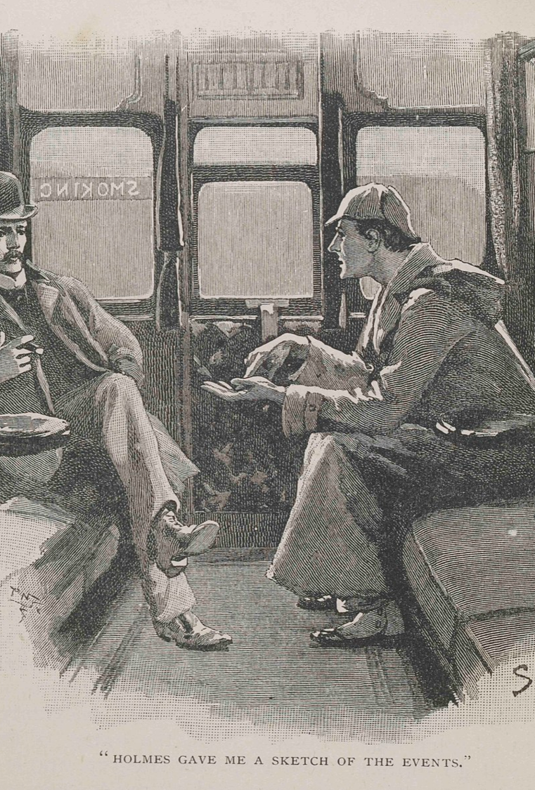
Arthur Conan Doyle in an interview for The Bookman (May 1892)
‘Sherlock Holmes was the literary embodiment of my memory of a professor of medicine at Edinburgh University, who would sit in the patients’ waiting room and diagnose the people as they came in, before even they had opened their mouths. He would tell them their symptoms. He would give them details of their lives, and he would hardly ever make a mistake.’

Slide 26
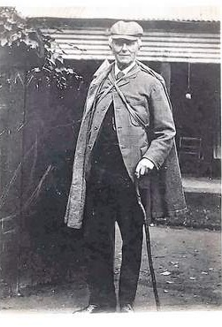
Joseph Bell 1837-1911

Slide 27
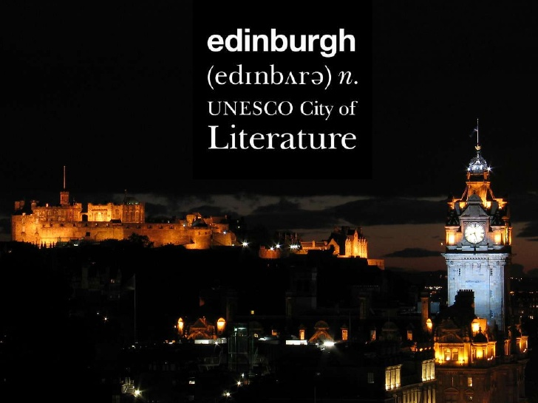
Centre for Open Learning The University of Edinburgh Paterson’s Land Holyrood Road Edinburgh EH8 8AQ E: Anya.Clayworth@ed.ac.uk W: https://www.ed.ac.uk/lifelong-learning Facebook: https://www.facebook.com/UoEShortCourses Instagram: https://www.instagram.com/UoEShortCourses/

