Slide 1

Take Note
Carole Mooney
Senior Widening Participation Officer
wideningaccess@napier.ac.uk

Slide 2

Active learning at college/university
Retaining information
An individualised approach
Notes:
Why do you think note taking is important when studying at university?

Slide 3

Note making
Why take notes? What kind of notes do you need?
What should you do in a lecture?
Notes:
3

Slide 4

Studying at University
What is different at University?
  Lectures
  Tutorials/Seminars
  Independent learning
Why do we need to take notes?
  To help us remember what was covered
  Not everything is in textbooks
  To help us revise later

Slide 5
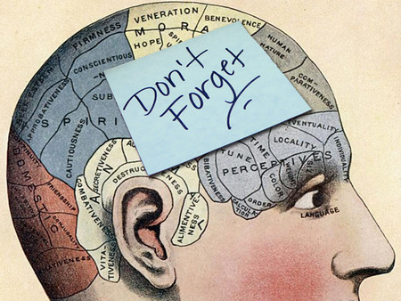
Why make notes?
Notes act as memory aid
  Tony Buzan (1999): Without active learning, we forget 98% of information in just three weeks
It actively involves you in the learning process
It helps to develop your understanding
It allows you to reduce information to a
manageable size
Notes are helpful when preparing assignments or for exams

Slide 6
The note making process
Before lecture
After lecture
During lecture
The note taking process works best when……
…it is integrated into your learning strategy.
Useful lecture notes
This can take many forms, but must suit you.

Slide 7
❶ Before: Prepare and tune in
Prepare:
  Advance reading
  Print off and read the lecture outline (slides or notes)
  If relevant, read your notes from the previous lecture
  Look up scientific / technical terms and subject-
  specific jargon.
  Tune yourself into the topic by thinking of questions.
Notes:
7

Slide 8
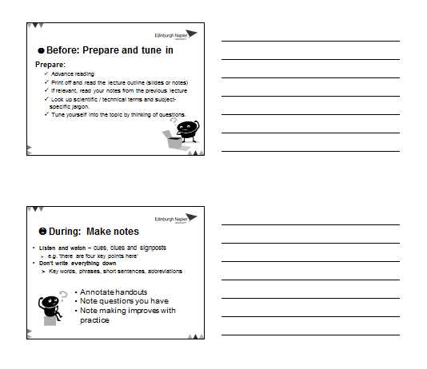
❷ During: Make notes
Annotate handouts
Note questions you have
Note making improves with practice

Slide 9
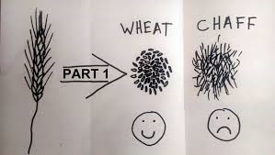
Lecturer signposting…
Framework: Lecturers often say at the beginning of a lecture how they have structured their lecture and what they are going to cover.
Don’t try to write everything down! Your goal isn’t to transcribe your lecturer word for word.
kizombaharmony.com

Slide 10
Lecturer signposting…
Pay attention to cues – conscious or subconscious.
“You need to know this,” or “This will come up in your…”
Repetition is often used to reinforce key points.
Anything said very slowly, so that it can be taken down word for word.
If your lecturer starts talking more quickly, loudly or with more emphasis.

Slide 11
Lecturer signposting…
Look out for for language that shows relationships between ideas…
  first, second, third
  especially, most significant, most important, however, on the other hand
  because, so, therefore, consequently
  a possible explanation of this…
  it might be that…
  to clarify…
  Look out for language that signposts direction…
  later on I’m going to talk about…
  and now I’m going to…

Slide 12
Most students adopt their own abbreviations for note taking
& | and
? | question mark - a good way to remind yourself to ask about something or look this point up later on
∴ | therefore
≤ | smaller or equal to…
Adapted from The Open University (2013)

Slide 13
~ | approximately
↑ ↑↑ ↓ ↓↓ | increase rapid increase decrease rapid decrease
# | number
cf | contrast with/cross reference
Adapted from The Open University (2013)

Slide 14
Other ways to capture
 | Process 1 | Process 2
Advantages | Less expensive | More effective
Disadvantages | Less effective | More expensive
Characteristics | Manual | Automatic
Evidence | Widely used | Laboratory testing
Notes:
If comparing perhaps one theory against another or different processes, you may be Able to quickly draw a table to capture the information.

Slide 15

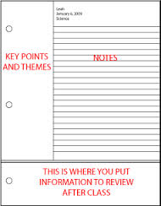
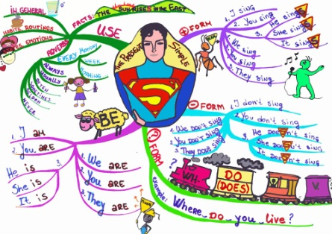
Get organised
How do you work best?
  What note-taking style works for you?
  Laptop? Planned?
  Mind maps?

Slide 16
Note taking style
You might want to:
  use colour coding, images or diagrams
  use a numeric model
  additional methods
  a combination of the above or whatever works for you
  Consider what style of note taking works best for you
nesslabs.com/from-note-taking-to-note-making
The Open University (2013). Effective note taking. Available from: http://www.open.ac.uk/choose/unison/develop/my-skills/effective-note-taking [accessed 03.02.21]

Slide 17

Identify your Learning Style
Do you absorb information best by:
Listening and then writing the information down
Describing what you have just heard to someone
Creating diagrams to illustrate key concepts
Notes:
17

Slide 18
After a class: add value
Review your lecture notes
You might want to:
  Edit and clarify your notes
  Add further information
  Question some of what you have
  Add your own thoughts
It's not enough just to re-read notes...
you have to use them!

Slide 19
In summary
Make notes in your own words
Use different methods for different purposes
  e.g. flowcharts for processes
  tables for comparison
Organise your notes
  title, date, page numbers – and file them
  combine all your notes from lectures, tutorials, independent study, group work etc. and compile for exam and assessment revision
Don't cram too much in – leave room to add in
Don’t leave reviewing notes until revision

Slide 20

Get Ready
http://getready.napier.ac.uk/

