Slide 1
Climate Change Impacts / Green Recovery Dr Andy Cross – School of GeoSciences 5th February 2021 andrew.cross@ed.ac.uk

Slide 2
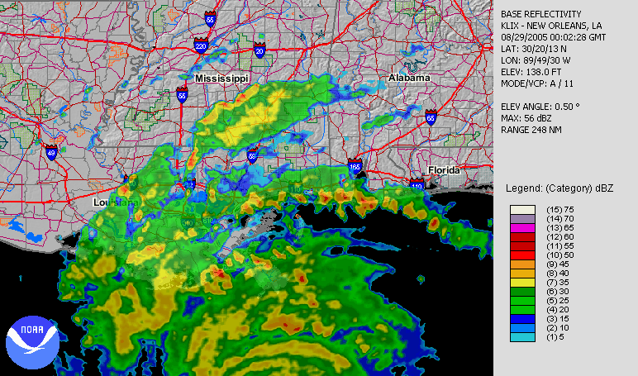
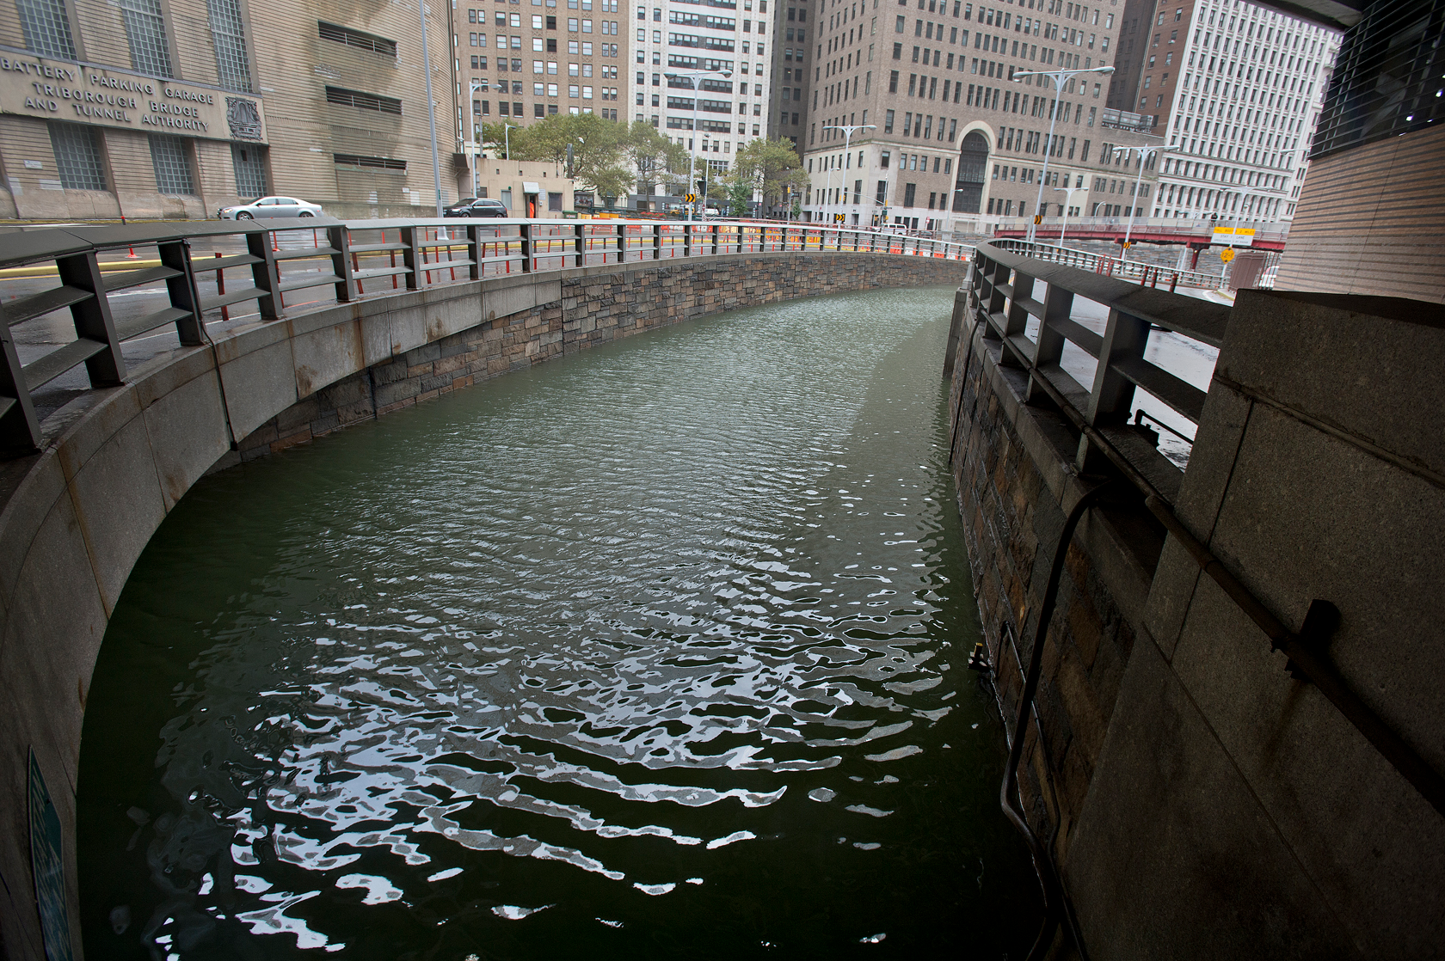
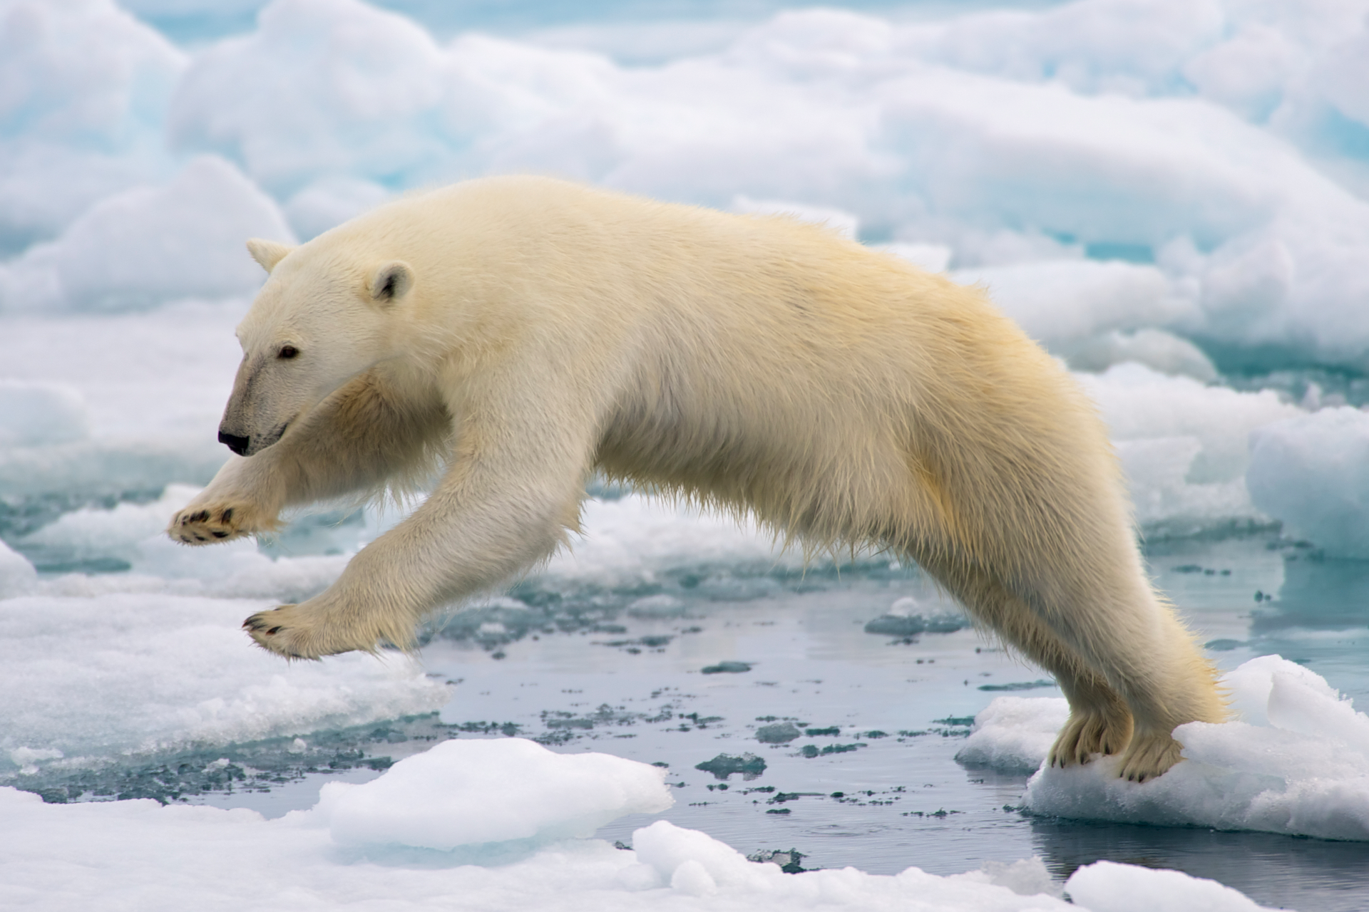
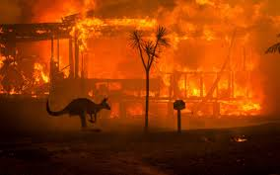
What is climate change?
Notes:
Brooklyn Battery Tunnel, Photo: Metropolitan Transportation Authority / Patrick Cashin (CC BY 2.0) https://en.wikipedia.org/wiki/Hurricane_Sandy#/media/File:Hugh_L._Carey_Tunnel_during_Hurricane_Sandy_vc.jpg
Flooding at Marblehead, MA, Photo: “The Birkes” (CC BY 2.0) https://en.wikipedia.org/wiki/Hurricane_Sandy#/media/File:Flooding_in_Marblehead_Massachusetts_caused_by_Hurricane_Sandy.jpg
Polar bear jumping on fast ice; Photo: Arturo de Frias Marques (CC BY-SA 4.0) https://en.wikipedia.org/wiki/Polar_bear#/media/File:Polar_Bear_AdF.jpg
Katrina radar; Photo: NOAA (public domain) https://en.wikipedia.org/wiki/Hurricane_Katrina#/media/File:Hurricane_Katrina_LA_landfall_radar.gif

Slide 3
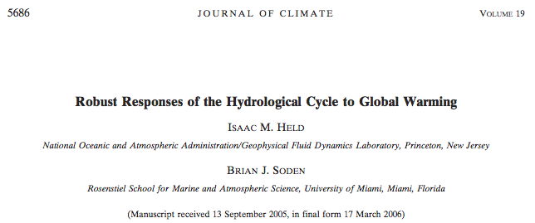
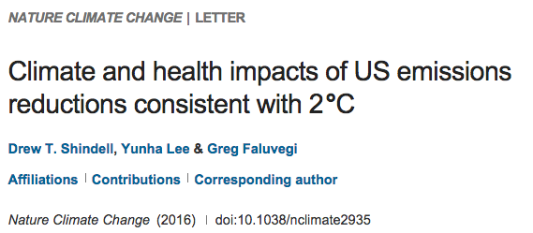
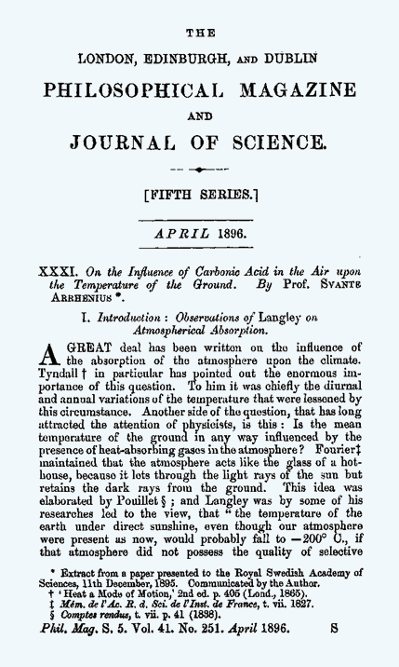
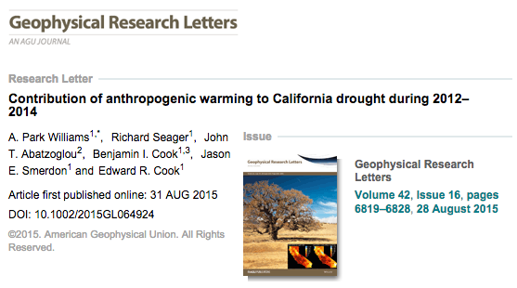
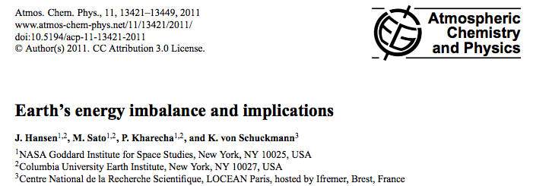
PEER REVIEWED LITERATURE

Slide 4
“Humanity is the major influence on the global climate change observed over the past 50 years. Rapid societal responses can significantly lessen negative outcomes.”
“It is clear from extensive scientific evidence that the dominant cause of the rapid change in climate of the past half century is human-induced increases in the amount of greenhouse gases…”
“The scientific evidence is clear: global climate change caused by human activities is occurring now, and it is a growing threat to society.”

Slide 5
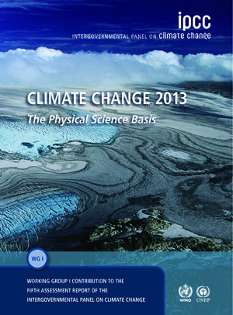
Intergovernmental Panel on Climate Change (IPCC)
International council of scientists and policymakers regularly outline the “state of the science”
Latest report freely available: https://www.ipcc.ch/report/ar5/

Slide 6
Intergovernmental Panel on Climate Change (IPCC)
“Human influence has been detected in warming of the atmosphere and the ocean, in changes in the global water cycle, in reductions of snow and ice, in global mean sea level rise, and in changes in some climate extremes.”
“It is extremely likely that human influence has been the dominant cause of the observed warming”
Notes:
Main conclusion of IPCC

Slide 7
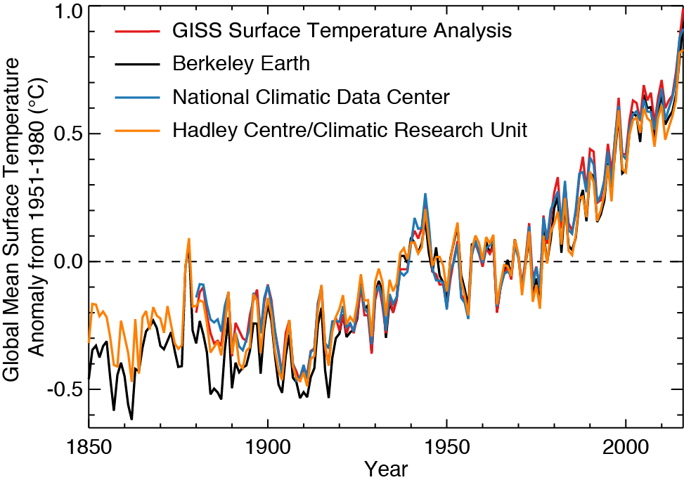
Warming is Unequivocal
ΔT ~ 1.0°C = 1.8°F
Anomaly:
Difference from average
Independent analyses of observations agree: Earth is warming
→ Global Warming
Notes:
Graphic produced by Eric Leibensperger from raw data.

Slide 8
Warming is Unequivocal
Recent years warmest on record
ΔT ~ 1.0°C = 1.8°F
Anomaly:
Difference from average
Independent analyses of observations agree: Earth is warming
→ Global Warming
Notes:
Graphic produced by Eric Leibensperger from raw data.

Slide 9
Attributing Climate Change
Observations
Model input = Natural drivers
Model input = Natural +
anthropogenic drivers
[IPCC, 2013]
Global climate models cannot reproduce observations without incorporating anthropogenic CO₂ emissions
Additional observational analyses have found the climate change “fingerprint” of anthropogenic CO₂ emissions

Slide 10
The Evidence is In: Earth’s Climate is Changing
Worst case scenario
Future change depends on trajectory of CO₂ emissions
Best case scenario
[IPCC, 2013]
We know:
- The climate is changing
- Climate change is anthropogenic
- Regulating CO₂ is the only way to mitigate future changes

Slide 11
How warm will it get?
Notes:
Before we investigate what the future impacts of climate change might be, we have to understand how much global average temperatures could rise. Climate change impacts will be largely dependent on how much warming we experience, and how quickly this occurs.
The amount that the climate will warm over the next century will be largely determined by the atmospheric concentration of greenhouse gases. By using climate models, scientists are able to map out the relationship of how the climate will warm for a given greenhouse gas concentration.
Many different climate models have been generated and run to analyse this relationship and predict future temperature increases. It’s important to note that some of the specifics of these models vary, and the exact relationship is uncertain—it is determined by a range of complex factors, interactions and feedbacks in the Earth system. The Intergovernmental Panel on Climate Change (IPCC), a UN a scientific intergovernmental body [if you're unsure or need some guidance of what the IPCC is, briefly review the content here)], have collated a wide range of model outputs and map out this variability in the form of error bars. Therefore, for a given greenhouse gas concentration, we can see the range of possible temperature changes which could occur.
Although there is uncertainty over how much warming will occur for a given greenhouse gas concentration (i.e. the climate response), the largest uncertainty is us: how much will humans emit in the coming century? The IPCC model this uncertainty through the use of “scenarios” (or the technical term 'Relative Concentration Pathways'; RCPs), which vary depending on how much action we take to reduce (or increase) our greenhouse gas emissions.
Source: Intergovernmental Panel on Climate Change (IPCC), 5th Assessment Report (AR5)
Our climate models predict that warming by 2100 could range anywhere between 1.5°C and 6°C depending on our future GHG emissions. Such a wide range in projected warming means that the resultant climate change impacts also vary dramatically—many with devastating consequences.
In 1992, the United Nations established the UN Framework Convention on Climate Change (UNFCCC), an international treaty comprised of 196 parties with an aim to limit greenhouse gas emissions to a level which would avoid “dangerous” climate change. Since then it has been decided that this “safe-dangerous” threshold (a level of warming which we think we can largely adapt to) is 2°C above pre-industrial levels. A 2°C warming limit has been adopted as an international target. To achieve this target we would need to see significant GHG reduction efforts—at the moment we’re currently on track for a warming of 3-4°C. In the UN international negotiations in Paris in 2015 (known as “COP21”), countries submitted their proposed GHG reduction plans; when we add all of these commitments together, we’re projected to reach 2.7°C warming (assuming that all nations fulfil their targets).
Is 2°C a “safe” level of warming? The answer is rather subjective. A 2°C warmer world will have varied impacts for different nations and groups. The livelihoods of a number of nations (such as low-lying islands) are particularly vulnerable to a warming of 2°C. At the Paris 2015 negotiations, the most vulnerable nations pushed for this target to be lowered to 1.5°C. Limiting warming to 1.5°C, however, is likely to be a scenario beyond our reach.

Slide 12
Climate Change Impacts

Slide 13
Climate Change and Covid 19
Big drop in emissions:

Slide 14
Climate Change and Covid 19
Blip, or build back better?:

Slide 15
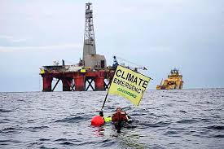
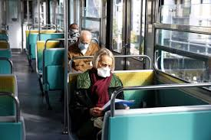
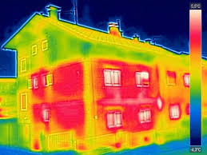
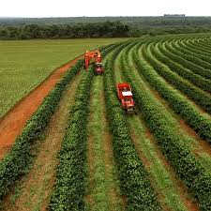
Climate Change and Covid 19
(Some) Crucial Sectors for
Green Recovery:
Energy
Transport
Buildings
Land Use
Education

Slide 16
Thanks for listening!
Any questions?
andrew.cross@ed.ac.uk

