Slide 1
Moving from college to university
Tracey Kerr, Widening Participation Manager, Heriot-Watt University
Access to Languages student, class of ????

Slide 2
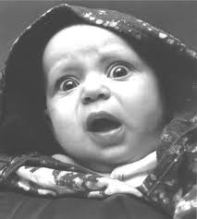
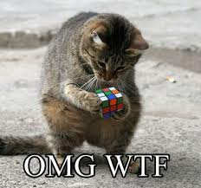
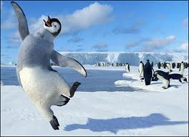
Personal reflections

Slide 3
Is it only me?
What I thought at first
Excited, nervous, anxious, glad – a huge mix of emotions
Lost, confused, small, ‘out of place’
Not confident – what am I doing here, what makes me think I can do this
A totally different life
Reality check
Students come in all shapes, sizes and types
Mature students, do fit in, don’t stick out, are often sought after/out by staff and students
2021 – shared experiences
Science – always something new and interesting for everyone

Slide 4
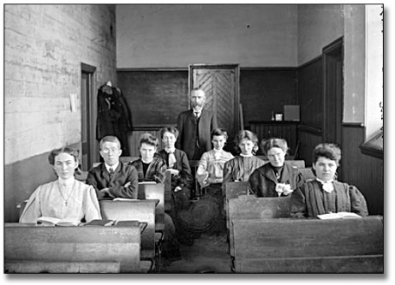
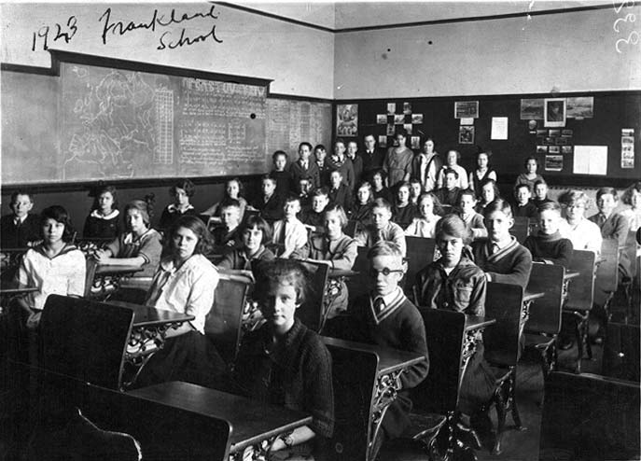
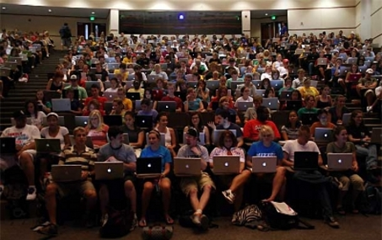
What are the differences

Slide 5
What are the differences?
Cultural differences
More direct teaching
Smaller classes
More use of continuous assessment
Skills Gaps
Practical skills – taking lecture notes, researching, etc
Conceptual notions – critical thought
Independent learner – more emphasis on private study, own ideas
Essays and reports – more discursive, more analytical, more independent
Group work is really important

Slide 6
How to survive
Involve family and friends
BE realistic – don’t be too proud or too scared
ASK FOR HELP
Keep sight of why you started this
Be positive about being a mature student
Prioritise – both your university and prive life
Give yourself time to settle in!

Slide 7
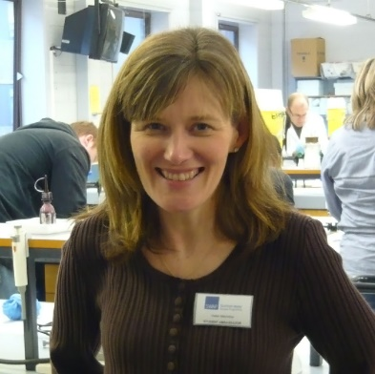
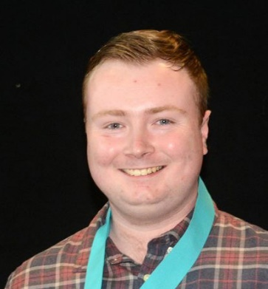
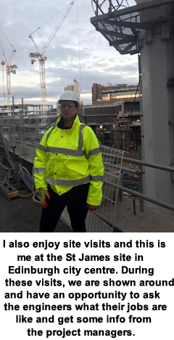
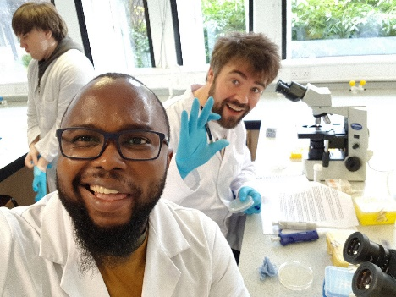
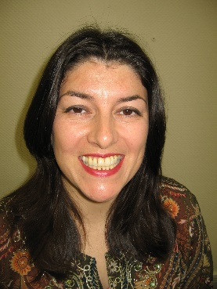
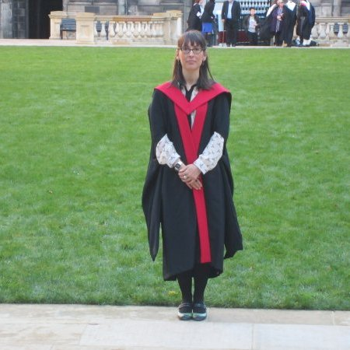
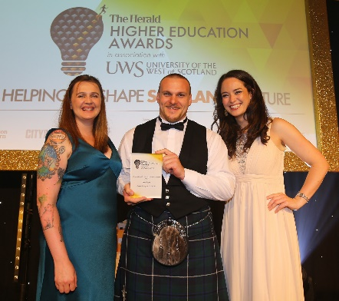
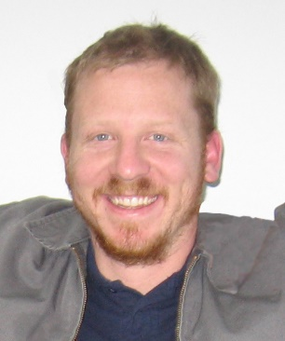
The future of SWAP
From access student to: -
Helen / Dylan - teaching
Allen Iruoesiri – Aquaculture officionado
Jacqueline Maitland – she’s going to crack Fusion Technology!
Frances Cunningham – Civil and Environmental Engineer (St James Centre site visit)
Andressa Gadda – Head of Policy and Research, Scottish Child Abuse Enquiry
Iain Scott – dietician and award winner
Kevin Stapleton (Kako) – playing with million pound telescopes in Japan

Slide 8
If in doubt ……
www.ZIDCard.com

Slide 9
Questions?

