Slide 1
Climate Change Impacts / Green Recovery Dr Andy Cross – School of GeoSciences 2nd March 2022 andrew.cross@ed.ac.uk

Slide 2
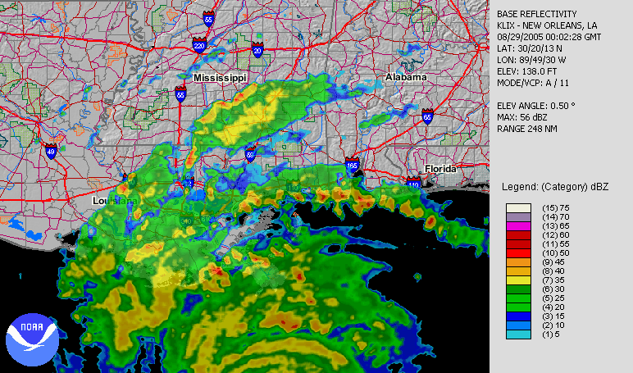
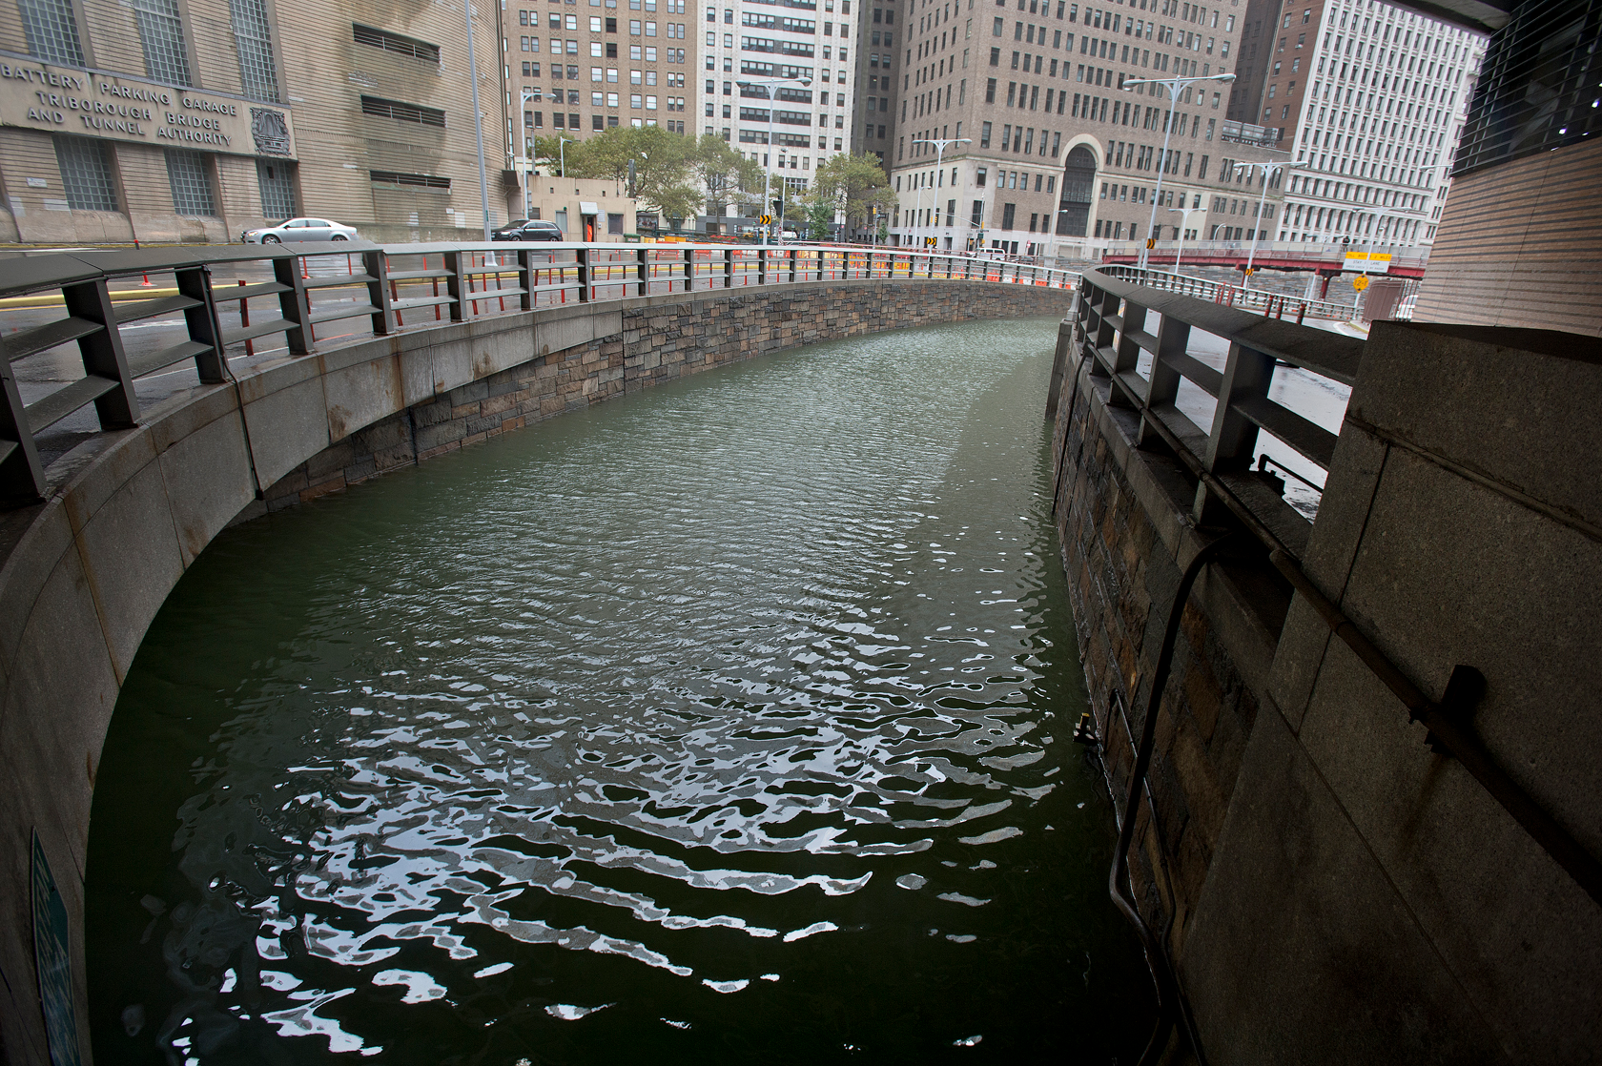
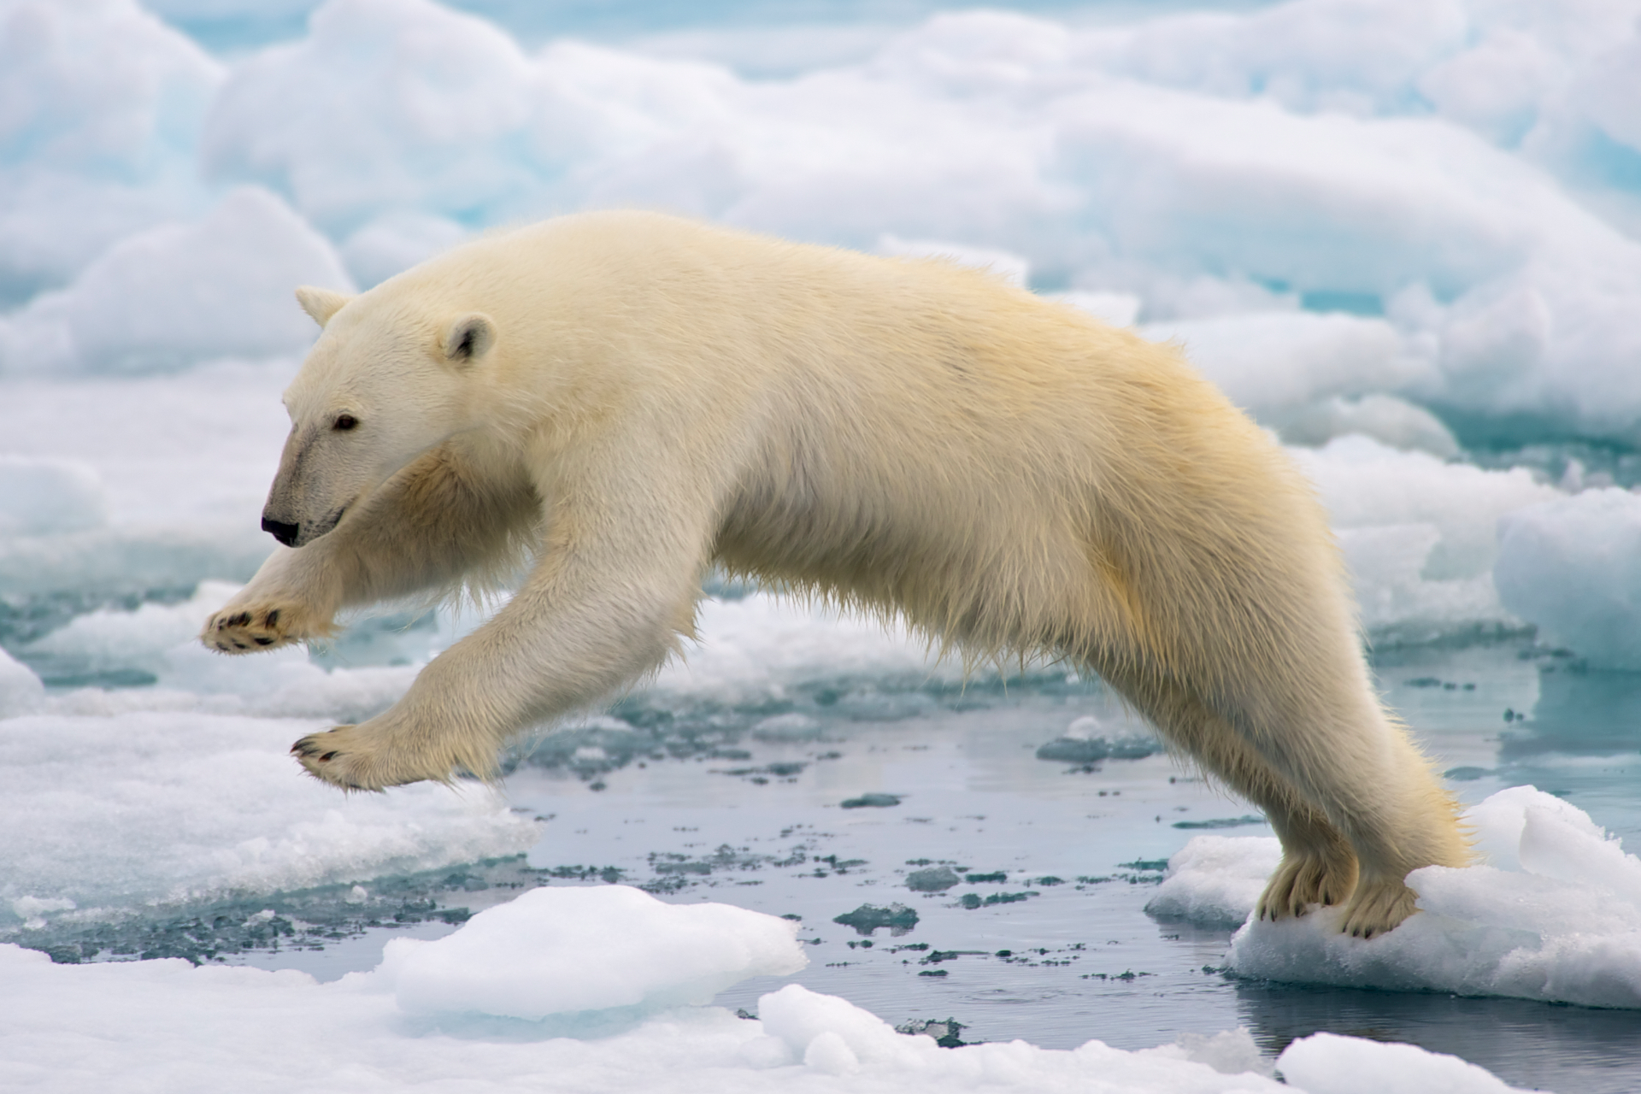
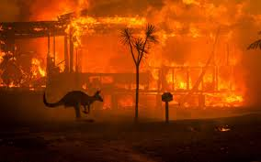
What is climate change?
Notes:
Brooklyn Battery Tunnel, Photo: Metropolitan Transportation Authority / Patrick Cashin (CC BY 2.0) https://en.wikipedia.org/wiki/Hurricane_Sandy#/media/File:Hugh_L._Carey_Tunnel_during_Hurricane_Sandy_vc.jpg
Flooding at Marblehead, MA, Photo: “The Birkes” (CC BY 2.0) https://en.wikipedia.org/wiki/Hurricane_Sandy#/media/File:Flooding_in_Marblehead_Massachusetts_caused_by_Hurricane_Sandy.jpg
Polar bear jumping on fast ice; Photo: Arturo de Frias Marques (CC BY-SA 4.0) https://en.wikipedia.org/wiki/Polar_bear#/media/File:Polar_Bear_AdF.jpg
Katrina radar; Photo: NOAA (public domain) https://en.wikipedia.org/wiki/Hurricane_Katrina#/media/File:Hurricane_Katrina_LA_landfall_radar.gif

Slide 3
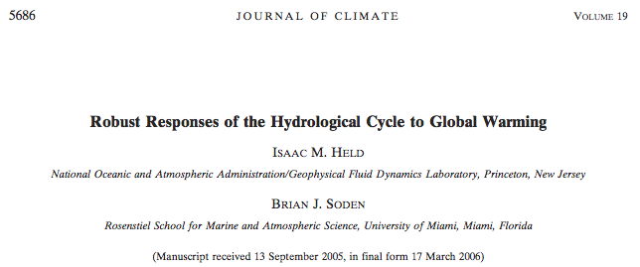
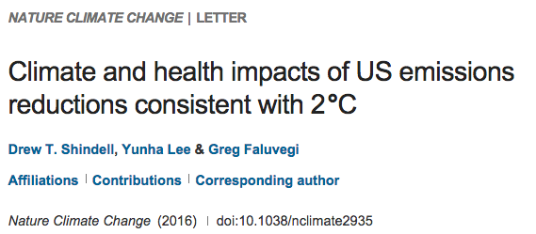
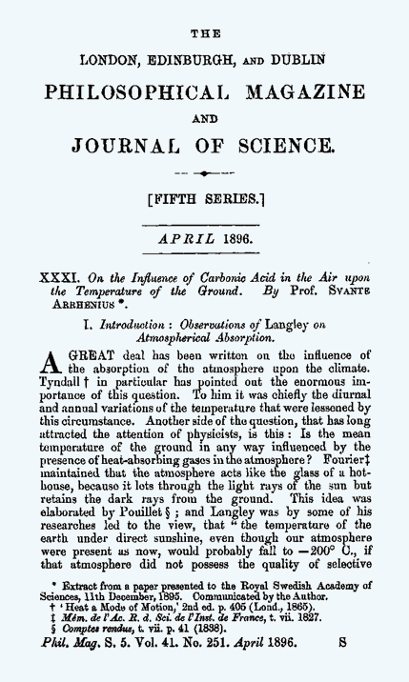
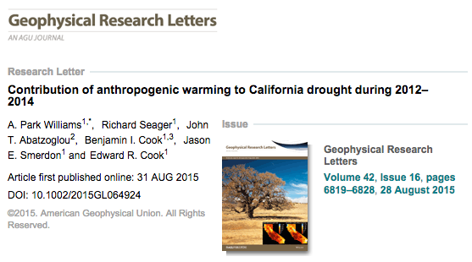
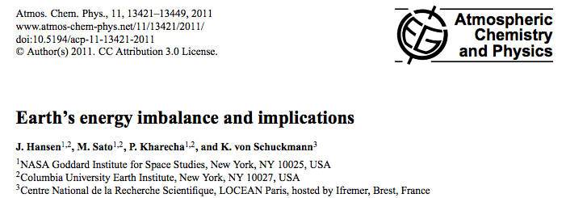
PEER REVIEWED LITERATURE

Slide 4
“Humanity is the major influence on the global climate change observed over the past 50 years. Rapid societal responses can significantly lessen negative outcomes.”
“It is clear from extensive scientific evidence that the dominant cause of the rapid change in climate of the past half century is human-induced increases in the amount of greenhouse gases…”
“The scientific evidence is clear: global climate change caused by human activities is occurring now, and it is a growing threat to society.”

Slide 5
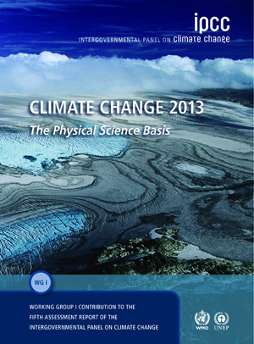
Intergovernmental Panel on Climate Change (IPCC)
International council of scientists and policymakers regularly outline the “state of the science”
Latest report freely available: https://www.ipcc.ch/assessment-report/ar6/

Slide 6
Intergovernmental Panel on Climate Change (IPCC)
“Human influence has been detected in warming of the atmosphere and the ocean, in changes in the global water cycle, in reductions of snow and ice, in global mean sea level rise, and in changes in some climate extremes.”
“It is extremely likely that human influence has been the dominant cause of the observed warming”
Notes:
Main conclusion of IPCC

Slide 7
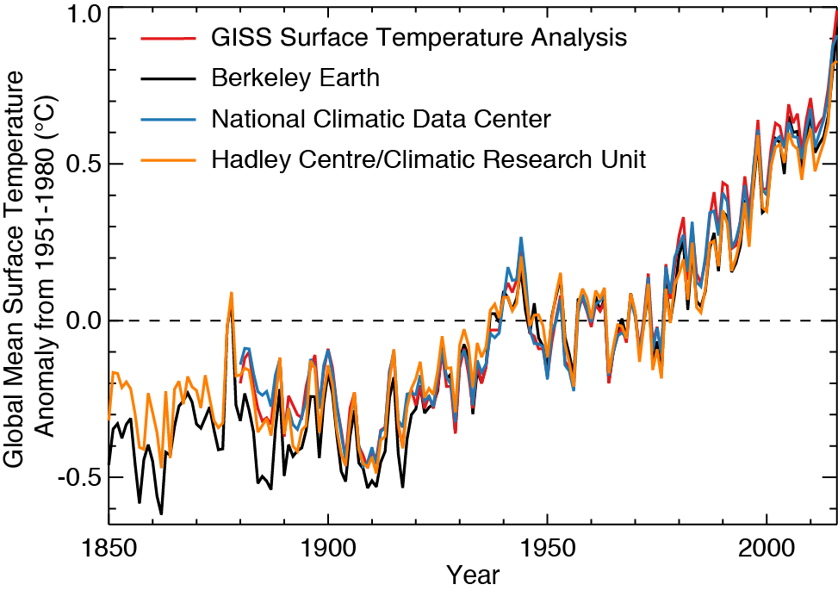
Warming is Unequivocal
ΔT ~ 1.0°C = 1.8°F
Anomaly:
Difference from average
Independent analyses of observations agree: Earth is warming
→ Global Warming
Notes:
Graphic produced by Eric Leibensperger from raw data.

Slide 8
Warming is Unequivocal
Recent years warmest on record
ΔT ~ 1.0°C = 1.8°F
Anomaly:
Difference from average
Independent analyses of observations agree: Earth is warming
→ Global Warming
Notes:
Graphic produced by Eric Leibensperger from raw data.

Slide 9
Attributing Climate Change
Observations
Model input = Natural drivers
Model input = Natural +
anthropogenic drivers
[IPCC, 2013]
Global climate models cannot reproduce observations without incorporating anthropogenic CO₂ emissions
Additional observational analyses have found the climate change “fingerprint” of anthropogenic CO₂ emissions

Slide 10
The Evidence is In: Earth’s Climate is Changing
Worst case scenario
Future change depends on trajectory of CO₂ emissions
Best case scenario
[IPCC, 2013]
We know:
- The climate is changing
- Climate change is anthropogenic
- Regulating CO₂ is the only way to mitigate future changes

Slide 11
Climate Change Impacts

Slide 12
Climate Change and Covid 19
Big drop in emissions:

Slide 13
Climate Change and Covid 19
Blip, or build back better?:

Slide 14
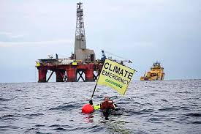
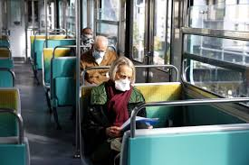
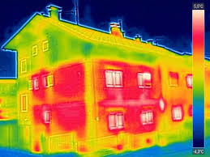
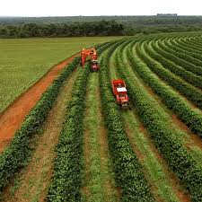
Climate Change and Covid 19
(Some) Crucial Sectors for
Green Recovery:
Energy
Transport
Buildings
Land Use
Education

Slide 15
Thanks for listening!
Any questions?
andrew.cross@ed.ac.uk

