Slide 1
Getting the most out of your lectures
Peter Tormey
Articulation Support Adviser
(Widening Participation)
wideningaccess@napier.ac.uk

Slide 2


Slide 3

Note Making
What should you do in a lecture?
What kind of notes do you need?
Notes:
3

Slide 4
What is different at University?
  Lectures
  Tutorials/Seminars
  Independent learning
Why do we need to take notes?
  To help us remember what was covered
  Not everything is in textbooks
  To help us revise later
It’s all on you!!

Slide 5

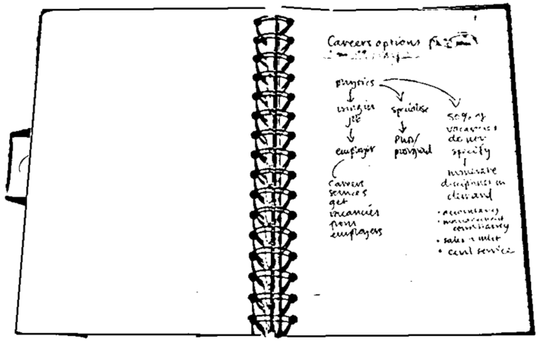
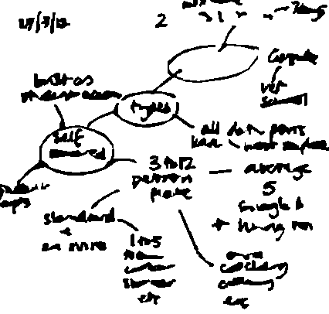
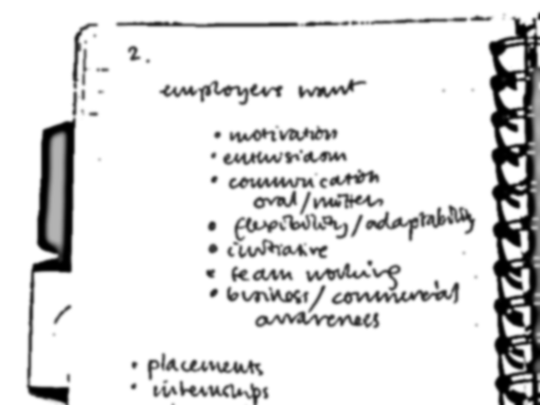
Why make notes?
Notes act as memory aid
Notes:
5

Slide 6
Why make notes?
Notes act as memory aid
  Buzan (1999): Without active learning, we forget 98% of information in just three weeks
It actively involves you in the learning process
It helps to develop your understanding
It allows you to reduce information to a
manageable size
Notes are helpful when preparing assignments or for exams
Notes:
6

Slide 7
Note Making Process
Before lecture
After lecture
During lecture
Useful lecture notes

Slide 8
❶ Before: Prepare and tune in
Prepare:
  Advance reading
  Print off and read the lecture outline (slides or notes)
  If relevant, read your notes from the previous lecture
  Look up scientific / technical terms and subject-specific jargon.
  Tune yourself into the topic by thinking of questions.
Notes:
8

Slide 9
❷ During: Make notes
  Listen and watch – cues, clues and signposts
    e.g. 'there are four key points here’
Don't write everything down
  Key words, phrases, short sentences, abbreviations
Annotate handouts
Note questions you have
Note making improves with practice

Slide 10
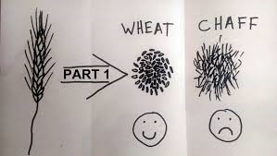
Lecturer signposting…
Framework: Lecturers often say at the beginning of a lecture how they have structured their lecture and what they are going to cover.
Don’t try to write everything down! Your goal isn’t to transcribe your lecturer word for word.
kizombaharmony.com

Slide 11
Lecturer signposting…
Pay attention to cues – conscious or subconscious.
“You need to know this,” or “This will come up in your…”
Repetition is often used to reinforce key points.
Anything said very slowly, so that it can be taken down word for word.
If your lecturer starts talking more quickly, loudly or with more emphasis.

Slide 12
Lecturer signposting…
Look out for language that shows relationships between ideas…
  first, second, third
  especially, most significant, most important, however, on the other hand
  because, so, therefore, consequently
  a possible explanation of this…
  it might be that…
  to clarify…
  Look out for language that signposts direction…
  later on I’m going to talk about…
  and now I’m going to…

Slide 13
Most students adopt their own abbreviations for note taking
& | and
? | question mark - a good way to remind yourself to ask about something or look this point up later on
∴ | therefore
≤ | smaller or equal to…

Slide 14
~ | approximately
↑ ↑↑ ↓ ↓↓ | increase rapid increase decrease rapid decrease
# | number
cf | contrast with/cross reference
Adapted from The Open University (2013)

Slide 15

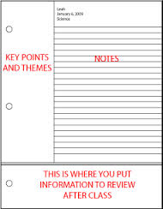
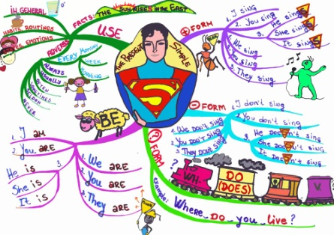
Get organised
How do you work best?
  What note-taking style works for you?
  Laptop? Planned?
  Mind maps?

Slide 16

Note making styles: a) linear notes
line by line
short and structured
headings and subheadings
abbreviations and key words
bullet points
  highlight
  key
  points

Slide 17


b) Mind mapping
Related theme 1
Related theme 2
Central idea
Visual
Not often
used in lectures
Make memorable
Highlighting
Good for organising after
Reading / revision
Colour

Slide 18

Identify your learning style
Do you absorb information best by:
Listening and then writing the information down
Describing what you have just heard to someone
Creating diagrams to illustrate key concepts
Notes:
18

Slide 19
Top tips
Make notes in your own words
Use different methods for different purposes
  e.g. flowcharts for processes
  tables for comparison
Organise your notes
  title, date, page numbers – and file them
Don't cram too much in – leave room to add in
Don’t leave reviewing notes until revision

Slide 20
❸ After: Add value
Review your lecture notes
You might want to:
  Edit and clarify your notes
  Add further information
  Question some of what you have
  Add your own thoughts
It's not enough just to re-read notes...
you have to use them!
Notes:
20

Slide 21

Get Ready
http://www2.napier.ac.uk/getready/managing_studies/index.html

Slide 22
The Open University (2013). Effective note taking. Available from: http://www.open.ac.uk/choose/unison/develop/my-skills/effective-note-taking [accessed 22.11.16]

