Slide 1











Numbers and Nurses
Arlene Boyle

Slide 2
Who Says Numeracy Is Important!
NMC
NES
NHS National Patient Safety Agency
Notes:
NMC 2007 – nurses need sound numeracy skills to practice – recent intro of Essential Skills Clusters – student nurses must demonstrate competency in numeracy skills to ensure can practice safely as nurse. http://www.nmc-uk.org/aDisplayDocument.aspx?documentID=3663 – see page 25 of this document
The Independent Article
Thirty-six patients died and almost 2,000 suffered "moderate or severe harm" as a result of errors in the drugs prescribed and dispensed in hospitals, an official report has disclosed.
The blunders were among more than 41,000 "medication errors" recorded by all 173 NHS trusts in England between July 2005 and July 2006. The Healthcare Commission, the NHS regulator that published the figures, said hospitals had to do more to improve their handling of medicines.
In a league table of performance it ranked 18 trusts as "excellent" and 12 as "weak." The remainder were good or fair.
The National Patient Safety Agency, which collected the figures, said 80 per cent caused no harm to patients and 15 per cent caused "low harm." The remaining 5 per cent - 2,000 errors - caused moderate or severe harm.
"Our data shows that there were 36 deaths where medication mistakes were thought to play a part, though it should be understood that some of these patients were already very poorly and should be put in the context of the one million people who are seen by the NHS every day," the agency said.
A spokeswoman said there were no details of the patients who had been harmed or died.
"A typical case would be someone prescribed Warfarin, the blood thinning drug, for heart disease who was given a second drug without being asked what he was already taking. The interaction might cause a bleed which would be severe," she said.
Trusts listed as excellent included Airedale NHS Trust and Barnsley Hospital NHS Foundation Trust, both in Yorkshire, and Guy's and St Thomas's NHS Foundation Trust in London. Those listed as weak included South Warwickshire General Hospitals NHS Trust and the Royal Cornwall Hospitals NHS Trust.
NPSA
The Patient Safety Division aims to identify and reduce risks to patients receiving NHS care and leads on national initiatives to improve patient safety.
Through the National Reporting and Learning System (NRLS), the Patient Safety Division collects confidential reports of patient safety incidents from healthcare staff across England and Wales. Clinicians and safety experts help analyse these reports to identify common risks and opportunities to improve patient safety.
Feedback and guidance are provided to healthcare
organisations to improve patient safety. These include
alerts to address specific safety risks, tools to build a strong
safety culture and national initiatives in specific areas such
as hand hygiene, design, nutrition and cleaning.
The Patient Safety Division works closely with royal colleges, frontline staff and organisations, patient groups, strategic health
authorities, other NHS bodies, academic centres and
sectors beyond healthcare to promote patient safety.

Slide 3
NMC Standards for pre-registration nursing education 2010
For Entry to the Register:
Is competent in the process of medication-related calculation in nursing field involving:
• tablets and capsules
• liquid medicines
• injections
• IV infusions including:
    unit dose and sub and
    multiple unit dose
    complex calculations
    SI unit conversion

Slide 4
What’s the Big Deal?
London Trust rejects nurses over numeracy and literacy skills April 2016
Chief exec raises fresh concerns over nurse numeracy skills May 2014
reasonable for patients to expect that each healthcare professional involved in delivering their care is competent
prescribing or administering medicines includes the ability to calculate drug doses safely and accurately
almost half of the medication errors reported are related to the wrongly calculated dose or strength of medicine (NPSA)
Notes:
A report analysing the NHS workforce has highlighted how one London trust rejected between 40% and 60% of band 5 nurse applicants because they did not meet the organisation’s standards for numeracy, literacy or compassion

Slide 5
Importance of Numeracy Skills
Patient Safety
Accountability / professional integrity
Expanding professional roles

Slide 6
School of Nursing and Health Sciences
Currently:
Must obtain appropriate numeracy qualification prior to acceptance
You must pass the initial numeracy assessment
Each year of course has numeracy / drug calculation assessments included (formative and summative) e.g. online numeracy tests, OSCEs each year, Medicine Administration workbook years 1 and 3

Slide 7
Where do we use numbers in nursing?
Measuring pulse and respirations – SEWS chart
Drug calculations –
  conversions eg milligrams to micrograms
  Number of tablets to administer
  Amount of elixir to administer
Fluid balance calculations
Nutritional assessment
Intravenous fluid requirements/rates
Administration – off duty, bed management
Understanding research etc.

Slide 8
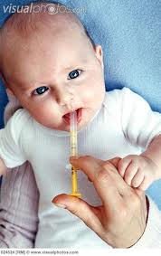
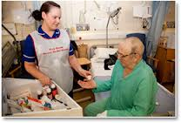
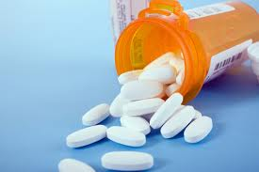
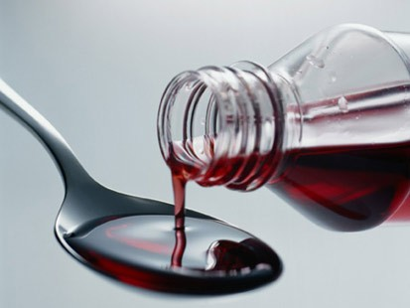
Medicines Administration

Slide 9
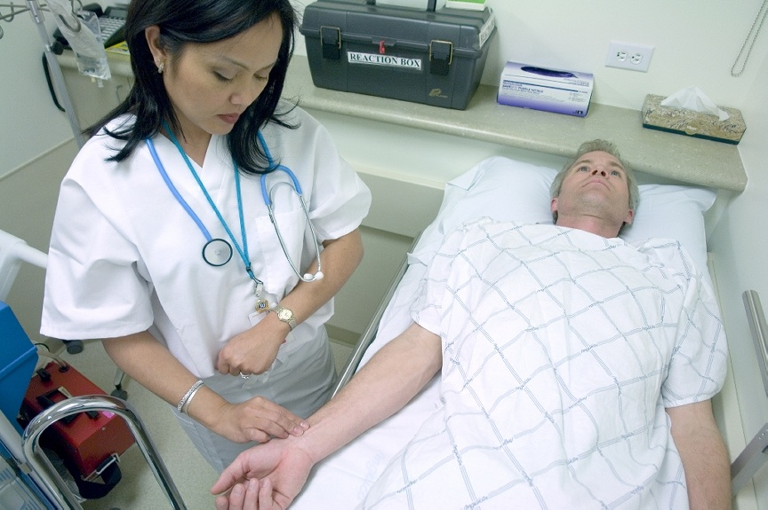
Measuring Pulse and Respirations

Slide 11
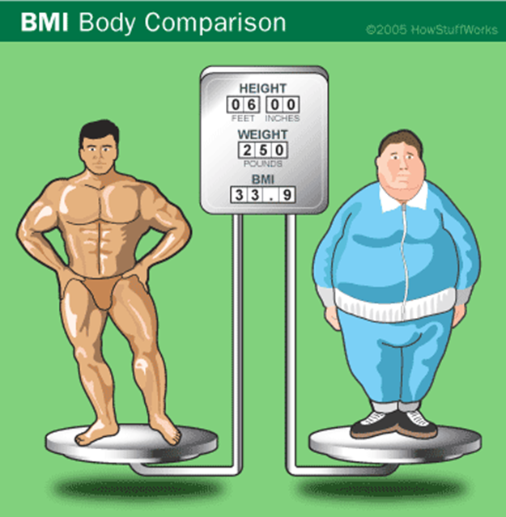
Body Mass Index
Formula:
Weight in kg
the height in m²
Eg: weight = 70kg
Height 1.6m x 1.6m =2.56
70/2.56 = 27.3
BMI = 27
BMI calculation

Slide 12


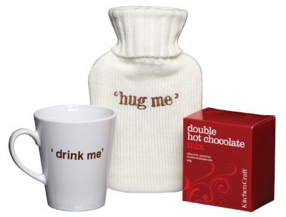

Mrs Brown’s Daily Intake
8am and 3 pm
cup of tea (150 mls)
Lunchtime –orange juice
(150 mls)
5.30 pm glass of water
(200 mls)
Bedtime Hot Chocolate
(150 mls)

Slide 13
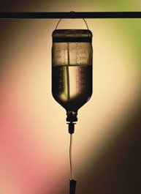
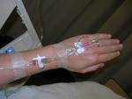
Intravenous (IV)
She also required Intravenous fluids = 2 bags (500mls each)
She is also receiving Intravenous antibiotics 200mls twice per day

Slide 14
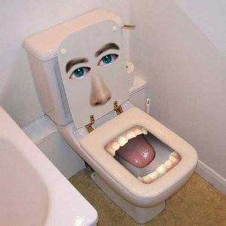
OOPS – it’s got to go somewhere!
6.30 am – 320 mls
9 am – 250 mls
10.15 am – 380 mls
11.25 am – 200 mls
(looks like she’s had a water tablet!!)
2.30 pm – 275 mls
6.00 pm – 390 mls
9.30 pm – 250 mls
Total = 2065 mls

Slide 15
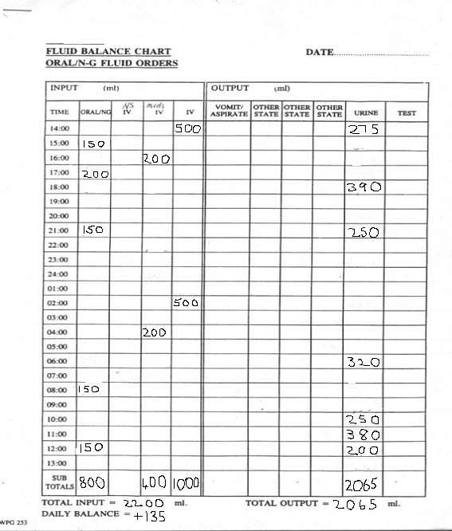

Slide 16
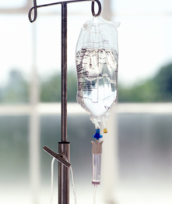
Intravenous Fluid Drip Rates
Formula:
Drip rate =
volume x drops/ml length of delivery (time)

Slide 17
So for example:
A 100 ml bag of fluid has to be given over 40
minutes. The number of drops per ml is 20,
what is the drip rate?
Drip rate = volume x drops/ml length of delivery (time in minutes)
= 100 x 20 = 50 drops per minute
40

Slide 18
Metric Conversions
Converting milligram to micrograms
Converting millilitres to litres etc
Some examples:
What is 785mg in grams?
To convert mg to grams – divide by 1000 as there are 1000 mg in a gram = 0.785g
How many millilitres (ml) are in 1.25 litres?
To convert litres to millilitre, multiply by 1000 as there are 1000 ml in a litre = 1250ml

Slide 19
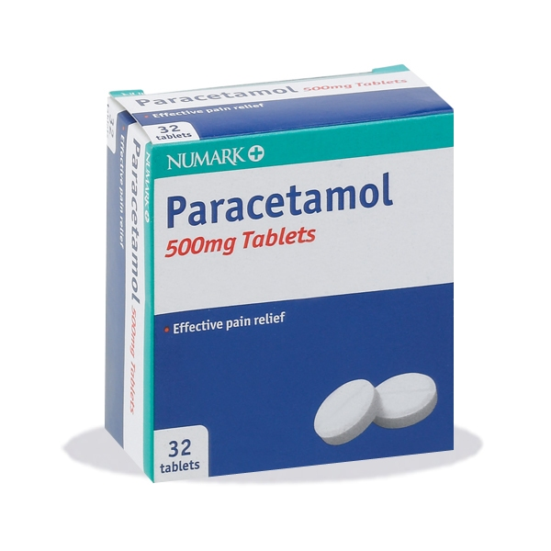
A Real Life Example
A typical prescription would read:
Paracetamol 1G every 4-6 hours for pain (maximum of 4G per 24 hours)

Slide 20

ANY QUESTIONS

