Slide 1
Preparing for life as a 1st year Nursing Student @UHI
03 February 2022

Slide 2
Welcome - introduction
Notes:
Introduce selves – me and Maureen. Give overview of my career
Next an introduction from Marie Cameron

Slide 3
BSc Nursing Programme

Slide 4
BSc Nursing
2 Campuses
Inverness at the Centre for Health Science
(Adult or MH)
Stornoway at Lews Castle College
(Adult Only)
NHS Partnerships
NHS Highland
NHS Western Isles
Notes:
Sites of where we are

Slide 5
Programme Structure – based on NMC Future Nurse: Standards of proficiency for registered nurses (NMC 2018)
7 Platforms:
Being an accountable professional
Promoting health and preventing ill health
Assessing needs and planning care
Providing and evaluating care
Leading and managing nursing care and working in teams
Improving safety and quality of care
Coordinating care
Notes:
New programme introduced in 2018. This is now found in your PAD – Practice Assessment Document – guard with your life, goes everywhere with you.
Working towards developing ePAD

Slide 6
Programme Structure – based on NMC Standards cont:
2 Annexes:
Communication and relationship management skills
Nursing procedures
Notes:
Build on build.
Lots new clinical skills introduced to the programme

Slide 7
Academic year
Notes:
This is what your 3 years will look like…. Explain breakdown placements etc

Slide 8
Year 1
In the first year all students will complete the following modules to pass the first progression point:
Foundations in science, skills and practice for nurses 1
Introduction to professional practice 1
Clinical Practice 1
Foundations in science, skills and practice for nurses 2
Introduction to professional practice 2
Clinical Practice 2
There is a focus on core skills, knowledge, and practice for all nurses (adult and mental health)

Slide 9
The Nursing Programme
Teaching: Flipped classroom – mix of face-to-face teaching and Guided Study. Range of teaching approaches, such as lectures, small group work, clinical skills etc. Slightly different at the moment with on going Pandemic
Theory and research-based practice are integrated in the classroom and the clinical setting.
Student-centred learning is central to our core education philosophy and our teaching methods encourage and support self-development and professional and personal awareness through reflection on experience.
Assessments include: examinations, essays, reports, presentations, clinical skills assessments, and assessments of practice.
Notes:
Explain what normally like and what last two years have been like

Slide 10
Clinical Practice Learning Areas
NHS Highland Area
NHS Western Isles area
Scotland
Notes:
We cover same ground as Belgium
Left pic covers all the areas we offer for clinical placements. Mention A&B affiliated to UWS hence they tend to cover that area

Slide 11
Essential Student Skills
Notes:
Access via MyDay platform. We direct you to utilise these resources, in addition the support within the dept PAT, AA on placement PA PS etc Alexandra…. Councelling sties

Slide 12
Essential Student Skills
https://induction.uhi.ac.uk/Core-Skills/Maths-and-Stats/index.html
https://induction.uhi.ac.uk/Core-Skills/induction-academic-writing/index.html
https://induction.uhi.ac.uk/Effective-Learner/Referencing-and-Plagiarism/index.html

Slide 13
Start Dates
Bachelor of Science in Nursing commences
5th September 2022
Please Note: 2nd Year entry, if available, for those qualifying will potentially start one week earlier to allow for induction.

Slide 14
Qualities We Look For:
Academic ability/potential
Motivation/ commitment/ experience
Care and Compassion
Some Knowledge of the Field
Good Communication skills/interaction
Good preparation and enthusiasm

Slide 15
Entry Criteria
3 Scottish Highers at a minimum of BBC
2 A Levels at grade BC or above
Relevant HNC/HND in Health related subject
Access to Nursing
SVQ3 + 2 Highers at C or above
SQA Level 6 Health Social and Child Studies inc 1 Higher at grade B or above (Lews Castle College)
Essential Requirements:
English: National 5 or Intermediate 2 at grade C or above; or Standard Grade (grade 3 or above); or SQA Communications 3; or GCSE English Literature or Language (C or above); or equivalent
Mathematics: National 5 or Intermediate 2 at Grade C or above in Mathematics or Applications of Mathematics; or Standard Grade (grade 3 or above); or GCSE (C or above); or equivalent
Desired requirements:
Human Biology/Biology/Science subject
Notes:
Many of you will already have done this but there may be some of you still thinking about applying

Slide 16
EU/Non EU Students
Recognised European or international equivalent qualifications are considered
If English is not your first language you must have evidence of your English language skills
Accepted English Language Tests by Nursing and Midwifery Council (NMC)
International English Language Test (IELTS)at 7.0 with writing element at 6.5 or above and all other elements at 7.00 or above
Occupational English Test (OET) Overall grade B if sat test up to August 2018: From September 2018 onwards must have an overall score above 350 (equivalent to 7.00 IELTS)

Slide 17
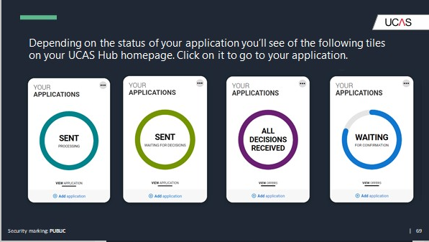
How to Apply
Applications are online via UCAS.com
You should pay particular attention to your personal statement and ensure you mention nursing.
The UCAS website has very good guidelines to help with completion of your application
Applications received by 26th January will be considered first.
Notes:
Via UCAS site, won’t linger, literally just a re-cap for you

Slide 18
Disclosing Disability or Medical Conditions
Whilst completing your application it is highly recommended that you disclose any disability.
This will allow you to be assessed, if required and for support to be put in place
Disclosing a disability is not detrimental to your application, however all students must be fit to undertake the clinical elements of the programme e.g. moving and handling & management of violence and aggression

Slide 19
What happens after I apply?
Those with the minimum entry criteria or above, or those working towards this will be invited, by email, to a Compulsory Applicant Selection Interview either online or face to face. Please check your email inbox and spam box regularly.
You will be sent applicant guidelines and information prior to the event. It is important that you read these and respond promptly to any information required to be returned to admissions e.g. photo identity documentation & proof of address

Slide 20
Invite to Applicant Selection Interview
On receipt of your email invite you should check the date, time and read all attached documents carefully.
If you are attending an online selection interview you will be sent a link to join. Please where possible use a PC/laptop rather than a phone.
If attending face-to-face, then details of location etc will be provided in the email.
The session will consist of:
Group Introduction – up to 4 (online) up to 6 (face-to-face)
Group Scenario & Discussion
Questions & Answers

Slide 21
Then….
Following the Applicant Selection Interview, within UCAS timelines, our Admissions team will update your offer status on UCAS Portal.
Please note this may take 24 hours to be reflected on your UCAS Portal

Slide 22
Responding to Offers
It is important that you check your UCAS Portal and respond within the UCAS deadlines given.
No response will result in your offer being withdrawn.
Please remember there may be a 24 hour delay between email notification of status update from Admissions and UCAS Portal showing this.

Slide 23
Accepting Your Offer
Once you accept your offer of a place on the programme you will receive PVG and Occupational Health forms to complete and return as part of your clearance checks.
You may also have to attend an Occupational Health Clinic.
You may also receive additional forms to complete and return
Please check your email regularly.

Slide 24
Unconditional / Conditional Offer
An unconditional offer means that you do not have any academic conditions to meet
A Conditional Offer means certain requirements need to be met before your place is confirmed.
For Both:
Pass current programme (to meet minimum entry qualifications)
Pass Criminal Record Check
(PVG – protection of vulnerable groups)
Be deemed fit by Occupational Health to undertake the programme in both clinical and theory elements.
It is essential that you declare the following;
Any previous nurse training, as a transcript and reference will be required
Previous convictions
Previous or current health issues or disabilities
Failure to declare any of the issues mentioned may put your offer at risk
Overseas students must also present proof of their English Language Test
IELTS/OET accepted by NMC.

Slide 25
Conditions of Offers and Programme requirements
If you do decide to accept a place at the University of the Highlands and Islands you are required to comply with the following:
Agree to travel to clinical placements in hospitals and the community, in the Department NHS Board areas of Highland or Western Isles, a placement agreement form will be sent once you have confirmed your offer of a place
Agree to undertake shifts up to 37.5 hours over a 24-hour shift pattern, 7 days per week. Shifts could be early morning, afternoon, evening and night duty on weekdays, weekends and bank holidays, both within hospitals and community settings. 40% of your time must be spent with your mentor
Comply with uniform and infection control policy on clinical placement
Holidays are fixed and not negotiable.

Slide 26
Absence During Programme
If extended periods of absence are incurred during your programme you may have to take a period of Suspension of Studies and be offered to return to the programme the following year, as you would be unable to meet the minimum 80% attendance requirement for each module of the programme
Notes:
Next up one of our recent Graduates Caitriona who did the access course.

Slide 27
Meet our Student’s

Slide 28
Students Award Agency Scotland
Provided you meet the residency conditions you can apply for a SAAS bursary.
Bursary of £10,000
You may also be entitled to dependants allowances or childcare costs which are means tested. Contact Alexandra Stewart – Student Support Officer Alexandra.stewart@uhi.ac.uk
Further information is available online
www.saas.gov.uk/full_time/nmsb/index.htm

Slide 29
Student Accommodation
There are two options locally:
NHS Highland: 4 bedroom flat, sharing facilities.
To apply please contact the accommodation manager on Tel: 01463 704350
high-uhb.raigmoreaccommodation@nhs.net
Cityheart Living: at UHI Inverness Campus
Online application
https://studentaccommodationuhi.co.uk/en
Western Isles Accommodation:
NHS Western Isles Accommodation – please contact
Accommodation Team – 01851708136/138
marina.maclean@nhs.scot
shona.matheson3@nhs.scot
margaret.macdonald6@nhs.scot
maria.stenhouse@nhs.scot
Bridge Centre
Accommodation - Lews Castle College UHI - HOME | bridge-centre (bayheadbridgecentre.co.uk)
01851 705808 or email info.bridgecentre@btconnect.com

Slide 30
Further Information
View the University website
www.uhi.ac.uk/en/courses/bsc-nursing
SAAS Bursary: www.saas.gov.uk/full_time/nmsb/funding_available.htm
Nursing and Midwifery Council – The Code
www.nmc.org.uk/standards/code/
Facebook: UHI Nursing and Midwifery- @uhinursing
Twitter: UHI Nursing and Midwifery- @uhinursing

Slide 31
Questions?
This Photo by Unknown Author is licensed under CC BY-SA

Slide 32
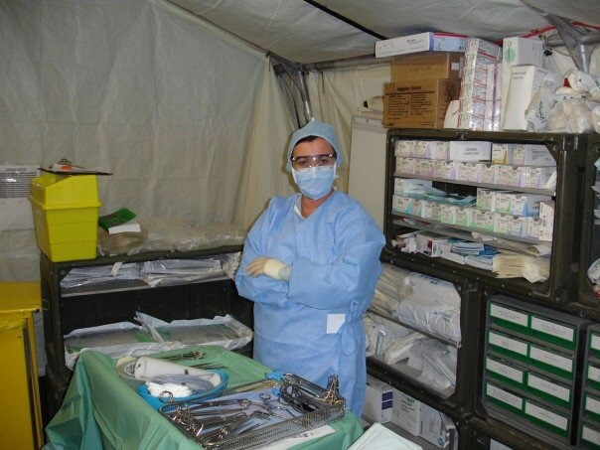
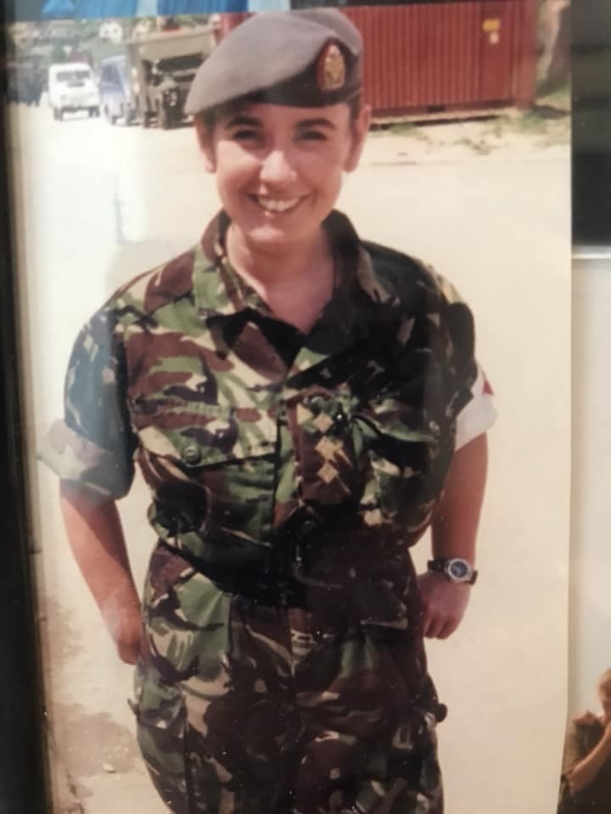
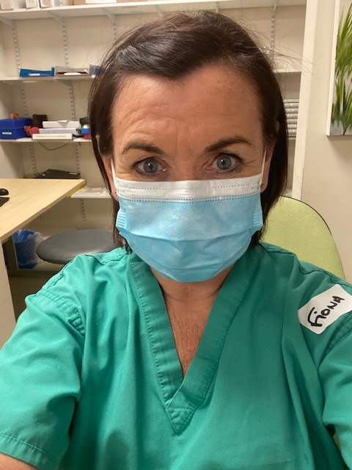
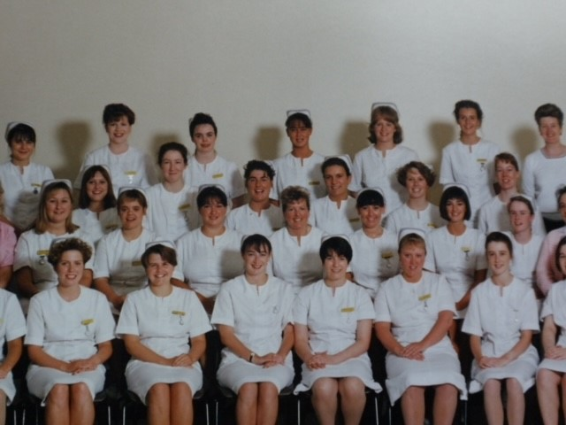
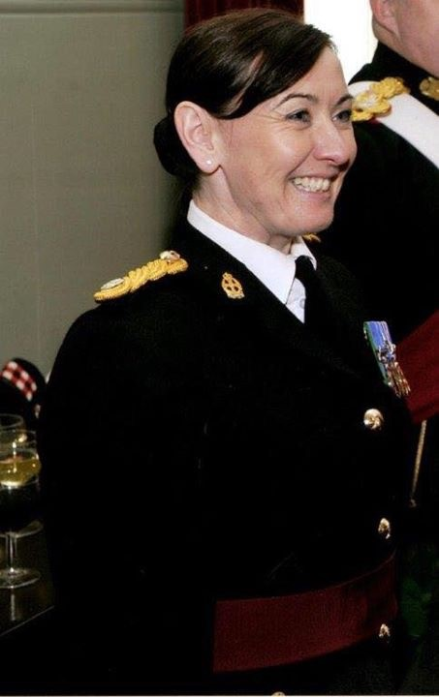
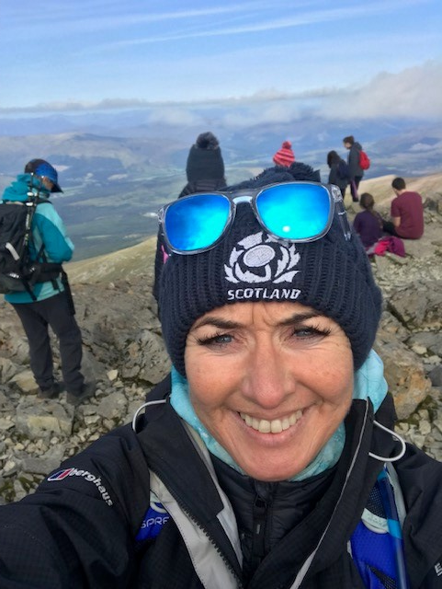
A glimpse of Fiona’s career!

Slide 33
We wish you every success with your career!
01463 279020
admissions.nursing@uhi.ac.uk
fiona.grist@uhi.ac.uk

