Slide 1
Research, reading, referencing & evaluation
N M Speirs
University of Edinburgh

Slide 2
Research, reading, referencing & evaluation
The relevance of the lecture?
And what about the tutorial & laboratory?
How does this all fit into my learning and ability to deal with exams?
Assessment literacy?

Slide 3
Research, reading, referencing & evaluation
What should you be reading?
Where would you find these sources?
How would you evaluate the reliability of these sources?

Slide 4
Research, reading, referencing & evaluation
There are a number of different sources that you can use;
Text book
Journal article
Report
Web site
Your university library will be the place to find these sources. Sometimes you wont even need to go into the library, it can be done online e.g. finding & printing a journal article.
What ever source you use, it is important that you are able to gauge its reliability.

Slide 5
Research, reading, referencing & evaluation
What’s your analysis of the content?
Read the preface (book) or abstract (article) to determine the author's intentions.
Is this source too elementary, too technical, too advanced, or just right for your needs
Is the information fact, opinion, or propaganda
Does the information appear to be well-researched & evidenced
Does the work update other sources, substantiate other materials you have read, or add new information

Slide 6
Research, reading, referencing & evaluation
References have two purposes:
(1) to provide the source of information you use (2) to enable the reader to find it.
There are a number of different styles that can be employed. You need to check that you are using the correct style.

Slide 7
Research, reading, referencing & evaluation
What does all this tell us?
Campbell, N. A., Reece, J. B., Urry, L. A., Cain, M. L., Wasserman, S.A., Minorsky, P. V. and Jackson, R. B. (2008) Biology (8th edition). Published by Pearson Education. ISBN-13: 978-0321536167.
Chapter 6 (A Tour of the Cell) Hillis, D. M., Sadava, D., Heller, H. C. and Price, M. V. (2012) Principles of Life. Published by Sinauer Associates. ISBN-13:978-1429286572.
Pauling, L., and Corey, R. B., J. Am. Chem. Soc., 72, 5349 (1950).
Astbury, W. T., and Bell, F. O., Nature, 147, 696 (1941).
Jones, A.C., Speirs, N.M. et al, J. Phys. Chem. A, 2002, 106 (44), pp 10725–10732.

Slide 8
Research, reading, referencing & evaluation
Where do the references appear?
The dimerization of phthalocyanines (and the closely related porphyrins) and its effects on the UV–Vis absorption spectrum are well documented in the literature (1–10). Dimerization results in a significant blueshift in the Q band region together with some band broadening. That is, the absorption band of the dimer species lies at higher energy than does that of the monomer. This can be explained in terms of exciton coupling between the two monomer chromophores (4,5,11).
Leznoff, C. C., A. B. P. Lever 1989 Phthalocyanines Properties and Applications VCH Publishers, New York
Gouterman, M. 1978 Optical spectra and electronic structure of porphyrins and related rings In The Porphyrins, Vol. III (Edited by D.Dolphin), pp. 1–156. Academic Press, San Diego
Sheppard, S. E., A. L. Geddes (1944) Effects of solvents on the absorption spectra of dyes. IV. Water as solvent: a common pattern. J. Am. Chem. Soc, 66, 1995–2002.

Slide 9
Research, reading, referencing & evaluation
Where do the references appear?
Research pertaining to the interaction between carbon nanotubes and conjugated organic molecules is attracting growing interest as a new topic of fundamental research with numerous potential applications ranging from sensing¹ to photovoltaics.² Combining the remarkable electrical, thermal, and mechanical properties of carbon nanotubes³ with the optoelectronic properties of conjugated organic compounds is also a promising path to realizing hybrid composite materials for utilization in emerging disruptive technologies such as nanoelectronics.^{2,4-6} Increasingly, materials systems exhibiting spontaneous nanostructuring upon processing from solution have also come to the fore as an economical path to realizing optimized device structures.^{7,8}

Slide 10
Research, reading, referencing & evaluation
Now you try……..
Author; N. Tang
Journal; Atmos. Environ.
Year; 1980
Title; On the equilibrium partial pressures of nitric acid and ammonia in the atmosphere.
Volume/page; 14, 819-834
Author; William R. Harvey, Signe Nedergaard
Journal; Proc. Natl. Acad. Sci. U.S.A.
Year; 1964
Title; Sodium-independent active transport of potassium in the isolated midgut of the Cecropia silkworm.
Volume/page; 51, 731-735
Author; Hassan, B.; Li, H.; McKeown, N. B.
Journal; J. Mater. Chem.
Year; 2000
Title;
Volume/page; 10, 39−45.

Slide 11
Research, reading, referencing & evaluation
Now you try……..
N. Tang, On the equilibrium partial pressures of nitric acid and ammonia in the atmosphere. Atmos. Environ.14, 819-834 (1980).
William R. Harvey, Signe Nedergaard, Sodium-independent active transport of potassium in the isolated midgut of the Cecropia silkworm. Proc. Natl. Acad. Sci. U.S.A.51, 731-735 (1964).
Hassan, B.; Li, H.; McKeown, N. B. J. Mater. Chem. 2000, 10, 39−45.

Slide 12
Research, reading, referencing & evaluation
The Royal Society of Chemistry referencing style;
Journal articles should be cited in the form:
A. Name, B. Name and C. Name, Journal Title, year, volume, page.
For example;
T. J. Hebden, R. R. Schrock, M. K. Takase and P. Müller, Chem. Commun., 2012, 48, 1851–1853.
Books should be cited in the form:
A. Name, B. Name and C. Name, Book Title, Publisher, Publisher Location, year.
For example;
S T Beckett, Science of Chocolate, Royal Society of Chemistry, Cambridge, 2000.

Slide 13
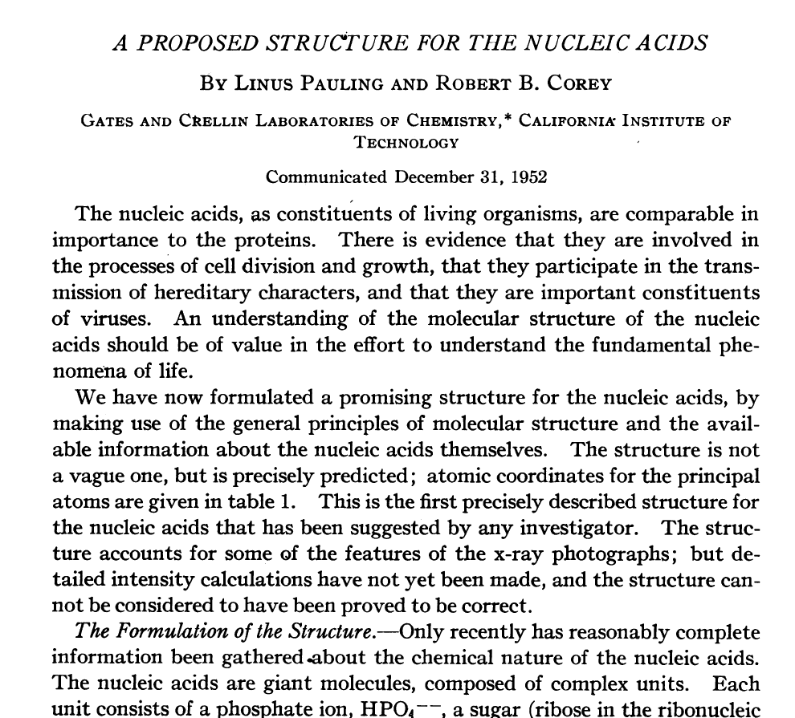
Research, reading, referencing & evaluation

Slide 14
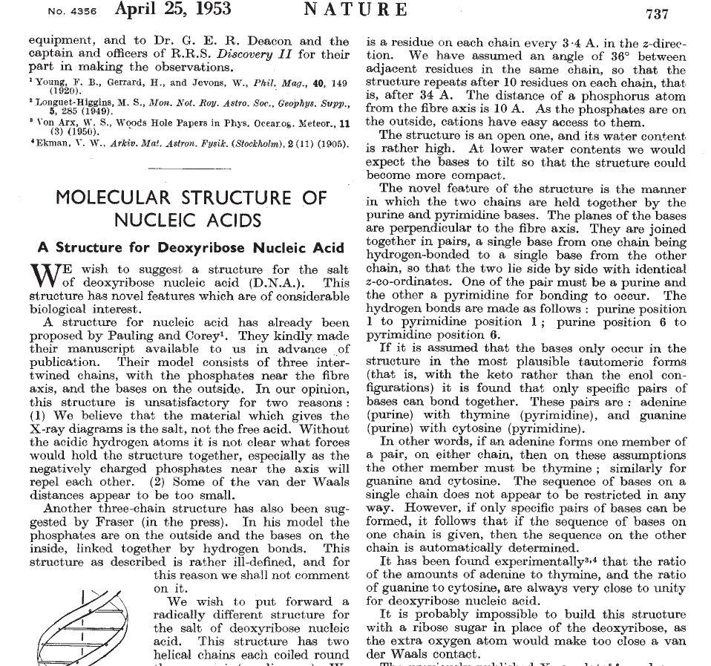
Research, reading, referencing & evaluation

Slide 15
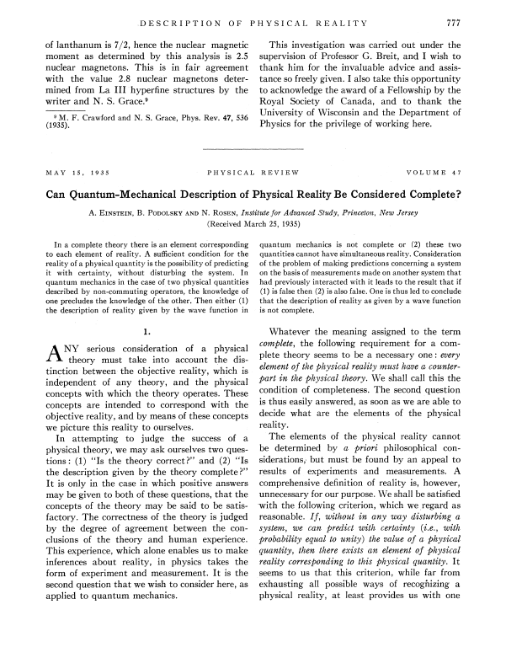
Research, reading, referencing & evaluation

Slide 16
Research, reading, referencing & evaluation
So, what research & enquiry related skills have I developed?
identify (e.g. counter examples)
define
analyse problems
identify or create solutions
synthesise
evaluate
critique / critical judgment / critically assess
interpret
creating new understanding
thinking creatively or imaginatively
formulate key questions
rational enquiry
search for, evaluate and use information

