Slide 1

Strategies for independent study
lectures
tutorials
SWAP humanities study skills day – Edinburgh University 2016
Virginia Bell - Effective Learning Adviser, Queen Margaret University

Slide 2

What am I supposed to be doing?
thinking
reading
summarising
note-making
understanding
discussing
writing…
Notes:
What do you do when you study? Ideas?

Slide 3
Your lecturers develop your key knowledge and understanding of the subject, but you develop your own study strategies.
But how do I actually do these??
Organising your time
Reading
Note-making and writing
Keeping motivated
Notes:
We’ll look at each of these – all vague areas, potentially confusing – and a few strategies to help make sense of your own study time. Also helps with stress management

Slide 4

Myth number 1
You have to study for hours…
Notes:
Common image of a student – but you have to live your life – what’s the truth? Less is more

Slide 5
Typical week?
Monday Tuesday Wednesday Thursday Friday
lectures

Slide 6
More typical week?
Monday Tuesday Wednesday Thursday Friday
lectures
Seminars/tutorials/other contact time

Slide 7
…with independent study
Monday Tuesday Wednesday Thursday Friday
lectures
seminars
Independent study

Slide 8
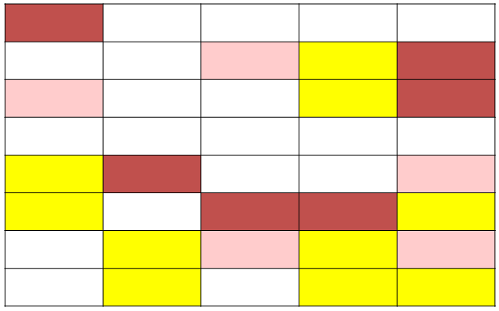

When to study?
Block out time – start with 2-3 hours per lecture.
Break into realistic chunks, over a week.
Study for 35 mins + 10 min break + 35 mins…useful model.
Don’t over-do it…build on it gradually.
Set a realistic goal for this time.
Treat it like a job.
Avoid evening study –
use for browsing a general background
book, study admin., planning next day…
Notes:
Shift activities – goals for sessions – when you know the task, you can get it dione – so make it specific. Timing helps.

Slide 9
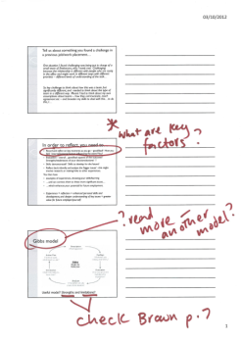
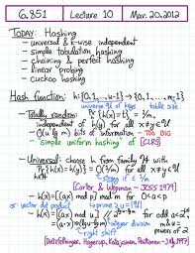
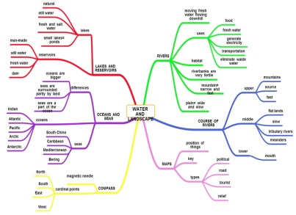

Build on the lecture: key strategies
Recap and reinforce:
Go quickly over notes, adding extra points and highlighting interesting/important ones.
Develop understanding and knowledge
Option 1: map out overview of key points/arguments from lecture (mind map? Linear notes? ) and helps processing.
Option 2: write a 200 word summary of the lecture –key points, what was interesting, and any questions
helps you spot gaps in understanding,
gives focus for study, and you practise writing!
Notes:
Done this, but…overview is finding your own shape for the information
Your voice is important
Also helps processing,make it make more sense.
Summarty – excellent exercise, maybe sometimes? To spot gaps?

Slide 10
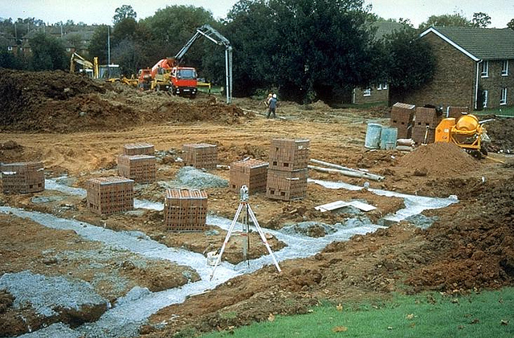
Build on the lecture:
Develop your research strategies
Select 1 or 2 topics – explore reading further on these, using reading list for ideas.
Take brief notes on what you find and file with lecture notes.
Building the foundations of
your subject knowledge
and understanding…

Slide 11

Myth no.2
You have to read loads…
It all depends what, why and how…

Slide 12




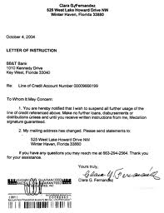



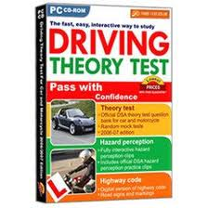



Slide 13
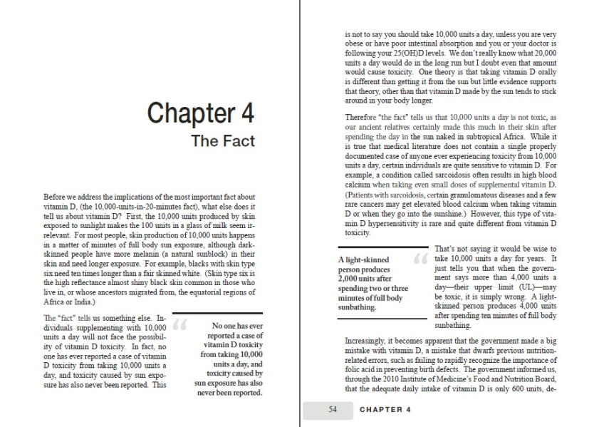
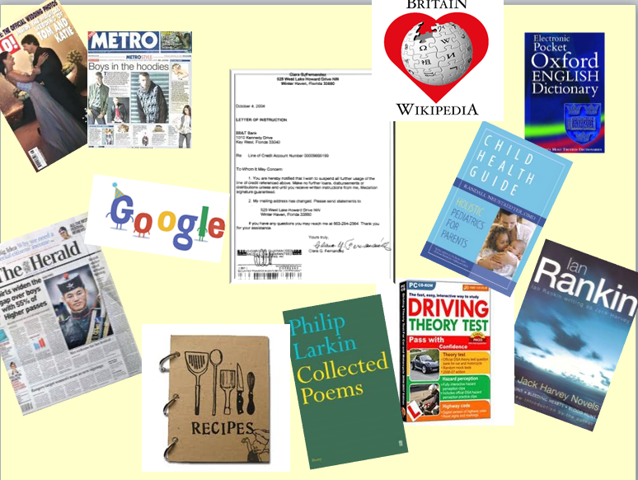
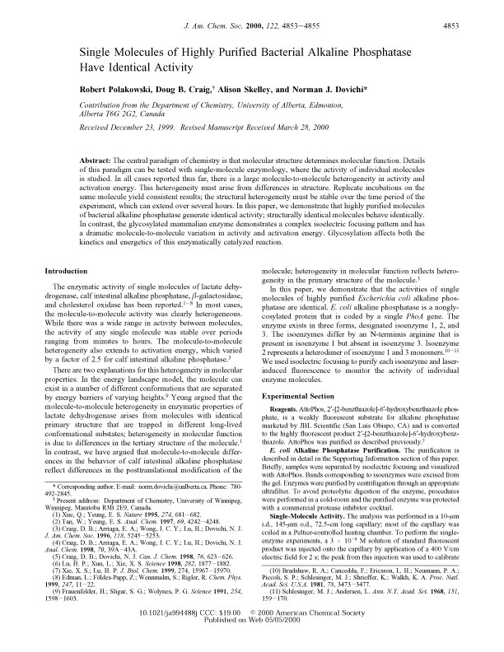
Do we need to read these in a different way?

Slide 14


How could you approach your course reading?
Start with a book list?
Start with a text?
How would each approach influence the way you read?

Slide 15
SQ3R –active reading strategy
Survey, skim, scan
Question
Read in a bit more detail – but not every word
Recall am I understanding this so far? How/when to use?
Do you want to read it in detail?
Review –Read more carefully, take brief notes if needed…
author/title details
Who’s the audience?
Key topics covered?
Readable? Difficult?
How might I use this?
Make an annotated bibliography
5 quick details for future reading…

Slide 16
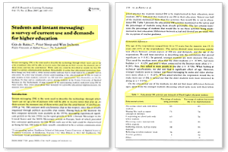
Skim
How is this interesting/
relevant to me?
Headings?
Intro-what is it about?
What are main topics?
Conclusion?
How does it link to intro?

Slide 17

Detailed reading? Active strategies
Read several times in different ways:
Read the introduction and conclusion
What’s it about? Final point?
Read the interesting bits first
Skip difficult words – unless key words
Short bursts are best – 20 minutes?
Stop and question often.
Try explaining the reading to someone “Basically, it’s about…”
Passive reading is a waste of time

Slide 18
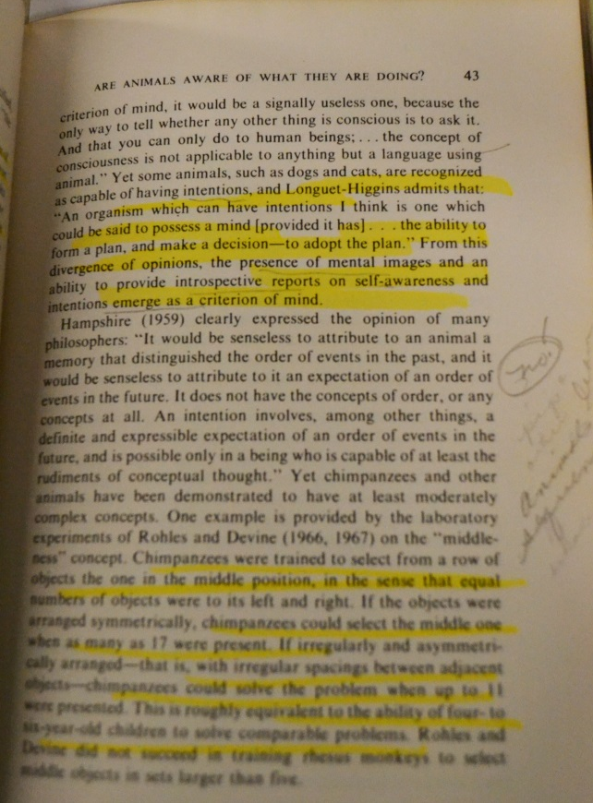

Is this a useful
reading strategy?
Or this?
Beware passive highlighting or stickering!
…but OK as a first step to note-making?

Slide 19
Myth no. 3
You have to take
loads of notes
Less is more

Slide 20

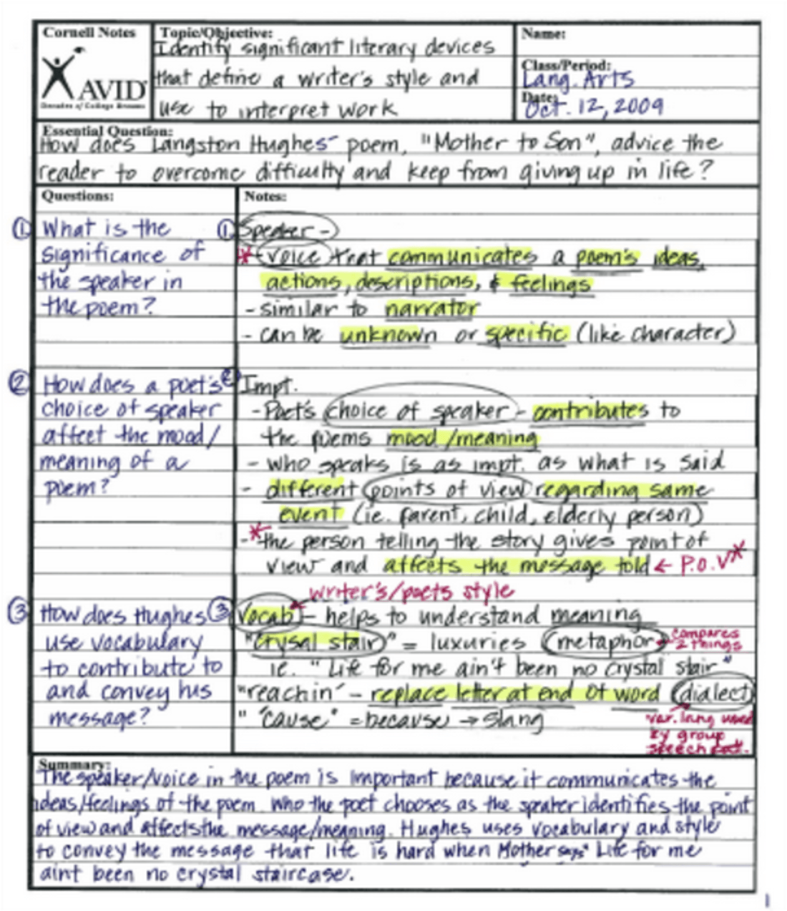

Effective note-taking strategies
Notes remind you of key content:
Keep notes brief
Note the text details:
author, title, date, pages
Paraphrase main ideas
Use bullet points
One point per paragraph? Per page?
If you note a “quotation” make sure you use “…” and note page number.
Note: how/when might I use this?
File somewhere useful.
Avoid passive note-making!!

Slide 21
Cornell-type notes – useful for summary of their ideas and yours
TOPIC | Book/article details
Key point p.34 Key point p.45-48 Key point p.80-85 | Paraphrase main ideas– note form or bullets
Critical summary: What do I think of the ideas? Useful? Similar to lecture? What questions does this raise? What have I learned from this – what to read next?
Research
skills
Reading +
paraphrasing
skills
Critical
thinking and
writing skills

Slide 22

Reading across the literature
Select a key topic
Browse for the topic in several books
Use the index/chapter headings
Read a few pages in each
Take a few notes
Keep notes together filed under that topic.

Slide 23
Taking notes on a topic from several sources
Useful for essay research
Non-verbal communication | Body-language Key features | Why important? | Challenges? | So what? How do they compare?
Smith (2010) Chapter 3 and 5
Ahmed and Jones (2007) Pages 45-47, 67-70
Sanchez et al (2008) Research article

Slide 24


Study challenge
We are motivated by seeing results
but
Study tasks often feel unproductive, with little tangible result.
The challenge:
How to make study tasks feel more productive?
(…and feel more motivated to do them).

Slide 25
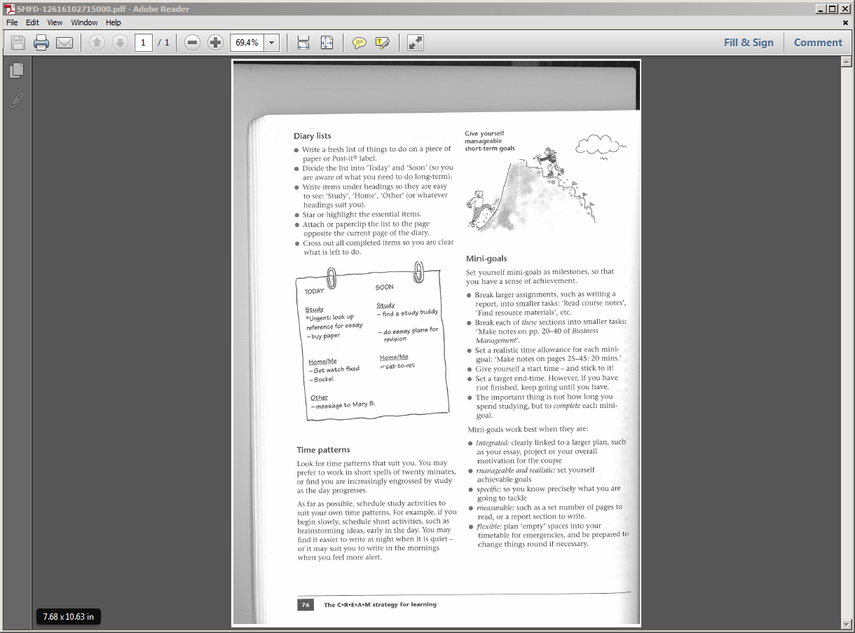
Take more control over study tasks
To make tasks more productive they need to be
Specific
Measurable
Achievable
Realistic
Timebound
(Cottrell, S., 2003. The study skills handbook)

Slide 26


Break things down
To do:
Write essay
When?
To do:
Go over question
Map out all relevant topics/ideas
Check lecture slides
Think about word length
Narrow down topics
Make wordcount plan
Find reading for first topic
Read and take brief notes
Plan section 1…
When?

Slide 27
Plan long-term and short-term goals,
working back from deadline
Week 1 | 2 | 3 | 4 | 5 | 6 | 7 | 8
essay |  |  |  |  |  |  | Essay in
report |  |  |  |  |  |  | Report in

Slide 28
Plan weekly goals, based on final goal
Week 1 | 2 | 3 | 4 | 5 | 6 | 7 | 8
essay | Break down question key tasks? rough plan | Research section 1 | Research section 2/3 | Draft section1 Plan 2 and 3 | Draft 2 and 3 | Check/redo Intro and conclusion references | Essay in
report |  |  |  |  |  |  | Report in

Slide 29
…then plan out tasks and times for a week
Week 3 | Mon | Tues | Wed | Thurs | Fri
AM | Check lecture notes on relevant sections | 10-11am find books topic 2 | 11-12 Article search | 10-12 Work out points for section 2 +3 | 10-12 Draft section 2 – 300 words?
PM |  | 2-4pm –read/notes from 3 books | 3-4pm Article search
EVE |  |  |  | Look over plan-change? | Read over draft. What to change?

Slide 30




Where to study?
Traditional places?
keep home study space focused,
distractions minimal
Different places for
different
study styles + activities
Music?
Silence?
Alternatives?
Background buzz?

Slide 31

Staying on top of things…
Prioritise your week:
study + non-study
Develop a filing system
Have proper time off
Communicate: keep in touch with tutors
Use study advice services
If you fall behind, tell someone-it’s normal.
Running out of time?
Remember the 4 Ds:
Do it
Dump it
Delegate it
Do it less well.

Slide 32


Developing study strategies takes time
There is no ‘right’ way – do try alternatives and find your own learning style.
Expect to develop study strategies over time, as you would with subject knowledge.
Reflect often, and change what isn’t working
Finally, collaborate, share resources, compare study strategies with peers…
independent study doesn’t mean you are
on your own!

Slide 33
Useful study skills resources
The study skills handbook, by Stella Cottrell.
Palgrave MacMillan.
Essential study skills: the complete guide to success at university, by Tom Burns and Sandra Sinfield.
Sage Study Skills series.
The Open University: Skills for OU study
https://www2.open.ac.uk/students/skillsforstudy/index.php

