Slide 1
The Climate Crisis Dr Andy Cross – School of GeoSciences 19th January 2024 andrew.cross@ed.ac.uk

Slide 2
What is the climate crisis?
The culmination of scientific and local knowledge
Evidence that we have fundamentally changed the global climate
That there are extremely negative consequences and action must be taken

Slide 3
Average global temperature increase by month
Source: UK Met Office

Slide 4
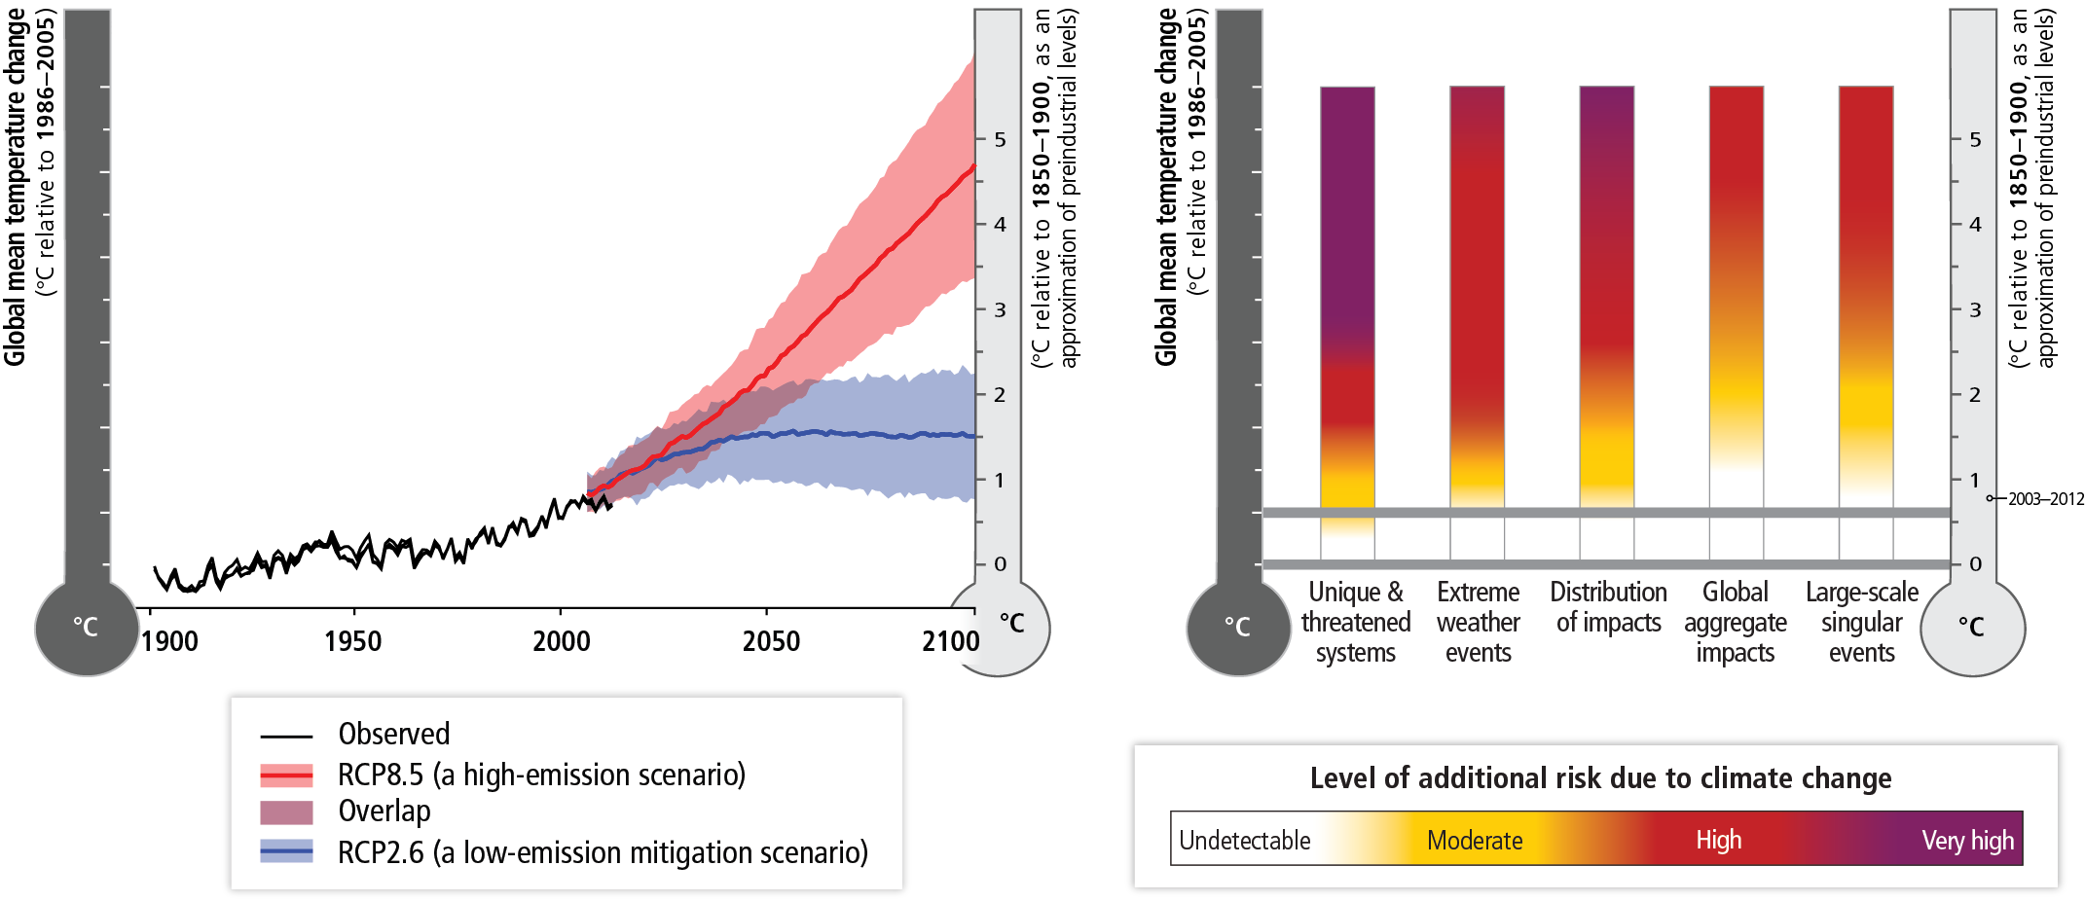

Slide 5
Source: MetOffice 2019

Slide 6
Top risks identified by Intergovernmental Panel on Climate Change –Assessment Report 5 (Working Group II)
Risk of death, injury, ill-health, or disrupted livelihoods in low-lying coastal zones and small island developing states and other small islands, due to storm surges, coastal flooding, and sea level rise.
Risk of severe ill-health and disrupted livelihoods for large urban populations due to inland flooding in some regions.
Systemic risks due to extreme weather events leading to breakdown of infrastructure networks and critical services such as electricity, water supply, and health and emergency services.
Risk of mortality and morbidity during periods of extreme heat, particularly for vulnerable urban populations and those working outdoors in urban or rural areas.
Risk of food insecurity and the breakdown of food systems linked to warming, drought, flooding, and precipitation variability and extremes, particularly for poorer populations in urban and rural settings.
Risk of loss of rural livelihoods and income due to insufficient access to drinking and irrigation water and reduced agricultural productivity, particularly for farmers and pastoralists with minimal capital in semi-arid regions.
Risk of loss of marine and terrestrial ecosystems, biodiversity, and the ecosystem goods, functions, and services they provide for coastal livelihoods.

Slide 7
Social impacts of Climate Change

Slide 8
Climate change resilience

Slide 9
Climate change in Scotland – what are the potential impacts/risks?
Have a chat with your neighbour for a few minutes and then report back!

Slide 10
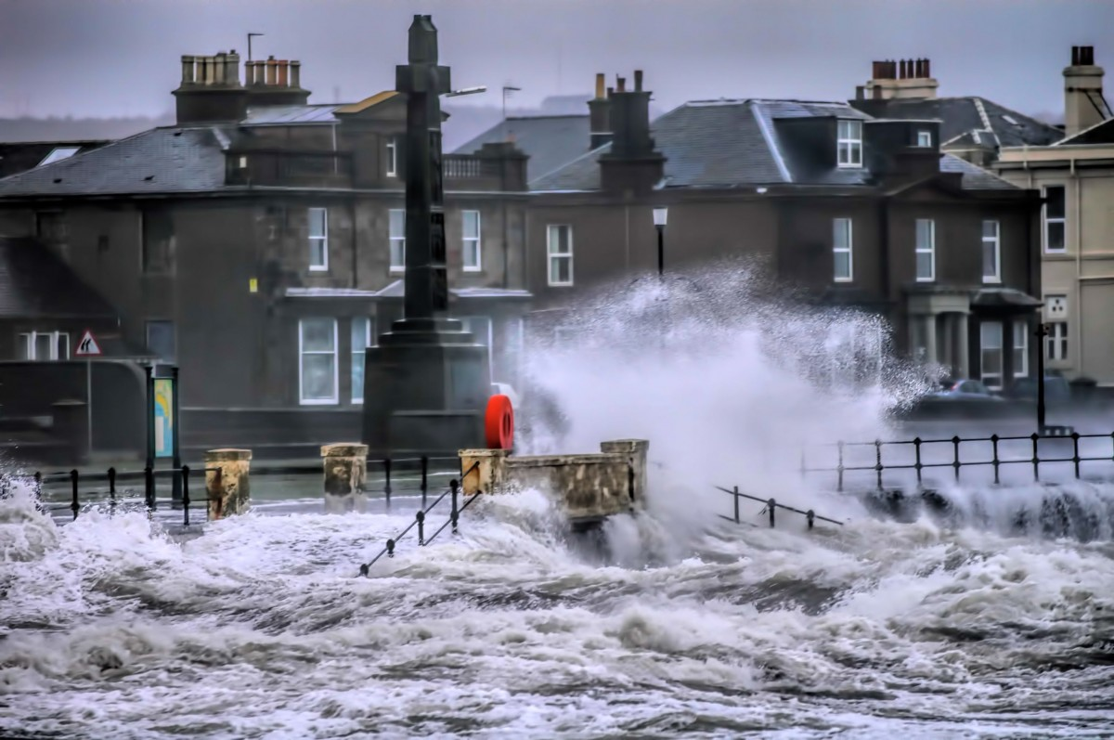
Climate change in Scotland – what are the potential impacts/risks?
Productivity of agriculture and forests
Health of the natural environment
Flooding / sea level rise
Security and efficiency of energy supplies
Infrastructure
https://www.adaptationscotland.org.uk/why-adapt/impacts-scotland

Slide 11
Some signs of hope?
Decreasing emissions / smaller carbon footprint
Energy efficiency / technology
Growth in renewables
ourworldindata.org

Slide 12
Thanks for listening!
Any questions?
andrew.cross@ed.ac.uk

