Slide 1
SWAP East – Access to Nursing 2017/18 Study Skills: Preparing for University Quick Guide to Essay Writing
Scottish University of the Year 2017
Michael Allardice
Academic Skills Centre, University of Dundee
15/11/17

Slide 2
Using this PowerPoint after the session
This PowerPoint is designed to be a useful learning resource to you after the SWAP East session at Fife Campus.
Drag up the bottom bar of each slide to reveal the explanatory notes underneath.

Slide 3
Academic Writing Conventions
Presentation
Academic Writing Conventions
Structure
Content
Notes:
THREE conventions of academic writing: PRESENTATION, STRUCTURE, CONTENT
What is meant by presentation?
use of language in an appropriate ‘register’, that is, in ways that are appropriate to the more formal format expected at this level of study.
use of paragraphing
correct spelling, grammar, punctuation and syntax
use of spacing to make the text more legible
page numbering
What is meant by content?
Is it relevant?
Does it contain what it is expected to contain?
Is there evidence and analysis? (more than just description)
What is meant by structure?
Is it ordered logically?
Does it flow?
This powerpoint will cover each of these three areas in turn.

Slide 4
What do we mean by presentation?
Good presentation is:
font style, size, spacing and page numbering
(But it’s MORE THAN just that!)
Good presentation includes paying attention to:
Spelling
Grammar
Punctuation
Syntax
Register
https://www.pexels.com/search/typewriter/
Notes:
The next few slides show how errors in punctuation, spelling and grammar can not only create a bad impression, but also change the meaning of what you are trying to say.
The fundamental message in the next few slides is that presentation is MORE than surface features. In order to show your content in its best light, it is necessary to use correct spelling, grammar, etc. or your argument/discussion can easily become lost. That’s why it is crucial to PROOF-READ and EDIT your work before submitting.
Significance of type-writer? They challenge the user to see their errors on paper. (N.B. we are not advocating typewriter use! Just for careful proof-reading step by step in the essay writing process.)
Definitions:
Syntax - the arrangement of words and phrases to create well-formed sentences.
Register - often refers to the degree of formality of language, but in a more general sense it means the language used by a group of people who share similar work or interests (e.g. the technical language of a subject or discipline).

Slide 5
Presentation
Notes:
REMOVE FOR VLE VERSION

Slide 6
Presentation
Notes:
Would YOU pay money to have this person proof-read your work?
You don’t have to pay someone to do it. You can learn to do it yourself.
Ideas for proof-reading:
Read your work aloud. What your eye misses your ear might pick up on!, especially with regard to punctuation and sentence structure.
Use electronic spelling/grammar checkers but be aware of their limitations. They are not infallible.
’Step away from the essay’ – let it ‘rest’ - go do something else then come back to it with fresh eyes.
Let someone else read it.
Any more……..?

Slide 7
Structure
ACTIVITY
IN SMALL GROUPS:
Think about the STRUCTURE of a piece of academic writing. Design or sketch a diagram or image that you think portrays the structure of a piece of academic writing.
https://pxhere.com/en/photo/776296
Notes:
Moving on to structure:
Good structure is a vital component of any piece of academic writing. Without it, no matter how good your content and presentation is, your points will seem jumbled, and you will take your reader on a ramble rather than a well signposted journey.
ACTIVITY (allow at least 15 minutes in total, preferably longer if time)
IN GROUPS:
Think about the STRUCTURE of a piece of academic writing. You have complete free rein. Use shapes, words, colours, anything…
Groups to feedback on their designs.

Slide 8
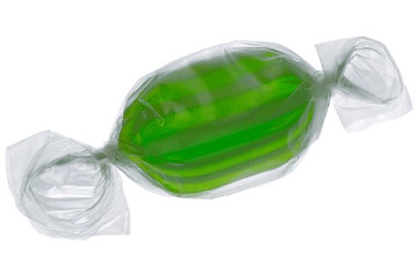
Essay Structure ‘The Sweetie Wrapper’
Notes:
Here’s our attempt. A very basic image, but captures the simplicity of how to structure a piece of academic writing.
However, there is meaning behind these deceptively simple shapes.

Slide 9
The ‘Sweetie Wrapper’ unwrapped
Context
Key ideas / Statement of intent
‘Signposting’
Return to intention
Mini conclusion concepts
Place in wider context
Introduction
Main
Body
Conclusion
Critical
analysis/
Mini-
conclusion
(from each
sub-point)
Subpoint 1
Subpoint 2
Subpoint 3
Notes:
Previous model in more depth.
This model can be applied to short essays and longer essays. It is the amount of sub-points, or depth of your analysis in your sub-points, that dictate the length of the essay. This basic structure holds true regardless of the length of the essay.
INTRODUCTION
Should ‘set the scene’, i.e. show where the topic sits in a wider context.
Begin to narrow it down. You can not write everything there is to know about the topic of the essay. That is why you need to be discerning: What are the specific areas that your essay will focus on? State your intentions and tell your reader exactly where you are going. Leave no surprises to the end.
‘Signpost’ the discussion that will follow in your main body.
In light of this, it is often a good idea to craft your introduction after the main body. At least be prepared to revise it to make sure it fits with what you have written.
MAIN BODY
Order your themes logically. The structure of each of these themes (or sub points) follows the same structure albeit on a micro scale. E.g. Each paragraph should have an introductory sentence, followed by a development of the theme or argument, followed by a mini conclusion. MORE ON THIS LATER in the PowerPoint.
CONCLUSION
Refer back to your intentions
Sum up the mini conclusions from your sub-points.
Draw it back out in to the wider context again.
A conclusion should not contain any new information, ideas or analysis. E.g. Don’t put in quotes by authors that haven’t appeared elsewhere in the essay. If you find yourself doing this, STOP and ask yourself if it’s worthy. If it is, work it into the main body. If it isn’t, leave it out.
A conclusion is not the place to carry out your analysis. Many students write purely descriptive essays then bank up all their analysis to the last paragraph or two. This is not how to do it. Critical analysis and evaluation should be build in to each stage in the main body.
Moving on to CONTENT…

Slide 10
“Not enough critical analysis…”
“Lacking in depth”
“Too descriptive”
But what do they mean?
Notes:
These are typical comments that students often receive in their feedback. But what do these comments actually mean, and what can you do to prevent your essays receiving such comments?

Slide 11
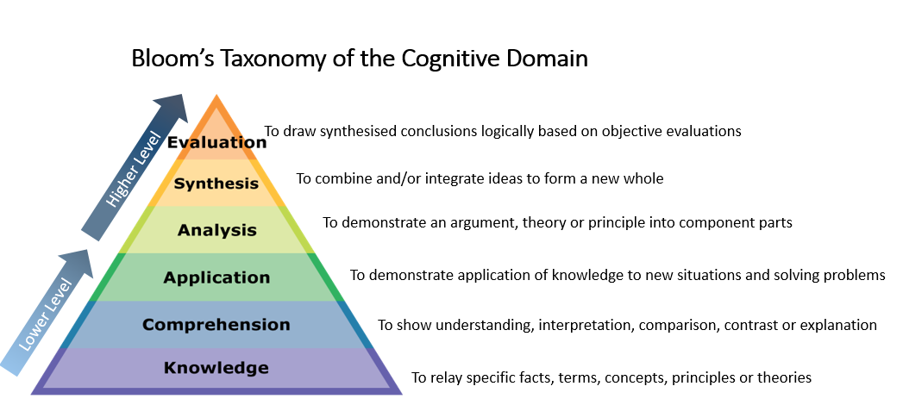
Content: How to bring criticality into your writing
Bloom’s Taxonomy of the Cognitive Domain
To draw synthesised conclusions logically based on objective evaluations
Higher Level
To combine and/or integrate ideas to form a new whole
To demonstrate an argument, theory or principle into component parts
To demonstrate application of knowledge to new situations and solving problems
Lower Level
To show understanding, interpretation, comparison, contrast or explanation
To relay specific facts, terms, concepts, principles or theories
See: Granello, D.H. (2001) Promoting Cognitive Complexity in Graduate Written Work: Using Bloom’s Taxonomy as a Pedagogical Tool to Improve Literature Reviews. Counselor Education and Supervision. 40 (4) Available at:http://onlinelibrary.wiley.com/doi/10.1002/j.1556-6978.2001.tb01261.x/epdf
Notes:
CONTENT
What exactly is critical analysis?
Here is some theory behind it…
Benjamin Bloom was an American educational psychologist in 1950s/60s. One of his biggest contributions to the field was his classification of educational objectives, which has come to be known as ‘Bloom’s Taxonomy’
At school, and maybe to a lesser extent, college – we can get by comfortably by hovering in these lower level skills (knowledge, comprehension). Having a sound knowledge of a subject, or remembering what your teacher told you about it or what you read about it (and ‘regurgitating’ it in essays or exams) isn’t enough in higher education.
University differs in the sense that your markers often take it for granted that you should already have a good working knowledge and comprehension of your topic or subject – therefore you don’t need to show this off in your essays. Very rarely will your markers be expecting to see you display only knowledge in your writing. What they expect to see is how you analyse the concepts, theories or principles; how you evaluate them, and how you synthesise them to make informed judgements or action plans. This is what markers mean by ‘critical analysis’, ‘depth’, etc.
The next few slides will look at techniques for helping you build in that all-important analysis.

Slide 12
Content: How to bring criticality into your writing Paragraph structure
TOPIC
EVIDENCE
ANALYSIS
Introduce the topic of the paragraph
Draw upon relevant literature
Explain its significance
Notes:
It is important to build ANALYSIS (aka ‘depth’, aka higher level Bloom’s Taxonomy), into each main point in your essay. Ideally each paragraph should contain all of these elements.
So how do we do this?:
One simple but effective model: ‘Cup of TEA’
Topic – introduce the topic of the paragraph. What is this paragraph about? Generally, this will be descriptive.
Evidence – show the evidence. Quote / draw upon evidence from literature on the topic. What theory relates to the topic of this paragraph?
Analysis – What’s the relevance of what you are saying? Why is it important? What’s the relevance to YOUR essay task or the argument you are trying to build?
This last part (i.e. higher level Bloom Taxonomy!) is the part that a lot of students miss out, and is one of the main reasons for poor grades.
NB. ‘Analysis’ in this sense can mean ‘critical analysis’, ‘critical evaluation’, ‘informed opinion’, ‘depth’, etc. (i.e. all the things that marks scribble over essays that are too descriptive!)

Slide 13
Structure AND Content What’s missing from this paragraph?
A key benefit to the internet as a research tool is the speed and ease with which material can be accessed, and the wide range of material available in such cases. Bloggs (2012) highlights the fact that research conducted in the past over a period of weeks can now be achieved in a matter of minutes. Furthermore, ‘the range of materials accessible by students now is far greater than it was thirty years ago’ (Smith 2013, p23).
SAMPLE PARAGRAPH
FROM
MAIN BODY
Notes:
This is a sample paragraph taken from part of the main body of an essay on the internet as a tool for research. What is missing from this paragraph?
Answer: It’s missing the ‘critical’ part. The A for Analysis if we are using the TEA model.
The student tells us what Bloggs and Smith say about the issue, but where is the critical analysis/mini conclusion? A paragraph likes this leaves your marker begging ‘So what? Why are you telling me this? What’s the significance to your argument?’

Slide 14
Structure AND Content How it all fits together
T
A key benefit to the internet as a research tool is the speed and ease with which material can be accessed, and the wide range of material available in such cases. Bloggs (2009) highlights the fact that research conducted in the past over a period of weeks can now be achieved in a matter of minutes. Furthermore, ‘the range of materials accessible by students now is far greater than it was thirty years ago’ (Smith 2010, p23). It can thus be argued that it is a benefit of the internet that students are now able to access far more material, much more quickly, than was possible in the past. However, it must also be noted that students can find themselves overwhelmed by this volume of material available.
E
A
Notes:
Again, back to the ‘sweetie wrapper’ structure, but this time showing how it relates to paragraph structure and TEA
The blue text denotes the all-important critical analysis. You can see it answers the ‘so what?’ that was left in the marker’s mind in the previous example.
Red = Topic
Green = Evidence
Blue = Analysis
If you are unsure if your essay has enough balance between description, evidence and analysis, try separating it in this way - use 3 different colours of highlighter and you’ll see easily if it is lacking in the all important evidence and analysis.
A good paragraph must introduce the topic of which that paragraph is about. It must then develop the topic and include evidence. Finally it must draw to a logical mini conclusion or critical judgement based on that evidence.

Slide 15
The ‘Sweetie Wrapper’ unwrapped
Introduction
Wider context
Statement of intent
‘Signposting’
Main body
Conclusion
Return to intention
Summarised analysis
Wider context
Critical
analysis/
Mini-
conclusion
(from each
subpoint)
1) T.E.A
Sense of flow between paragraphs/ discourse marking
2) T.E.A
3) T.E.A
Summarised here
Notes:
This slide takes us back to the bigger picture of the whole essay, but this time with a focus on T.E.A. in the main body.
Note how the critical analyses from all the sub-points is drawn together and summarised in the conclusion.

Slide 16
Thank you, and…
…with your future studies!

Slide 17
dundee.ac.uk
Notes:
Any questions – please email asc@dundee.ac.uk

