Slide 1
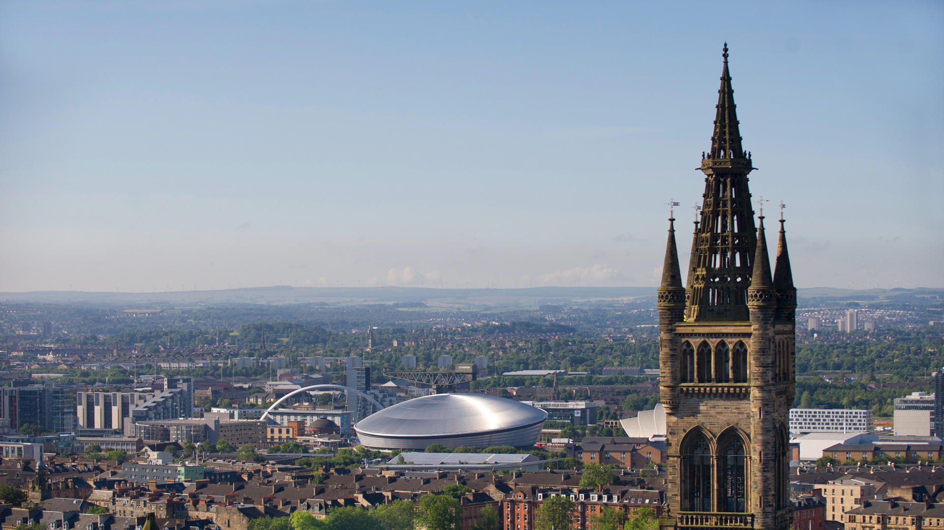

Studying at the University of Glasgow
Jenn Weightman, Amy McDermott & Dan Keenan
Widening Participation & Lifelong Learning
jennifer.weightman@glasgow.ac.uk
amy.mcdermott@glasgow.ac.uk
daniel.keenan@glasgow.ac.uk

Slide 2
History MA
Year 1 | Year 2 | Year 3 | Year 4
History (1A / 1B) | History (2A / 2B) | History | History
Classical Civilisation (1A / 1B) | Classical Civilisation (2A / 2B)
CEES (1A / 1B) | Theatre Studies (1A / 1B)

Slide 3
Psychology MA
Year 1 | Year 2 | Year 3 | Year 4
Psychology (1A / 1B) | Psychology (2A / 2B) | Psychology | Psychology
Archaeology (1A / 1B) | Archaeology (2A / 2B)
History (1A / 1B) | Politics (1A / 1B)

Slide 4
Sociology MA (SocSci)
Year 1 | Year 2 | Year 3 | Year 4
Sociology (1A / 1B) | Sociology (2A / 2B) | Sociology | Sociology
Politics (1A / 1B) | Politics (2A / 2B)
Philosophy (1A / 1B) | Economic & Social History (1A / 1B)

Slide 5
Sociology MA SocSci
Year 1 | Year 2 | Year 3 | Year 4
Sociology (1A / 1B) | Sociology (2A / 2B) | Sociology | Sociology
Politics (1A / 1B) | Politics (2A / 2B)
Philosophy (1A / 1B) | Economic & Social History (1A / 1B)
Sociology / Politics MA SocSci Joint Honours
Year 1 | Year 2 | Year 3 | Year 4
Sociology (1A / 1B) | Sociology (2A / 2B) | Sociology | Sociology
Politics (1A / 1B) | Politics (2A / 2B)
 |  | Politics | Politics
Philosophy (1A / 1B) | Economic & Social History (1A / 1B)

Slide 6
English Literature MA
Year 1 | Year 2 | Year 3 | Year 4
English Literature (1A / 1B) | English Literature (2A / 2B) | English Literature | English Literature
Comparative Literature (1A / 1B) | Comparative Literature (2A / 2B)
Classical Civilization (1A / 1B) | History of Art (1A / 1B)

Slide 7
English Literature MA
Year 1 | Year 2 | Year 3 | Year 4
English Literature (1A / 1B) | English Literature (2A / 2B) | English Literature | English Literature
Comparative Literature (1A / 1B) | Comparative Literature (2A / 2B)
Classical Civilization (1A / 1B) | History of Art (1A / 1B)
English Literature / Comparative Literature MA
Year 1 | Year 2 | Year 3 | Year 4
English Literature (1A / 1B) | English Literature (2A / 2B) | English Literature | English Literature
Comparative Literature (1A / 1B) | Comparative Literature (2A / 2B)
 |  | Compar. Literature | Compar. Literature
Classical Civilization (1A / 1B) | History of Art (1A / 1B)

Slide 8
History MA
 | Mon | Tues | Weds | Thurs | Fri
09.00-10.00
10.00-11.00 | History Seminar | History Lecture | History Lecture | History Lecture
11.00-12.00
12.00-13.00 |  | Classical Civ. Seminar | CEES Tutorial
13.00-14.00 | CEES Lecture | CEES Lecture |  | CEES Lecture
14.00-15.00
15.00-16.00 |  | Classical Civ. Lecture |  | Classical Civ. Lecture | Classical Civ. Lecture
16.00-17.00

Slide 9
Sociology MA (SocSci)
 | Mon | Tues | Weds | Thurs | Fri
09.00-10.00
10.00-11.00 | Philosophy Lecture | Philosophy Lecture
11.00-12.00
12.00-13.00 | Sociology Lecture | Sociology Lecture
13.00-14.00 |  | Politics Lecture | Politics Lecture | Politics Lecture
14.00-15.00 |  |  | Philosophy Seminar | Politics Tutorial
15.00-16.00 |  | Sociology Tutorial
16.00-17.00

Slide 10
Psychology MA
 | Mon | Tues | Weds | Thurs | Fri
09.00-10.00
10.00-11.00 |  | History Lecture | History Lecture | History Lecture
11.00-12.00 | Psychology Practical
12.00-13.00 |  |  | Archaeology Lecture | Archaeology Lecture
13.00-14.00 | Psychology Lecture | Psychology Lecture | Psychology Lecture
14.00-15.00 |  |  |  | History Seminar
15.00-16.00 |  |  |  | Archaeology Seminar
16.00-17.00

Slide 11

Useful resources:
UofG Course Catalogue: https://www.gla.ac.uk/coursecatalogue
UofG Degree Structure & specific Subject Information & Resources: https://www.gla.ac.uk/undergraduate/teachers/videosvirtualresources
Campus Tours: https://www.gla.ac.uk/explore/visit/campustours

Slide 12
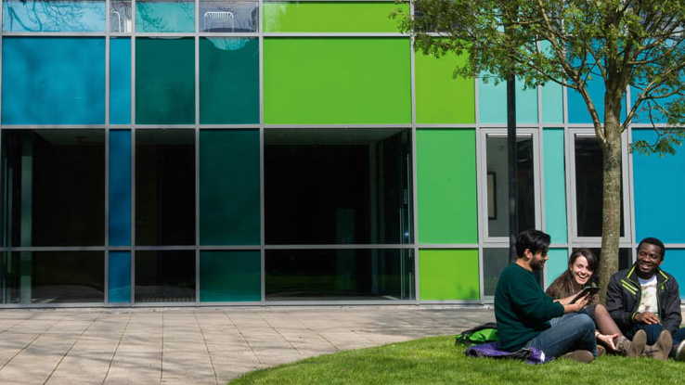
Further support & engagement from UofG:
SWAP Study Skills Day
  Specific event for SWAP offer holders, on UofG campus in Spring
UofG Summer School
  Mini-university experience, June-July, providing fantastic preparation for beginning studies at UofG in September
  SWAP students are welcome to take part, free of charge
Local Student Orientation
  Induction event held week before ‘Freshers Week’, with bespoke engagements for new UofG mature student/adult returner entrants (SWAP, UofG Access, etc.)
Talent Scholarships & Travel Bursaries

Slide 13
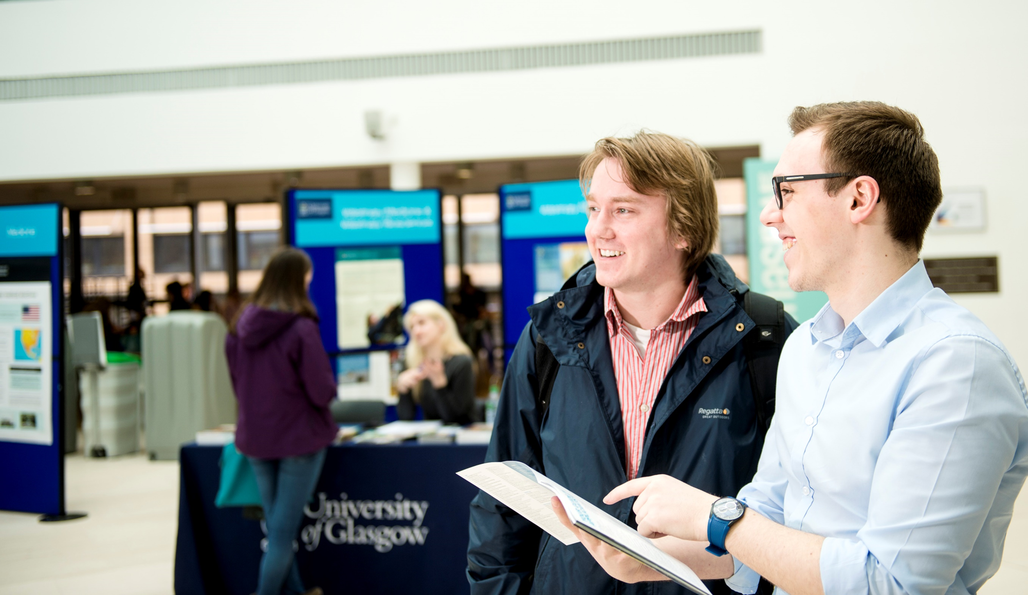
Further on-course support at UofG:
Adviser of Studies
Student Support Officers
Student Learning Development
Mature Students Association
Disability Service
Financial Aid (Discretionary & Childcare Fund)
Careers Service
Student Representative Council (clubs & societies)

