Slide 1
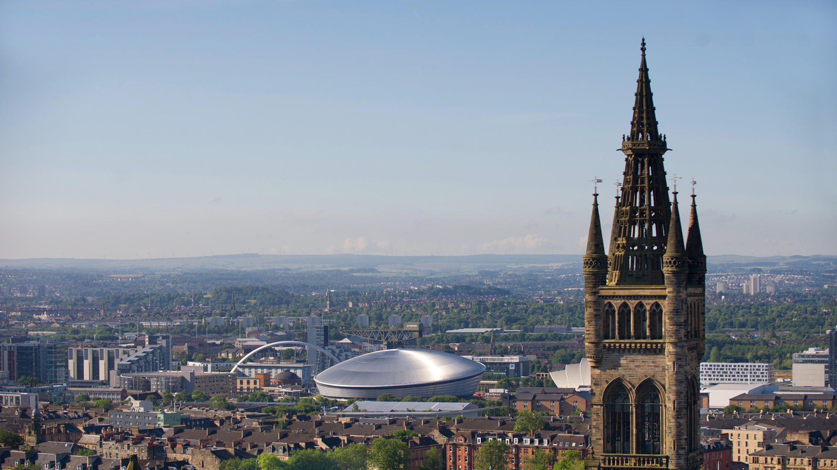

Studying at the University of Glasgow
Jenn Weightman, Amy McDermott & Dan Keenan
Widening Participation & Lifelong Learning
jennifer.weightman@glasgow.ac.uk
amy.mcdermott@glasgow.ac.uk
daniel.keenan@glasgow.ac.uk

Slide 2
Marine & Freshwater Biology BSc
Year 1 | Year 2 | Year 3 | Year 4
Biology 1A & 1B (2 x 20 credits) | Fundamental Topics in Biology (30 credits) e.g. Contemporary Issues in Biology (30 credits) | Marine & Freshwater Biology 3A & 3B (2 x 60 credits) | Life Sciences Project (40 credits) Compulsory ‘Core Skills’ course (20 credits) Life Sciences Honours Options (3 x 20 credits)
Chemistry 1 (40 credits) | History level 2
 | Animal Biology, Evolution and Ecology (30 credits) e.g. Genes, Molecules & Cells (30 credits)
Another subject choice, e.g. Psychology 1A & 1B (2 x 20 credits)

Slide 3
Molecular & Cellular Biology BSc
Year 1 | Year 2 | Year 3 | Year 4
Biology 1A & 1B (2 x 20 credits) | Fundamental Topics in Biology (30 credits) e.g. Contemporary Issues in Biology (30 credits) | Molecular & Cellular Biology 3A & 3B (2 x 60 credits) | Life Sciences Project (40 credits) Compulsory ‘Core Skills’ course (20 credits) Life Sciences Honours Options (3 x 20 credits)
Science Fundamentals 1X & 1Y (2 x 20 credits) | History level 2
 | Genes, Molecules & Cells (30 credits) e.g. Microbiology and Immunology (30 credits)
Another subject choice, e.g. History 1A & 1B (2 x 20 credits)

Slide 4
Mathematics BSc
Year 1 | Year 2 | Year 3 | Year 4
Maths (40 credits) | Maths | Maths | Maths
Physics (40 credits) | History level 2
 | Physics
Computing Science (40 credits)

Slide 5
Maths/Physics (Joint Honours) BSc
Year 1 | Year 2 | Year 3 | Year 4
Maths (40 credits) | Maths | Maths | Maths
Physics (40 credits) | History level 2
 | Physics | Physics | Physics
Computing Science (40 credits)

Slide 6
Chemistry BSc
Year 1 | Year 2 | Year 3 | Year 4
Chemistry (40 credits) | Chemistry | Chemistry | Chemistry
Biology (40 credits) | History level 2
 | Biology
Geography (40 credits)

Slide 7
Psychology BSc
Year 1 | Year 2 | Year 3 | Year 4
Psychology (40 credits) | Psychology | Psychology | Psychology
Earth Science (40 credits) | History level 2
 | Earth Science
German (40 credits)

Slide 8
Marine & Freshwater Biology
 | Mon | Tues | Weds | Thurs | Fri
09.00-10.00 | Psychology Lecture | Psychology Lecture | Psychology Lecture
10.00-11.00 |  |  | Biology Laboratory
11.00-12.00
12.00-13.00
13.00-14.00
14.00-15.00
15.00-16.00 | Chemistry Lecture | Chemistry Lecture | Chemistry Lecture | Chemistry Lecture | Chemistry Lecture
16.00-17.00 |  |  | Psychology Practical
17.00-18.00 | Biology Lecture | Biology Lecture | Biology Lecture | Biology Lecture

Slide 9
Molecular & Cellular Biology
 | Mon | Tues | Weds | Thurs | Fri
09.00-10.00 | Biology Lecture | Biology Lecture | Biology Lecture | Biology Lecture
10.00-11.00 |  | History Lecture | History Lecture | History Lecture
11.00-12.00
12.00-13.00 | History Seminar | Biology Laboratory
13.00-14.00
14.00-15.00
15.00-16.00 | Science Fund. Lecture | Science Fund. Lecture | Science Fund. Lecture | Science Fund. Lecture
16.00-17.00
17.00-18.00

Slide 10
Mathematics
 | Mon | Tues | Weds | Thurs | Fri
09.00-10.00 | Physics Lecture | Physics Lecture | Physics Lecture | Physics Lecture | Physics Lecture
10.00-11.00 | Comp Sci Lecture | Comp Sci Lecture | Comp Sci Lecture | Comp Sci Lecture | Comp Sci Lecture
11.00-12.00 |  | Physics Tutorial
12.00-13.00 | Mathematics Lecture | Mathematics Lecture | Mathematics Lecture | Mathematics Lecture | Mathematics Lecture
13.00-14.00 |  |  |  |  | Mathematics Laboratory
14.00-15.00 | Comp Sci Lab/Tutorial
15.00-16.00
16.00-17.00

Slide 11
Chemistry BSc
 | Mon | Tues | Weds | Thurs | Fri
09.00-10.00 | Biology Lecture | Biology Lecture | Biology Lecture | Biology Lecture
10.00-11.00 | Chemistry Lecture | Chemistry Lecture | Chemistry Lecture | Chemistry Lecture | Chemistry Lecture
11.00-12.00 |  | Geography Lecture | Geography Lecture | Geography Lecture
12.00-13.00
13.00-14.00 | Geography Tutorial
14.00-15.00 |  |  |  |  | Biology Laboratory
15.00-16.00
16.00-17.00
17.00-18.00

Slide 12
Psychology BSc
 | Mon | Tues | Weds | Thurs | Fri
09.00-10.00 |  | Earth Science Lecture | Earth Science Lecture | Earth Science Lecture
10.00-11.00
11.00-12.00 |  | German Language Tutorial |  | German Language Language Class
12.00-13.00 |  |  |  | German Language Tutorial
13.00-14.00 | Psychology Lecture | Psychology Lecture | Psychology Lecture
14.00-15.00 | German Language Lecture
15.00-16.00 |  | Psychology Practical
16.00-17.00 |  |  |  | Earth Science Laboratory
17.00-18.00

Slide 13
Aeronautical Engineering BEng
 | Mon | Tues | Weds | Thurs | Fri
09.00-10.00 |  | Aerospace Eng Lecture |  |  | Materials Lecture
10.00-11.00 | Aerospace Eng Lecture |  | Analogue Electron Laboratory
11.00-12.00 | Eng Skills Lecture | Eng Maths Lecture | Eng Maths Lecture | Eng Maths Lecture | Eng Maths Lecture
12.00-13.00 |  | Eng Skills Lecture |  |  | Eng Maths Tutorial
13.00-14.00 | Eng Maths Tutorial | Statics Lecture | Statics Lecture
14.00-15.00 |  | Materials Lecture | Statics Laboratory
15.00-16.00
16.00-17.00

Slide 14

Useful resources:
UofG Course Catalogue: https://www.gla.ac.uk/coursecatalogue
UofG Degree Structure & specific Subject Information & Resources: https://www.gla.ac.uk/undergraduate/teachers/videosvirtualresources
Campus Tours: https://www.gla.ac.uk/explore/visit/campustours

Slide 15
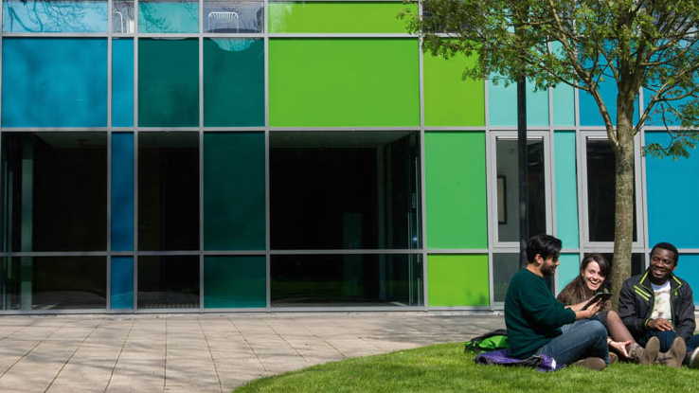
Further support & engagement from UofG:
SWAP Study Skills Day
  Specific event for SWAP offer holders, on UofG campus in Spring
UofG Summer School
  Mini-university experience, June-July, providing fantastic preparation for beginning studies at UofG in September
  SWAP students are welcome to take part, free of charge
Local Student Orientation
  Induction event held week before ‘Freshers Week’, with bespoke engagements for new UofG mature student/adult returner entrants (SWAP, UofG Access, etc.)
Talent Scholarships & Travel Bursaries

Slide 16
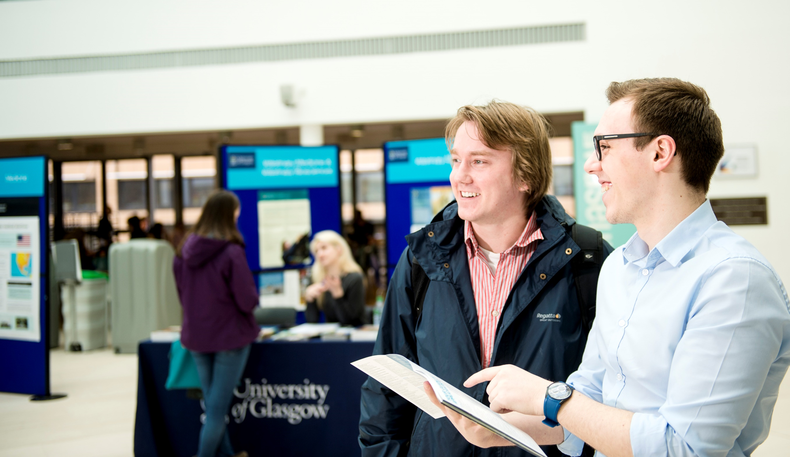
Further on-course support at UofG:
Adviser of Studies
Student Support Officers
Student Learning Development
Mature Students Association
Disability Service
Financial Aid (Discretionary & Childcare Fund)
Careers Service
Student Representative Council (clubs & societies)

